Slide 1
End of First Quarter!!
Children’s Books
Friday Books
Nick
Brandy
Kenzee
Sierra
Pablo
Alix

Slide 2
Teen Pregnancy
Nathan’s Story
Video
http://eq.uen.org/emedia/items/482894dd-9a2e-d2b4-4e6d-643df818e3b5/1/
Finish from 48:36

Slide 3
Challenging situations
Break me
Identify challenging situations for children and understand the skills that are needed to help them cope

Slide 4
Break the pot
Have a student come up and break the pot placed in the brown bag. Smack it only once or twice.
Give it to someone else to work on taping it back together during class.

Slide 5
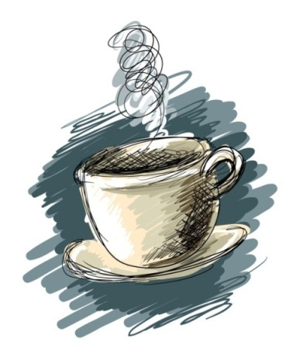
A Cup of Tea (Hope Floats)
Pay attention to the major stressors going on in the life of this family.
Note how it is affecting them.
Note how it makes you feel and what you are thinking.
12:21
1:34

Slide 6
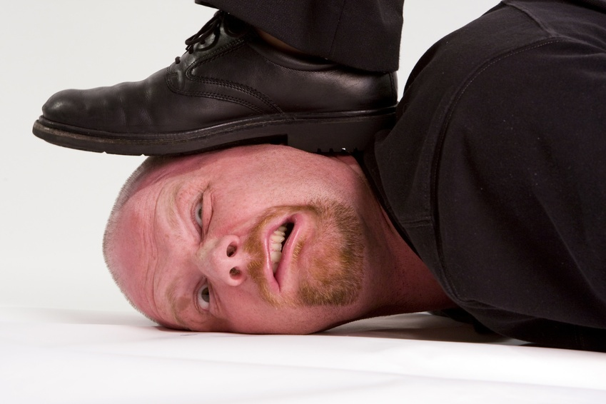
1- What life situations cause a child stress?
Death *
Divorce *
Moving *
Abuse
Family money problems
New baby
Parent Remarriage
Illness
New school year or a new school
Change of any kind to their life or schedule

Slide 7
2- How do children commonly react to stress? What are effects of these reactions?
Eating problems
Mood changes
Restlessness
Changes in Sleep Patterns
Irritability
Loss of energy
Behavior disorder
Ignore it
Sadness
Loss of temper
Bedwetting, nailbiting, thumbsucking
Withdrawal
Headaches
Stomachaches
Aggression
Difficulty Concentrating
Unexplained fears
Lower self-concept
Substance abuse
Nervousness
Drop in academic performance
Baby talk
Accident prone

Slide 8
Can you walk through paper?
Help a child get through their challenging situations by giving them coping skills.

Slide 9
3- What support can be given to help a child when they are dealing with challenging issues?
1- Children need to talk about their feelings.
2- Children need more help and support than adults. You can use the other adults in the child's life to fill this role.
3- Children usually can understand what is going on.
4- Children should be told the truth in a calm and reassuring way.

Slide 10
4- Challenging situations can create fear in a child. What are some strategies to deal with these fears?
1- Respect their fears and avoid belittling the child.
2- Children tend to be most fearful between the ages of 2 to 7 because they cannot yet discriminate between real and unreal dangers.
3- Help a toddler overcome fears by being understanding and comfort to the child.
4- Help the child overcome fears by using make-believe play to act out the fearful situation.

Slide 11
Never underestimate, for the parent or the child, the power in:
Daily exercise or movement
Eating nutritionally
Having leisure time
Enjoying hobbies
Adequate sleep
Relaxation methods
Talking about feelings

Slide 12
5- Describe coping skills to deal with DIVORCE:
A- Divorce
1- Reassure the child that they are still loved by both parents.
2- The child should not be blamed for the divorce.
3- Maintain as much stability in the child’s life as possible. (same school, same home…)
4- Provide continuity in the child’s daily schedule and situation.
5- Children often believe that their parents will get back together again.
6- Parents should never belittle/bad mouth one another in front of the kids.

Slide 13
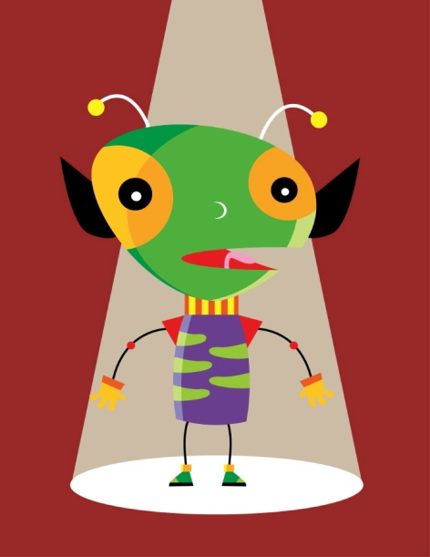
Specific effects of Divorce on child’s ages:
A. Preschoolers (2-5 years)
Major theme: Fear of abandonment
Symptoms: sleep disturbances
What to do: Explain that custodial parent will always return.
B. Young childhood (5-9 years)
Major theme: Fear of being displaced
Symptoms: School & social Grief
What to do: Discuss fears
C- Adolescence
Major theme: Fear of own relationship failure.
Symptoms: Independence, promiscuous
What to do: Communicate.
Alien Child activity

Slide 14
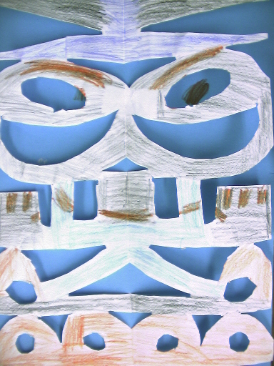

Slide 15
5- Describe coping skills to deal with DEATH:
B- Death
1- Children dealing with death feel grief and need to express it.
2- Help Children understand that they will not die just because someone else has.
3- Reassure children by being specific about when you will return whenever you leave.
4- Under the age of 3, children usually think of death as if the person has gone on a short vacation and that they will be back. Death does not seem permanent to them.
5- Teach a child about death before the child is confronted with the death of a loved one.
While waiting, complete the abuse table

Slide 16
Specific effects of Death on child’s ages:
Early Childhood (2-5)
Think it’s reversible, think little kids’ can’t die, egocentric (they caused it), Don’t understand forever, fear abandonment
Middle Childhood (6-12)
Understand physical death causes (gun, attack, illness), death is irreversible, death is only for old, sick, and careless, still egocentric (won’t happen to me), intrigued by details of death

Slide 17
Specific effects of Death on child’s ages:
Adolescence
Natural for all people, death results in bodily deterioration, feelings of invincibility (it won’t happen to me), visualize being old or sick and dying, develops morals and values about death.

Slide 18
Explaining death to Children
Do
Be honest. Kids are strong.
Check children’s interpretation of what they are thinking.
Death is universal – everything dies Ie: animals, flowers
Help remove unwanted guilt
tell them what caused the death and that it had nothing to do with them
Don’t
Say “Grandma is only sleeping”
Neglect listening to them express their feelings
Force a child to touch the body
Think that one discussion is enough

Slide 19
STAGES OF GRIEVING Have you ever lost an object? You had to grieve for it the same way you would grieve for losing a person.
Denial and feelings of shock
Anger
Blame someone or something
Guilt
Blame oneself for something they did in the last few months.
Bargaining
With other people or with God to not let it happen
Acceptance
Coming to terms, move on, adjusting to change

Slide 20
What is abuse?
Any behavior that results in the mistreatment of another.
What is the difference between an abuser and one who is not an abuser?
ABOUT 10 seconds!
5 categories of abuse

Slide 21
Spilled Milk
Listen to this story and be ready to discuss how you feel about it what happens.

Slide 22
Is this child abuse?
A girl is slapped for screaming at her mother; the slap stings, but leaves no lasting mark or pain.
A boy is punished in a way that requires stitches.
A father burns his daughter’s palms with a lighted cigarette when he finds her smoking.

Slide 23
Is this child abuse?
A mother is careless and spills scalding coffee on her daughter, who is seriously burned.
A boy’s arm is broken after wrestling with his father for sport.
A girl is spanked so hard she is badly bruised, but the father says he did not mean to hurt her.

Slide 24
Is this child abuse?
A boy is grounded for a week for a minor offense.
A father takes away his son’s driver’s license for getting a parking ticket.

Slide 25
Discussion
Is there a difference between child abuse and discipline?
Where do we draw the line?
Define Child Abuse.
What do you considered child abuse?

Slide 26
Fatalities
Each day in the United States, more than 3 children die as a result of child abuse in the home.
Most of the children who die are younger than six years of age.
More children (age four and younger) die from child abuse and neglect than any other single, leading cause of death for infants and young children.

Slide 27
Utah Statistics as of ‘08
19,878 referrals were investigated by Child and Family Services in FY08. (up from 17,000 in the year 2000)
8,284 (42 percent) of those referrals were supported.
Of the total abused and neglected children in FY08, 53 percent were female and 47 percent were male.
Children 0-5 years comprise 42 percent of all supported victims and adults 18-30 years comprise 44 percent of supported perpetrators.
Domestic violence is the most frequently supported allegation, at 32 percent.
Sexual abuse is the second most supported allegation at 24 percent.

Slide 28
By age 18, one of every four girls and one of every six boys has been sexually abused.
It is estimated that 100,000-500,000 children are sexually abused each year.

Slide 29
Eighty-five percent of sexual assaults on children are committed by someone the child knows and usually trusts
Child abuse is a very serious problem in every community nationwide.
Child abuse knows no boundaries. It happens in every class, race, ethnic group, educational, and economic group. No family is immune.
A report of child abuse is made – on average - every 10 seconds.
More children (age four and younger) die from child abuse and neglect than any other single leading cause of death for infants and young children. This includes accidental falls, drowning, choking on food, suffocation or fires in the home.
Each day in the United States, more than three children die as a result of child abuse in the home.

Slide 30
Types of Child Abuse
Neglect – 63%
Physical – 19%
Sexual – 10%
Emotional – 8%

Slide 31
Physical Abuse
non-accidental injury of a child that leaves marks, scars, bruises, or broken bones.
Physical indicators: unexplained bruises,
burns, human bites, broken bones, missing hair, scratches.
Behavioral indicators of physical abuse:
wary of physical contact with
adults, behavioral extremes
(aggressive or withdrawn),
frightened of parents, afraid to
go home, cheating, stealing,
lying (a sign that expectations
in the home are too high),
layered clothing.

Slide 32
Emotional Abuse
– parental behavior, such as rejecting, terrorizing, berating, ignoring, or isolating a child, that causes, or is likely to cause, serious impairment of the physical, social, mental, or emotional capacities of the child.
Physical indicators of emotional abuse: speech disorders, lags in physical development, failure to thrive.
Behavioral indicators of emotional abuse: habit disorders (sucking, biting, rocking), conduct disorders (withdrawal, destructiveness, cruelty), sleep disorders or inhibition of play, behavior extremes (aggressive or passive).

Slide 33
Neglect
– failure of parents or caretakers to provide needed, age appropriate care including food, clothing, shelter, protection from harm, and supervision appropriate to the child’s development, hygiene, and medical care.
Physical indicators of neglect: constant hunger, poor hygiene, excessive sleepiness, lack of appropriate supervision, unattended physical problems or medical needs, abandonment, inappropriate clothing fro weather conditions.
Behavioral indicators of neglect: begging or stealing food, frequent sleepiness, lack of appropriate supervision, unattended physical problem or medical needs, abandonment, inappropriate clothing for weather conditions.

Slide 34
Sexual Abuse
– any inappropriate sexual exposure or touch by an adult to a child or an older child to a younger child. This includes, but is not limited to: fondling, sexual intercourse, sexual assault, rape, date rape, incest, child prostitution, exposure, and pornography. It does not matter whether the victim was forced or tricked into any of the above, it is considered sexual abuse by the state of Utah.
Physical indicators of sexual abuse: difficulty in walking or sitting, torn, stained, or bloody underclothing, pain or itching in genital area, bruises or bleeding in rectal/genital area, venereal disease.
Behavioral indicators of sexual abuse: age-inappropriate sexual knowledge/sexual touch, abrupt change in personality, withdrawn, poor peer relationships, unwilling to change for gym or participate in physical activities, promiscuous behavior/seductive behavior, drop in school performance/decline in school interest, sleep disturbances, regressive behavior (i.e., bed wetting).

Slide 35
Help a child deal with abuse
COMPLETE ABUSE SORTING ACTIVITY:
Sort each abuse into its type of abuse. Check yourselves on the next slides.

Slide 36
PHYSICAL ABUSE
Destroying your belongings
Throwing objects at you
Touching you in ways that hurt or scare you
Twisting your arm, slapping, or biting you
Pushing or shoving you
Depriving you of food, shelter, money, or clothing
Threatening you with weapons
Hitting, punching, or kicking you
Choking or throwing you
Hitting or kicking you in a series of blows
Abusing you to the point you need medical treatment
Breaking your bones and/or causing internal injuries
Causing miscarriage or injuries that require a therapeutic abortion
Denying you medical treatment
Inflicting permanent disabling and/or disfiguring injuries
EMOTIONAL ABUSE
Taunting you in the name of “fun”
Ignoring you and/or your feelings
Insulting you repeatedly
Telling you that you will fail
Blaming you for his/her faults
Threatening you with violence or retaliation
Threatening to hurt your pets
Threatening to abuse the children and/or get custody of them
Telling you that you must stay because you can’t make it alone
Accusing you of being violent when you protect yourself in any way
Labeling you as crazy, stupid, ugly, etc…
Blaming you for things that go wrong
Holding back approval as a form of punishment

Slide 37
NEGLECT
Abandonment
Unattended physical problems or medical needs
Lack of supervision
Child is consistently hungry, poor hygiene, has inappropriate dress
SEXUAL ABUSE
Talking about you or others as sexual objects
Forcing you to have sex, including sex after a beating or when you are ill
Criticizing your sexual performance
Withholding affection to punish you
Accusing you of looking at, talking to, or having sex with another
Forcing you to engage in sexual activities that are uncomfortable for you
Inflicting harm or mutilation to you genitals
Hurting you during sex

Slide 38
Abuse and neglect reporting procedures
If you suspect it, you are at law to report it.
Report these to the community agency by telephone,
Include name, age, and address of the child the their parents
Report the facts that led you to your suspicion
Ask for advice as to how to proceed.
After the telephone conversation, write everything down and keep this for your own records.

Slide 39
Look at the pot
How well is it put together?
It is taped together, but is it really complete? Why NOT? What do you see?
No matter how well we help our kids through challenging situations, there will always be scars and memories left to deal with.
Be careful with what you put your kids through!

Slide 40
Finish working on past assignments
STATE scenarios
Empathy station reactions
Guidance observation
Parenting Style Essay

Slide 41
Attributes and skills of a quality caregiver
Caregiver’s Personal Characteristics and Personality
Caregiver treats adults and children with respect
Caregiver is adequately trained in child-related education
Care giver is stable and consistent
Caregiver is actively involved with the children

Slide 42
Attributes and skills of a quality Child Care Center
Adult to child ratio meets the state standards
Family Care is 1 adult to 5 children with no more than two infants
Child Care Centers are more specific for each age group
Care Center follows a curriculum of daily schedules and activities
Children spend time in both small and large group activities
Is the care center staff stable vs. high turnover rate
Parents are encouraged to be actively involved in the center
Children are not forced to eat and are not punished or rewarded with food
Recreation equipment is provided and is appropriate and accessible
Children are not left unattended
Discipline is based on positive guidance and teaching the children to self-discipline
There is no form of physical punishment

Slide 43
Safety Considerations in a child care center
The environment is safe and clean and has an emergency plan
The food served to the children is well balanced and represents the food groups
Food preparation and serving area is safe and clean
Indoor/Outdoor Play areas are clean and safe and in good repair
Hazardous materials are up and out of the children’s reach
Care center has taken appropriate fire safety measures
●f the care center does transportation, vehicles are equipped appropriately for children
Physical examinations and immunizations are required by all children
Personal hygiene is observed by caregivers and children
Children’s injuries are taken care of
Caregivers are CPR certified

Slide 44
In your opinion, what is the importance of location, flexibility, cost, and convenience when looking for a child care center?

Slide 45
Unit 3, Reflection #2
What is your personal secret for happiness that you can pass on to a child? Explain

