Slide 1
Architecture Vocabulary
Interior Design II
Sketch and Define

Slide 2
Arcade
A series of adjoining arches with their supporting columns

Slide 3
Balustrade
A row of repeating balusters -- small posts which support the upper rail or railing

Slide 4
Belvedere
A raised turret or pavilion.
The Italian roots (bel= beautiful and vedere=see) describe a place from which one can see a beautiful view.

Slide 5
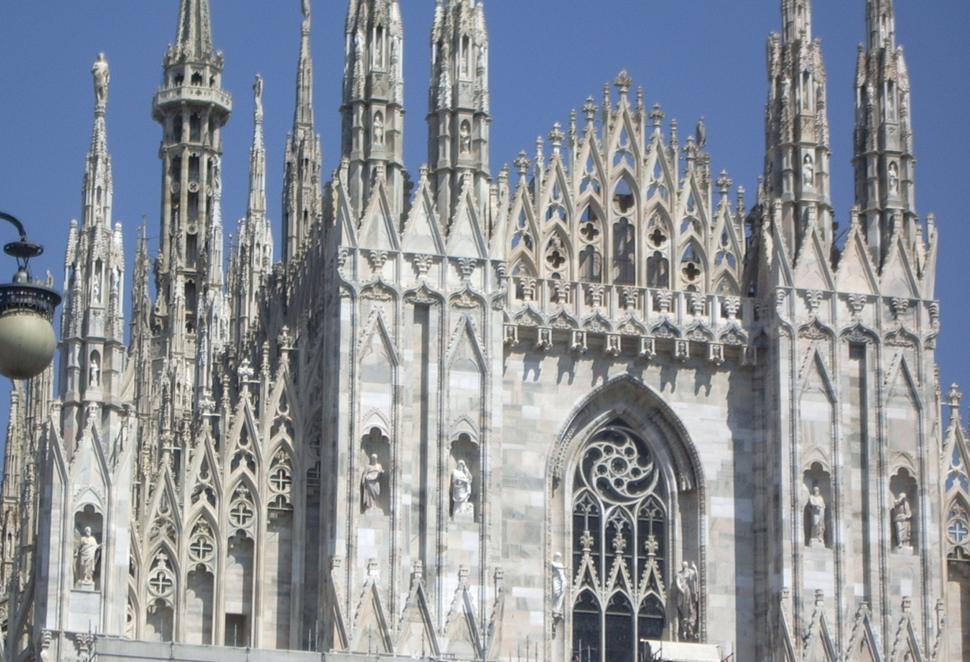
Breakfront
Building with section(s) that protrudes.

Slide 6
Captain’s Walk
An observation platform built above the roof

Slide 7
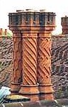
Chimney Pot
Ends of the pipes that carry smoke from the chimney to the air
Tudor England went crazy with them!

Slide 8
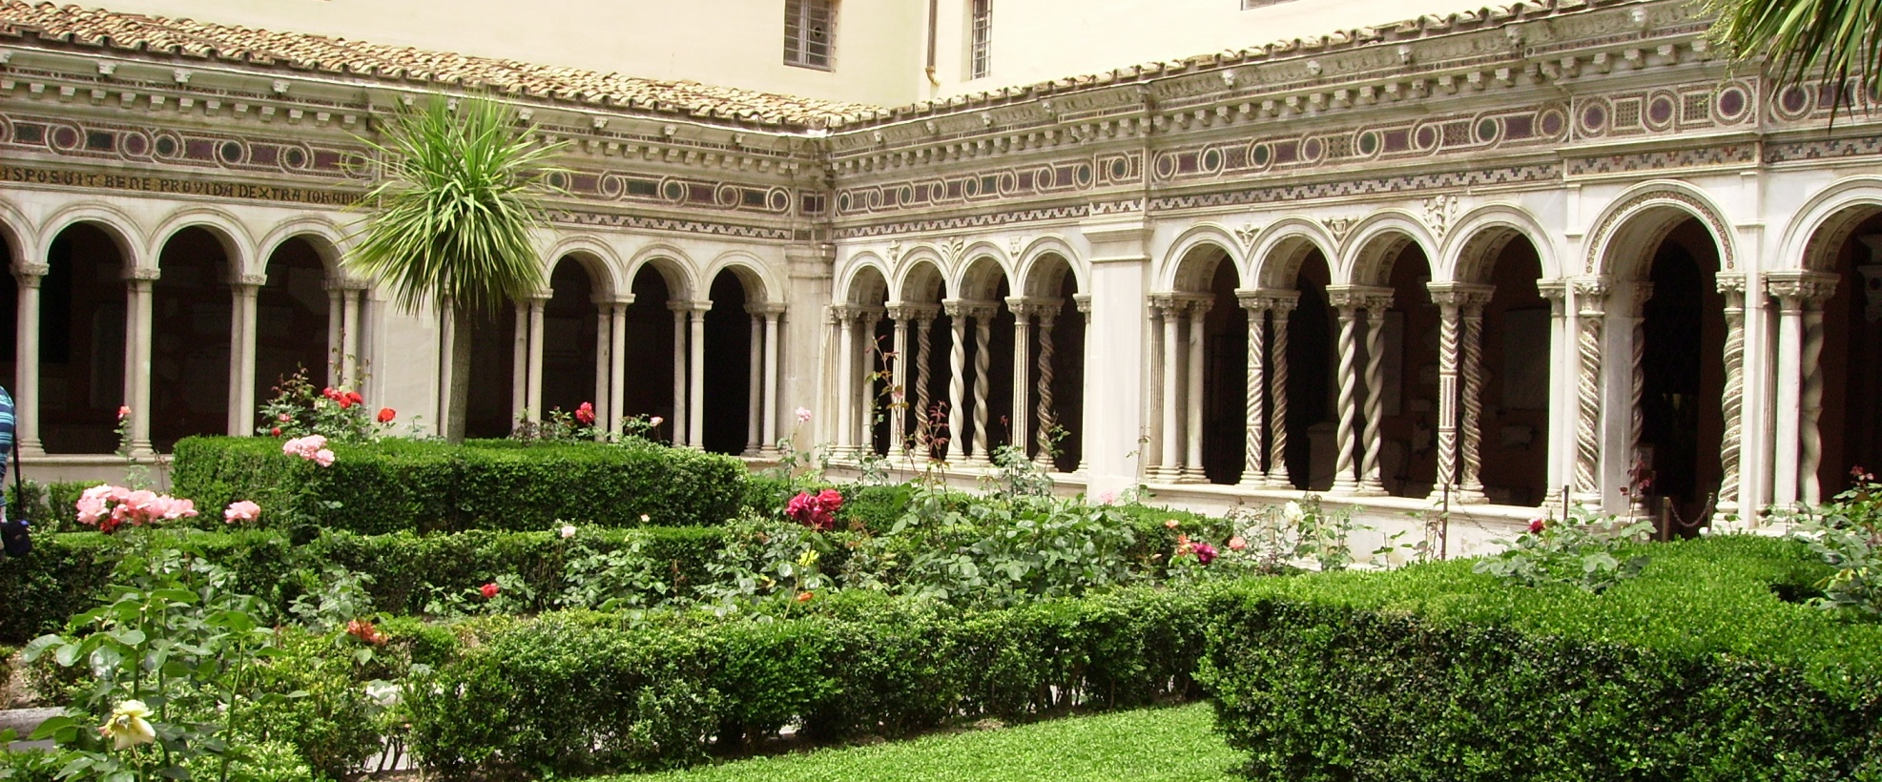
Colonnade
A long sequence of columns joined by their entabulature

Slide 9
Column
A free standing pillar

Slide 10
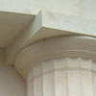
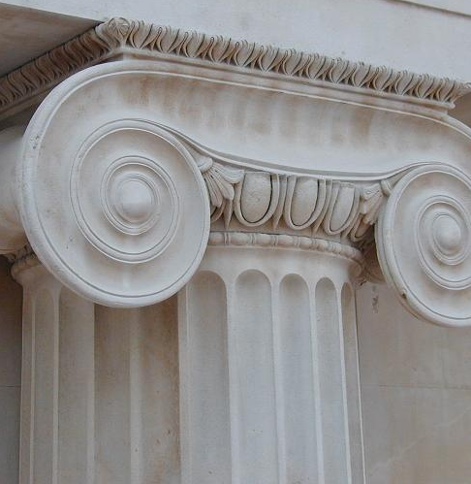
Doric Ionic Corinthian
Types of Capitals -

Slide 11
Cornice
uppermost section of moldings along the top of a wall or just below a roof.

Slide 12
Cupola
a dome-shaped ornamental structure placed on the top of a larger roof or dome.

Slide 13
Dentil trim
An architectural decoration composed of small square projecting blocks used in a cornice (think teeth!)

Slide 14
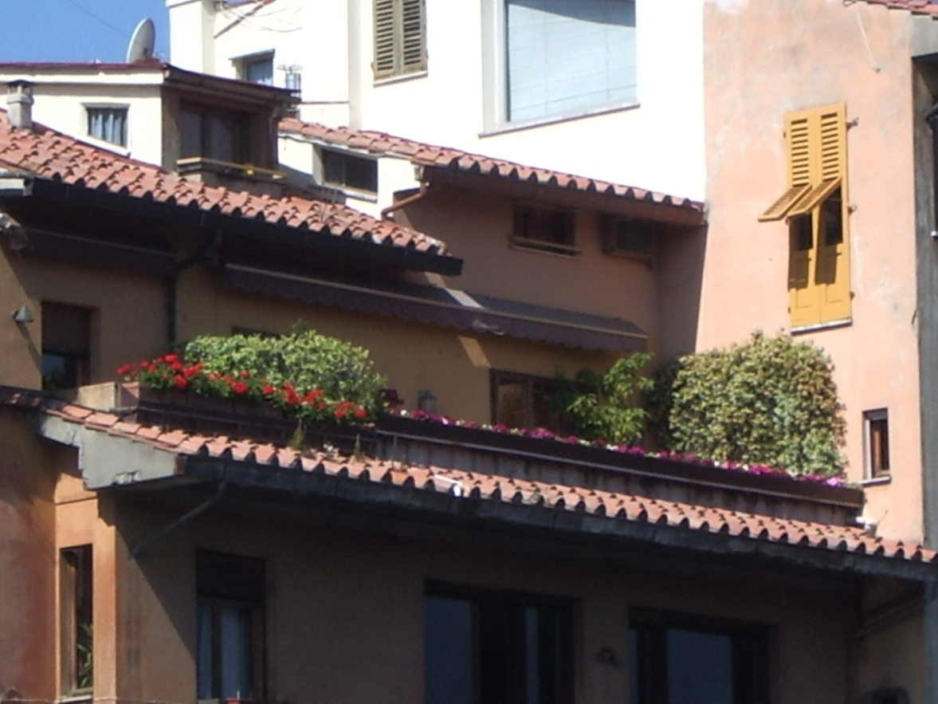
Eaves
the edge of a roof that projects beyond the side of the building

Slide 15
Entablature
moldings and bands which lie horizontally above columns, resting on their capitals

Slide 16
Flying Buttress
A free-standing buttress attached to the main structure by an arch or a half-arch

Slide 17
Gable
The end portion of a building formed by the roof coming together at the top
The House of Seven Gables - read the book!

Slide 18
Gothic Arch
a pointed arch; usually has a joint (instead of a keystone) at the apex

Slide 19
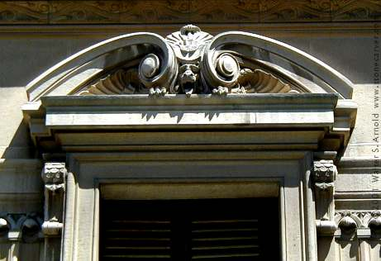
Pediment An architectural decoration above a portico
Triangular
Broken
Scroll
Segmental (round)

Slide 20
Pendant
An object suspended from above

Slide 21
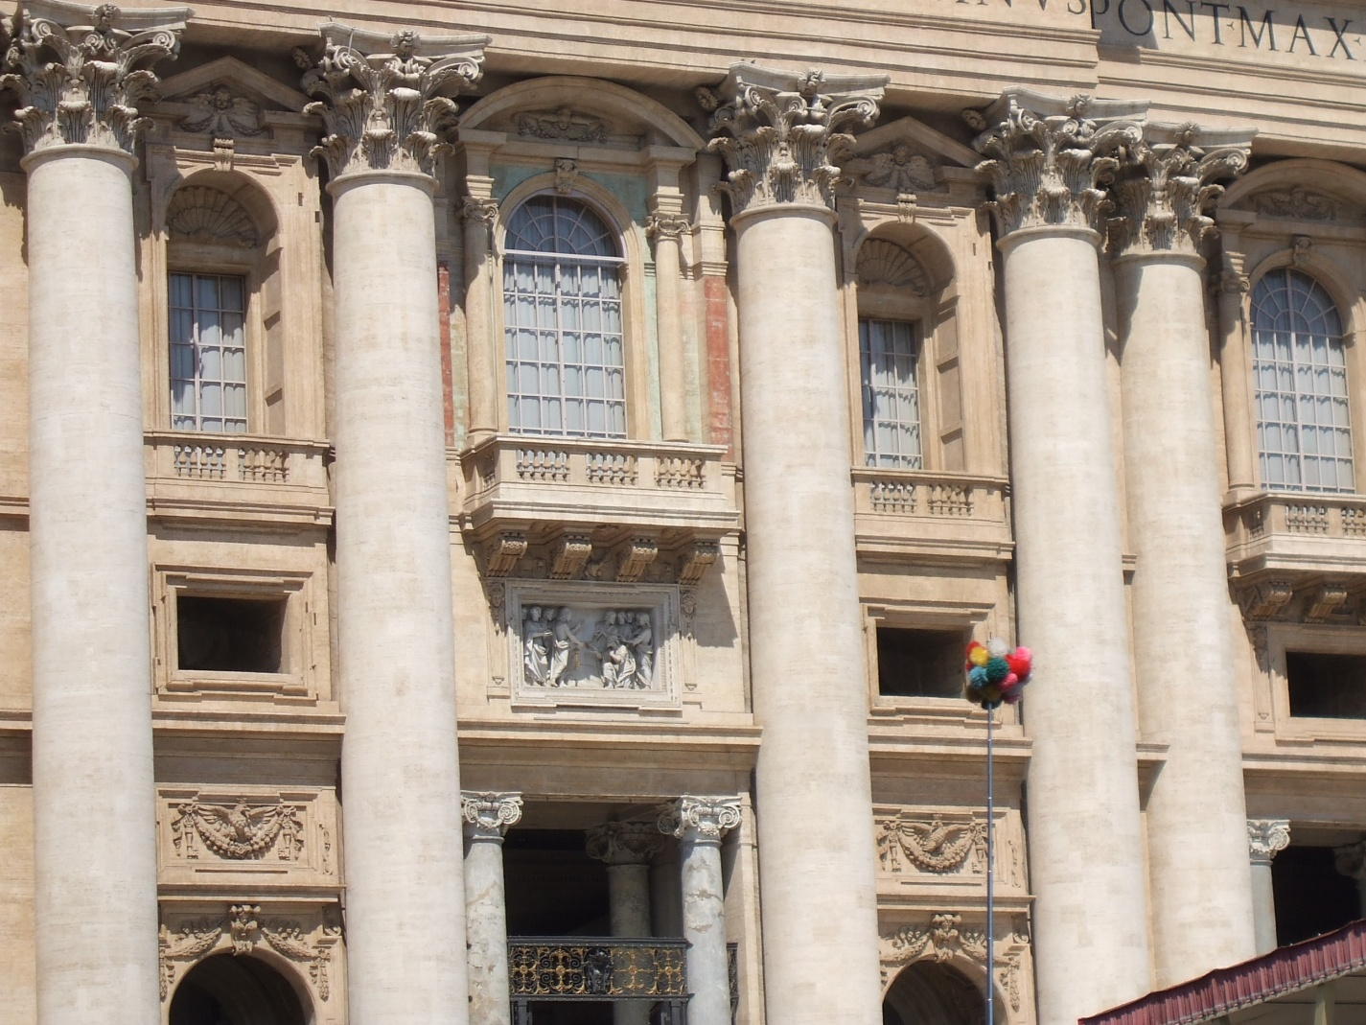
Pilasters
A column that is part of a wall - can be semicircular or flat

Slide 22
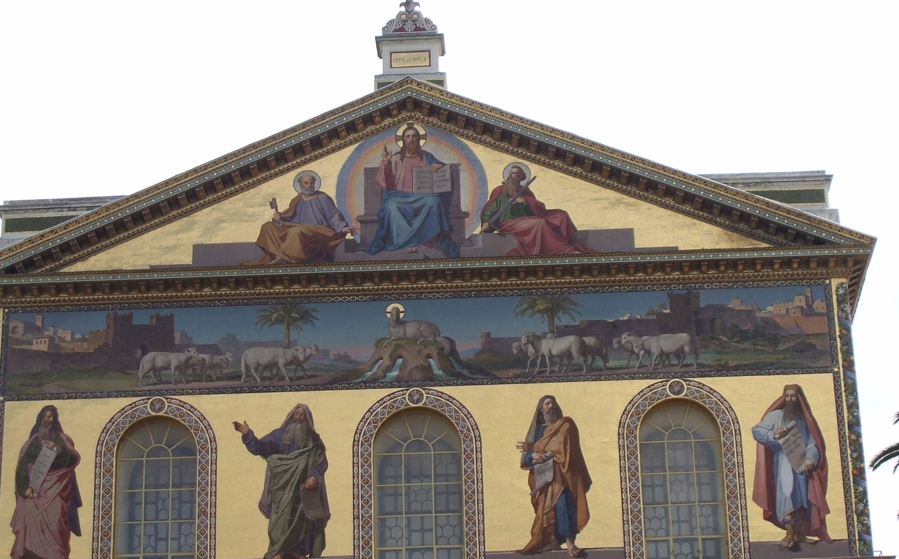
Pitch
A slope or the degree of slope – usually refers to a roof

Slide 23
Portico
A projection from the main structure of a building over the front entrance supported by columns, and often capped by a triangular pediment

Slide 24
Corner Quoins
Stone surfaces that cover corners of buildings
Alternate in length

Slide 25
Roman Arch
basic rounded arch, usually with a keystone – originated with the Etruscans

Slide 26
Shingles
materials that are relatively thin, enough to be overlapped as they are put in place.

Slide 27
Shutters
Panels mounted on beside windows
Originally hinged so they could swing shut over a window to protect the glass during bad weather

Slide 28
Timbers
Wide, heavy beams of lumber

Slide 29
Tudor Arch
variation of the Gothic arch
Top of arch is flattened

Slide 30
Turrett
A tower, often at an angle or on the corner of a building

Slide 31
Wrought Iron
Decorative metal

Slide 32
Wood exterior
Requires the most maintenance
Not as expensive as brick
Type depends on supply, location, cost

Slide 33
Brick exterior
One of the most expensive
Low or no maintenance

Slide 34
Siding
Inexpensive
Aluminum or vinyl
Low or no maintenance

Slide 35
Stone exterior
Price depends on market
Low or no maintenance
Can be as much as brick

Slide 36
Half Timber
Construction of timber frame having the spaces filed with masonry or plaster
Most of current construction is decorative

Slide 37
Roof Types
A-Frame

Slide 38
Roof Types
Dovecote

Slide 39
Roof Types
Flat

Slide 40
Roof Types
Gambrel

Slide 41
Roof Types
High Pitch

Slide 42
Roof Types
Low Pitch

Slide 43
Roof Types
Hipped

Slide 44
Roof Types
Mansard

Slide 45
Roof Types
Saltbox

Slide 46
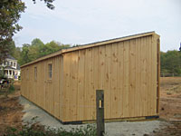
Roof Types
Shed

Slide 47
References
http://architecture.about.com/library/bl-glossary.htm
http://www.pitt.edu/~medart/
http://www.pitt.edu/~medart/menuglossary/INDEX.HTM
Wendy Curtis - personal photo file
Interior Design Curriculum Guide, USOE

Slide 48
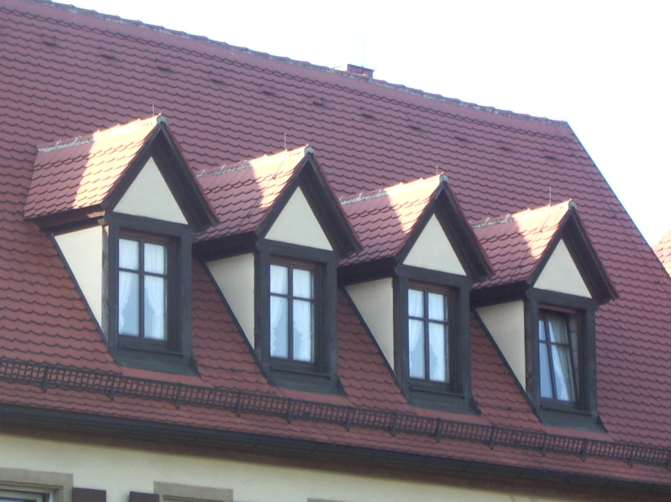
Dormer windows
A window in a small gable-like projection built out from a sloping roof

Slide 49
Palladian window
A window consisting of three vertical parts, with the central part higher than the flanking ones and topped with a fanlight

