Slide 1
BIRTH DEFECTS

Slide 3
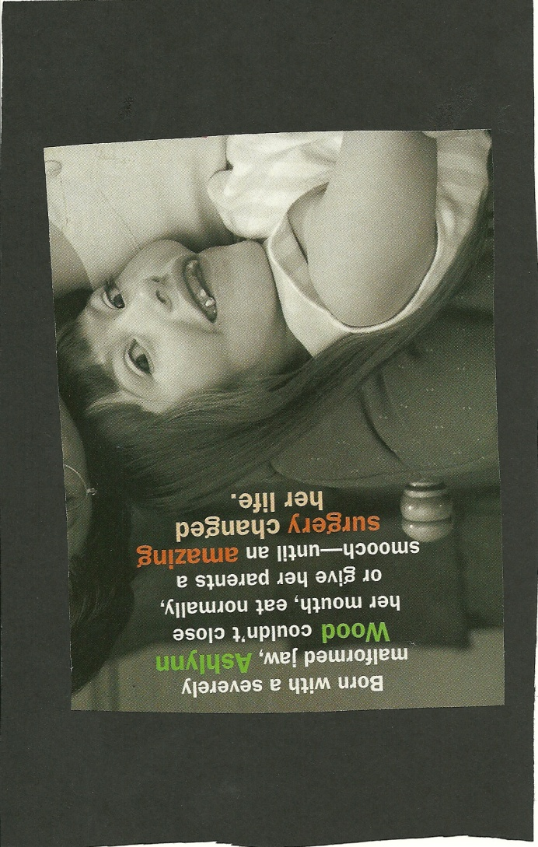

Slide 8
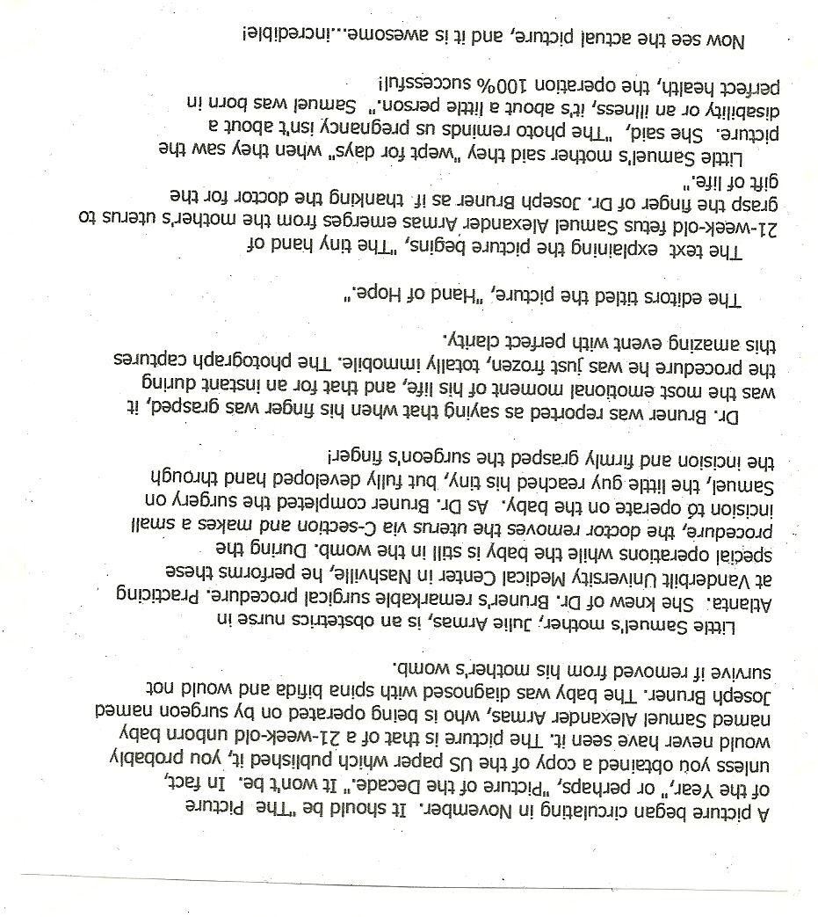

Slide 9
Child activity – Tissue Dye

