Slide 1
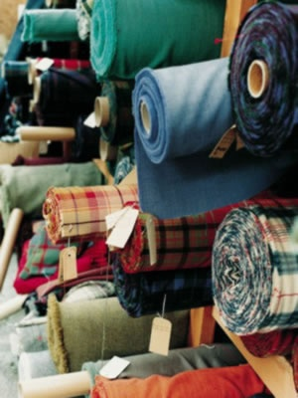
Fabric Construction
Yarn Twists, Weaving, Pile Weaves, Knits, and Non-Wovens

Slide 2
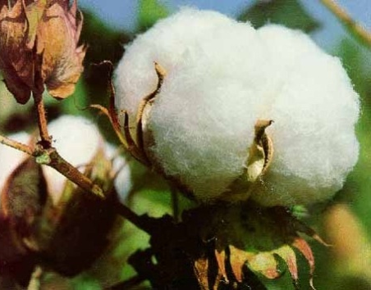
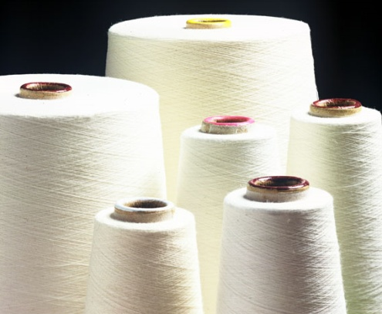
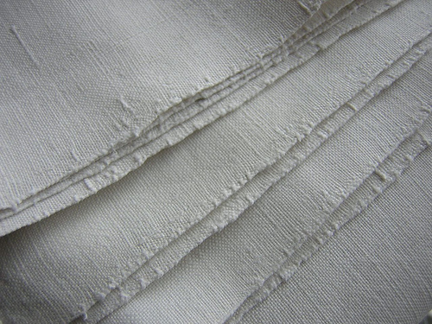
Fiber Yarn Fabric
1. All fabric is made from fiber, either natural or synthetic.
2. The fiber is processed and twisted into yarn.
3. The yarn is then woven or knit into fabric.
Fiber
Yarn
Fabric

Slide 3
How It’s Made!
Watch the short video from “How It’s Made” on the fiber to fabric process.

Slide 5
Yarn Twist
1. Twist affects the COLOR of fabric.
2. Twist affects the TEXTURE of fabric.
Silk (Loose)=Smooth
vs.
Wool (Tight) = Coarse
3. Twist affects the STRENGTH of fabric.
Tightly Twisted = Strong Fabric/Fibers
Loosely Twisted = Weak Fabric/Fabrics

Slide 6
Yarn Twist, cont.
4. Twist affects the DIAMETER of fabric.
Several fibers twisted together will add to the diameter, or thickness, of finished fabrics.
5. Twist affects the FLEXIBILITY of the fabric.
Tightly Twisted = Less Flexible Fabric/Fibers
Loosely Twisted = More Flexible Fabric/Fabrics
Loose Twist
Tight Twist

Slide 7
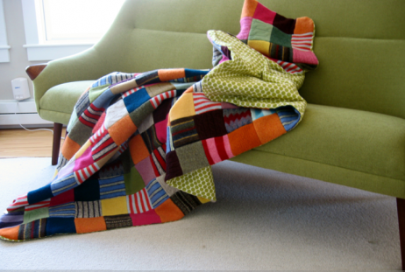
Fiber Blends
1. Fibers are often blended together to increase strength, durability, absorption, and other characteristics.
2. The most common fiber blend is:
Cotton & Polyester
Others Include:
Wool & Nylon
Raime & Cotton

Slide 8
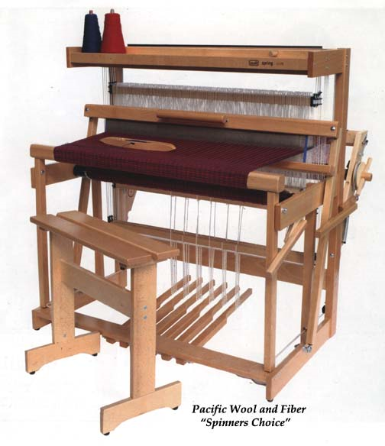
WOVEN FABRICS
1. Woven fabrics are created by the interlocking of two separate yarns.
2. The three main types of woven fabric are:
Plain Weave
Twill Weave
Satin Weave

Slide 9
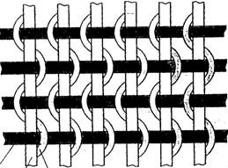
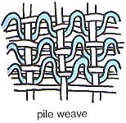
Pile Weaves
1. Pile weaves are woven with three sets of yarns instead of two.
2. The extra yarn gives the final fabric more texture.

Slide 10
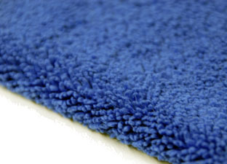
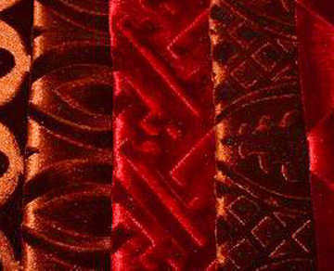
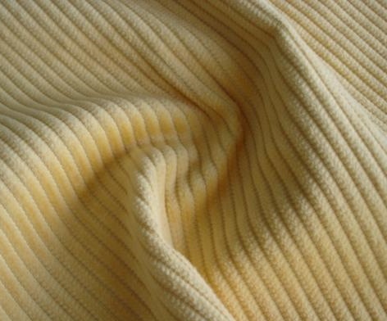
Pile Weaves, cont.
4. Examples of Pile Fabrics:
a. Corduroy
b. Terry Cloth
c. Polar Fleece
d. Velveteen
e. Velvet

Slide 11
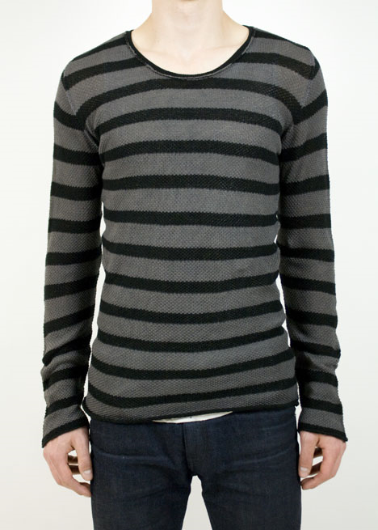
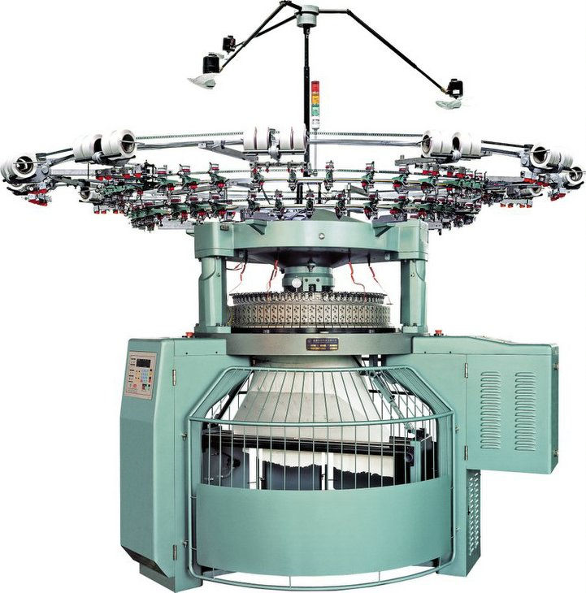
KNIT FABRICS
1. Knits are popular because:
a. They are easy to care for.
b. They are inexpensive to produce.

Slide 12
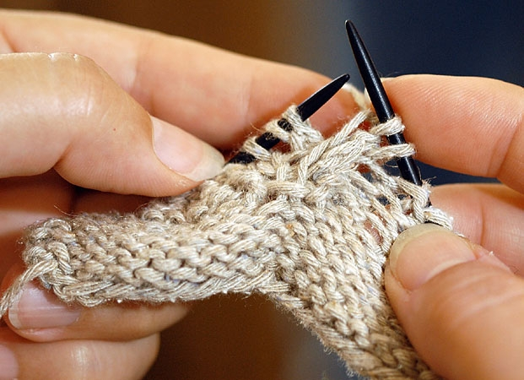
Knits, cont.
2. If the fabric has a LOOSE KNIT, it will =
a. Stretch
b. Sag
c. Get baggy
d. Have less recovery from stretching
3. If the fabric has a TIGHT KNIT, it will have =
a. More stability,
b. Less shrinkage,
c. Better recovery from stretching (shape recovery)

Slide 13
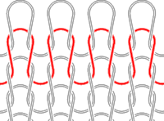
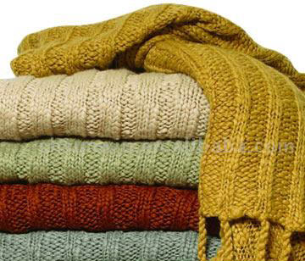
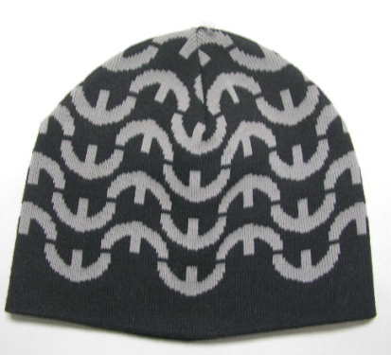
Knits, cont.
4. Diagram of knits
5. Examples of Knit Fabrics:
a. Jersey Knit
b. Rib Knit
c. Single Knit
d. Interlock Knit
e. Tricot Knit

Slide 14
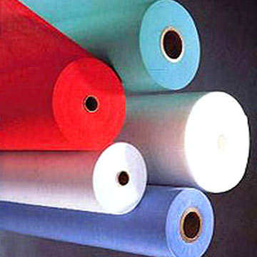
NON-WOVEN FABRICS
1. Making fabric without knitting or weaving
2. The Felting Process:
a. A mass of fibers interlock and shrink with heat and moisture
b. The best fibers used for felting are:
Wool
Rayon mixed with hair or fur fibers
Why?

Slide 15
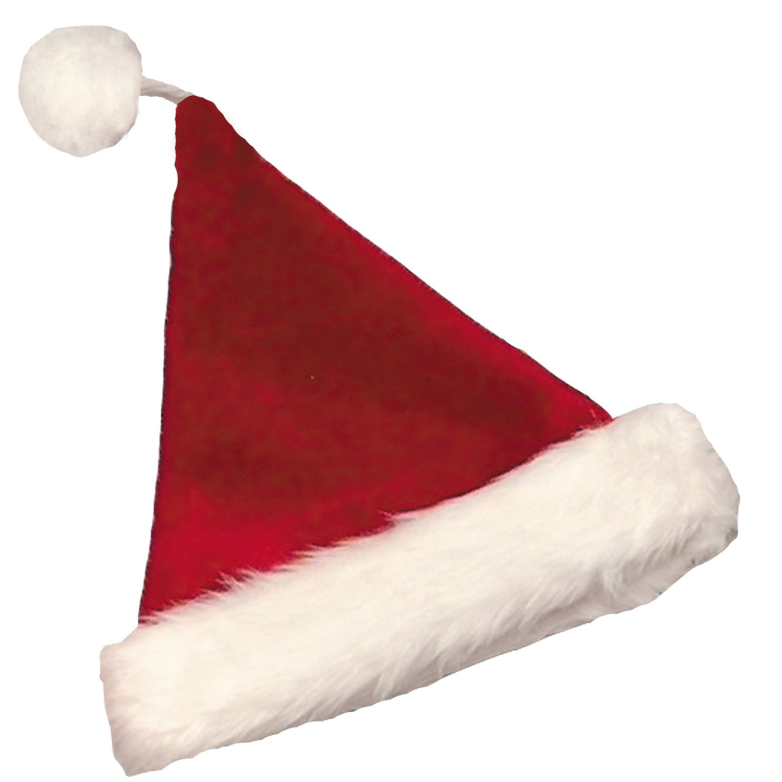
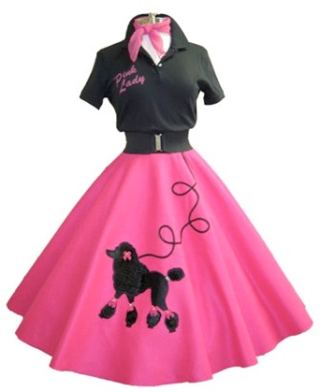
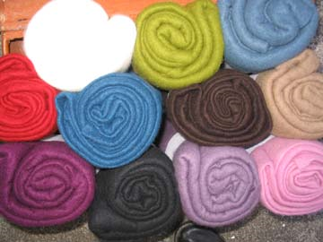
Felt
1. Felt comes in a variety of thicknesses, are easy to shape, will not unravel, and has shock and sound absorbency.
2. Felt will not recover from stretching, and holes in it cannot be mended satisfactorily.

Slide 16
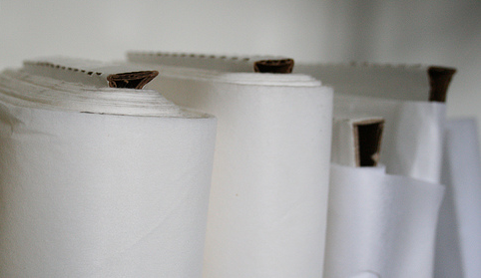
Interfacing
1. Interfacing is a non-woven fabric used to strengthen and stabilize other fabrics.
2. Interfacing comes in a variety of weights, thicknesses and colors.
3. Most modern interfacings have heat-activated adhesive on one side. These are called “fusible” interfacings.

