Slide 1
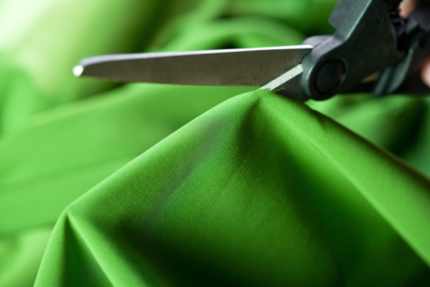
Preparing Fabric and Patterns to Be Cut

Slide 2
1. Pre-Shrink
Fabrics with high cotton content will shrink after its first laundering.
Wash and dry the fabric as you normally would to pre-shrink the fabric before cutting out any pattern pieces.

Slide 3
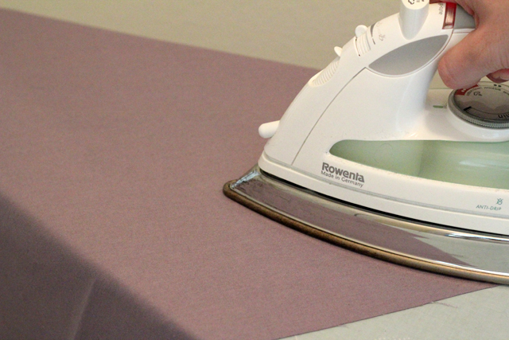
2. Press and Straighten Grain
After the fabric is dry, you will need to refold, press and straighten the grainlines.
Press the fabric WRONG sides together with SELVAGES touching.

Slide 4
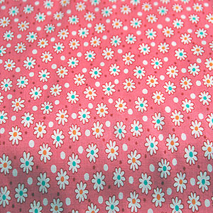
3. Check for Directional Fabrics
Some fabrics are considered one-way, or directional, because of the pattern.
All pattern pieces must be placed going in the same direction.
Directional Fabric
Non-Directional Fabric

Slide 5
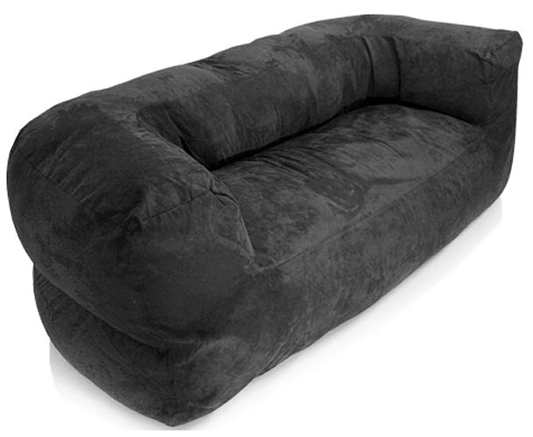
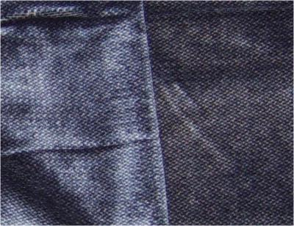
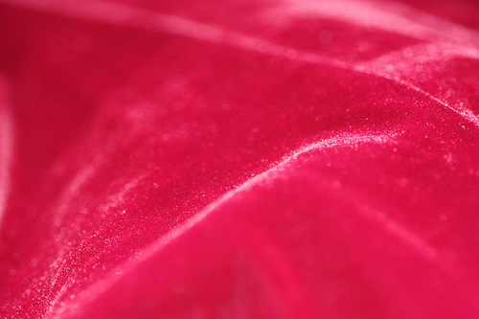
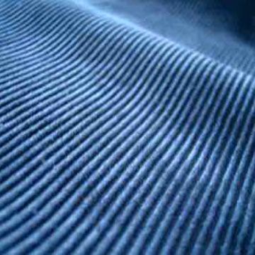
4. Fabrics with a Nap
Other directional fabrics include those with a nap.
Nap: soft and fuzzy surface on fabric created by raised, short fiber ends (Ex: velvet, corduroy, etc.)

Slide 6
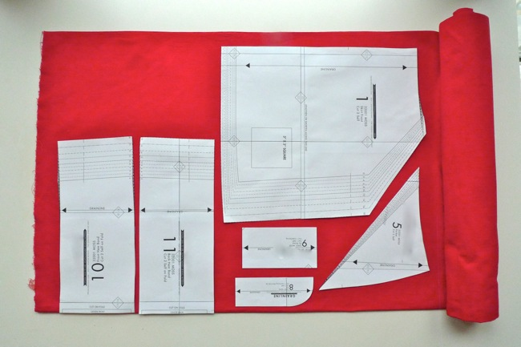
5. Laying Out Pattern Pieces
Place pattern pieces on fabric according to the grainlines.
Pay close attention to pattern symbols, like place-on-fold, and how many pieces of fabric should be cut from each pattern piece.

Slide 7
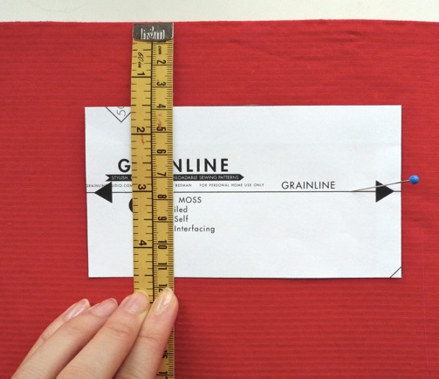
6. Check the Straight of Grain
Pin one end of the grainline and measure the distance from the pinned side of the grainline to the selvage.
Then measure the other end of the grainline to the selvage.
The two measurements should be the same. Pin the pattern in place.

Slide 8
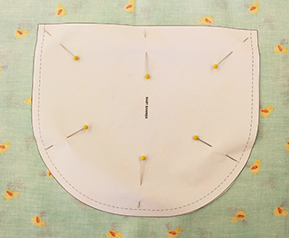
7. Pinning Down Pattern Pieces
When pinning pattern pieces to fabric in order to cut them out be sure to pin INSIDE the cutting line.
Don’t use too many pins. Space them out enough to prevent bunching, but close enough to keep the pattern in place.

Slide 9
8. DOUBLE CHECK!
Double check your pinning and grainlines before you begin cutting.
Measure twice, cut once!

Slide 10
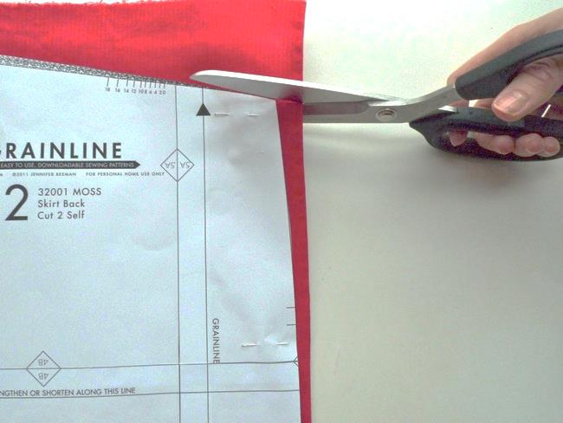
9. Cutting Out Pattern Pieces
Use the proper cutting equipment. Sharp fabric shears are best for cutting around pattern pieces.
Keep the fabric as flat as possible when cutting around pieces. Do not lift fabric in the air.
Remember to cut OUT and AROUND notches!

Slide 11
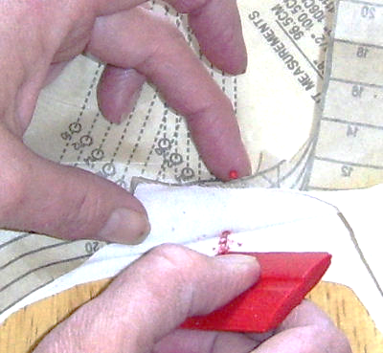
10. Marking The Fabric
Transfer any pattern markings and symbols to the fabric AFTER the pattern pieces have been cut out, but BEFORE the patterns are unpinned and removed.

Slide 12
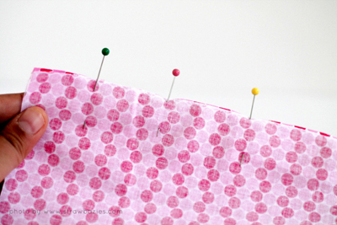
11. Pinning Fabric Before Sewing
When pinning fabric together in order to sew them, pin perpendicular to where the seam line will be.
The pinhead should be sticking out away from the fabric by about 1/4”-1/2” for easy removal while sewing.

