Slide 1
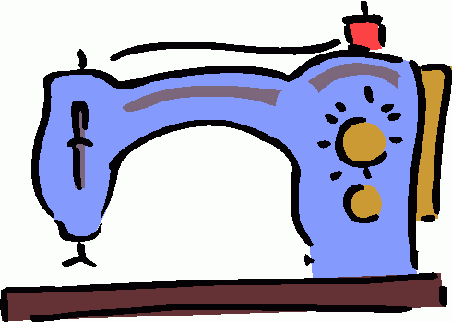
Pattern Symbols

Slide 2
Pattern symbols are an important part of sewing. Learning how to read and use pattern symbols will help you to create a professional looking project, save you time and also make sewing it together much easier.
Pattern symbols should be transferred from the paper pattern piece to the fabric AFTER the fabric has been cut out, but BEFORE the paper pattern is removed.

Slide 3
1. Grainline
Arrowed line indicating how to place the pattern piece on the material. This usually runs PARALLEL to the selvage.
2. Place-On-Fold Line
An arrow with bent corners to indicate pattern must be placed and cut on a folded edge of fabric.

Slide 4
3. Notches
Diamond shaped symbols that extend beyond the cutting line on the pattern. They are used to match up pattern pieces.
4. Double/Triple Notches
Used to match up pattern pieces. Double and triple notches usually symbolize the front and back of a pattern piece.

Slide 5
5. Dart
Folds sewn into fabric to help provide a three- dimentional shape to a garment.
Single Dart
Double-Ended Dart

Slide 6
6. Button
A small fastener usually made of plastic. It is most commonly used in clothing.
7. Buttonhole
A sewn slash in a garment used with a button as a fastener.

Slide 7
8. Triangles / Circles / Squares
Symbols most commonly used for placing sleeves, pockets or decorations.

Slide 8
Grainlines

Slide 9
Grainlines in woven fabric are important to understand because they can affect the final outcome of your project. Grainlines can affect the stretch and fit of clothing and the lining up of printed designs. The direction of the grainline arrow will show you how to place your pattern pieces.

Slide 10
A. Crosswise Grain
Perpendicular to the selvage edge of fabric-has a little bit of stretch.
Perpendicular to Selvage

Slide 11
B. Bias
Diagonal angle on fabric-provides the MOST amount of stretch in the fabric.
Bias

Slide 12
C. Lengthwise Grain
Parallel to the selvage edge of fabric-has the LEAST amount of stretch.
Parallel to the Selvage

Slide 13
D. Place-On-Fold
An arrow with bent corners to indicate pattern must be placed and cut on a folded edge of fabric.
D.

Slide 14
E. Selvage Edges
The tightly woven edges on fabric that runs lengthwise down the fabric.
E.

Slide 15
F. Raw Edges
The cut edges that will ravel and fray .
F.

