Slide 1
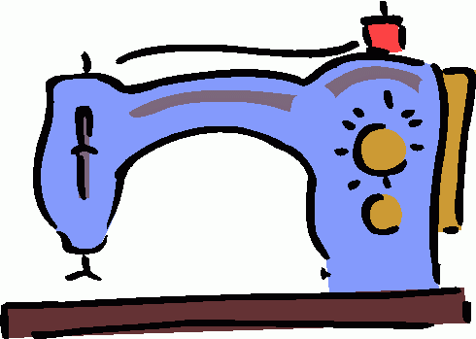
Sewing Equipment

Slide 2
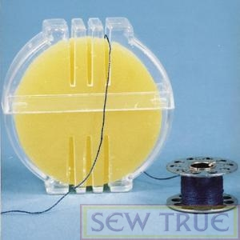
1. Beeswax
Coats and strengthens thread for hand sewing or embroidering. It also helps prevent knots.

Slide 3
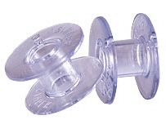
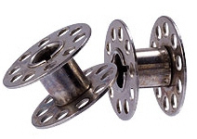
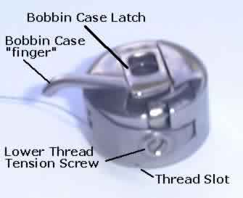
2. Bobbin
A small spool, made of plastic or metal, around which the lower thread of the sewing machine is wound.
3. Bobbin Case
The part of the sewing machine that holds the bobbin.

Slide 4
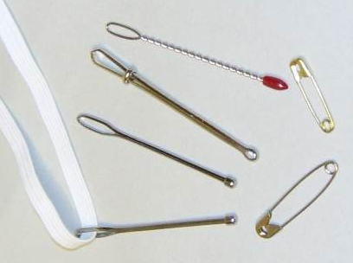
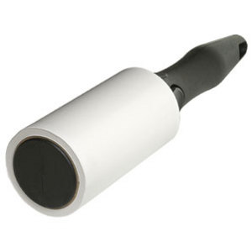
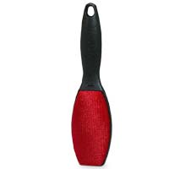
4. Bodkin
A small tool used to draw elastic or other material through a casing.
5. Lint Roller
Used to remove thread and fabric fibers from clothing.

Slide 5
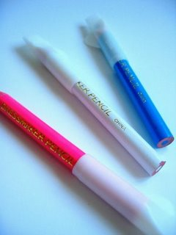
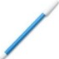
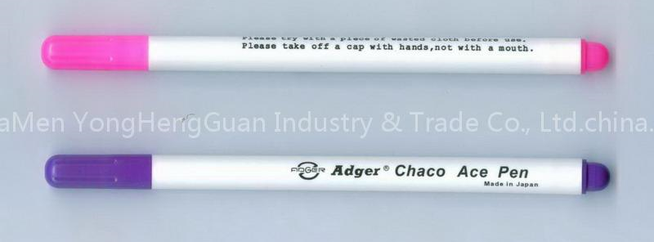
6. Marking Pens or Pencils
Fabric safe pens or pencils used for transferring pattern markings. Most are water-soluble or have disappearing ink.
7. Measuring Tape
Flexible piece of equipment used to measure body measurements, grainlines and long distances.

Slide 6
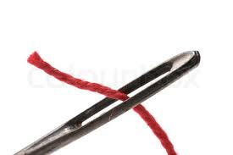
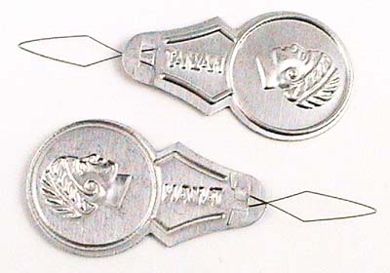
8. Needle
A small, slender piece of metal with a sharp point at one end ad a hole, or “eye” at the other. Used for hand sewing.
9. Needle Threader
A small piece of equipment used to pull thread through the eye of a hand needle.

Slide 7
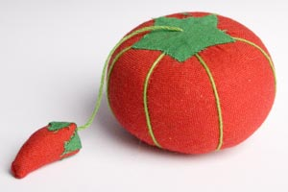
10. Pin Cushion
Small cushion used to hold and sharpen straight pins.
11. Pins
Holds layers of fabric together for cutting and sewing.

Slide 8
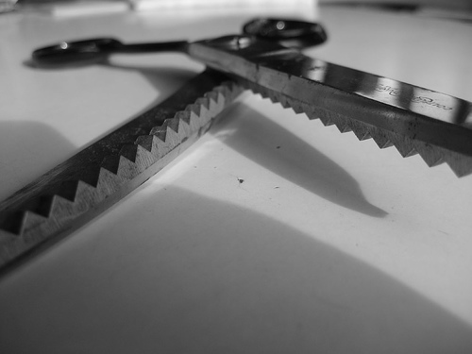
12. Pinking Shears
Shears used to cut a zig-zag, ravel-resistant edge on the fabric.

Slide 9
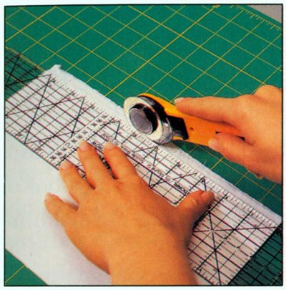
13. Rotary Cutting Equipment
Equipment used to cut very straight, clean lines in fabric. Never use the rotary blade without the ruler or the cutting mat.
Rotary Mat
Rotary Ruler
Rotary Cutter

Slide 10
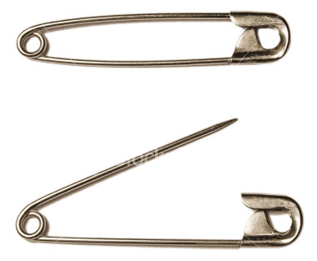
14. Safety Pins
Pins used to fasten fabric together that have a protective clasp on the end.
15. Scissors
Scissors used for cutting patterns and other non-fabric items, like paper patterns.

Slide 11
16. Seam Gauge
Metal six-inch ruler with a sliding marker.
17. Seam Ripper
Useful tool that helps unpick small stitches.

Slide 12
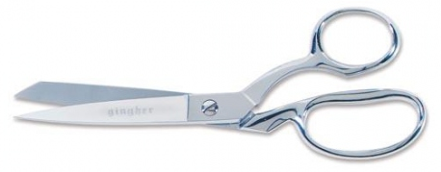
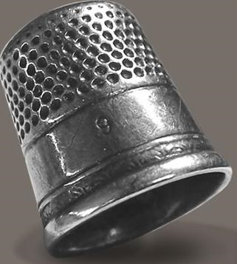
18. Shears
Sharp cutting tool to be used ONLY on fabric.
19. Thimble
A small metal cone used to protect fingers during sewing.

Slide 13
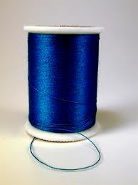
20. Thread
A very long, thin strand of cotton, nylon or other fibers used for sewing. Standard thread is “all-purpose” and high quality thread prevents stitching problems.

Slide 14
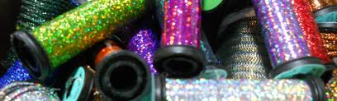
21. Specialty Thread
Includes thread such as quilting, heavy duty, embroidery and metallic. These are used for specific purposes or for decoration.

Slide 15
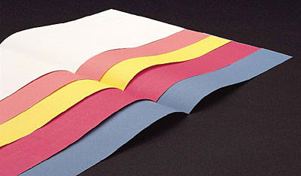
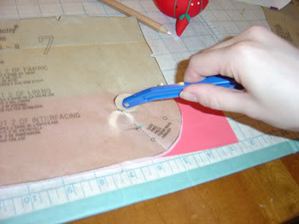
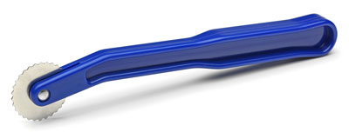
22. Tracing Paper & Wheel
Powdered paper and metal wheel used to transfer pattern markings to fabric.

Slide 16
Sewing Terms

Slide 17
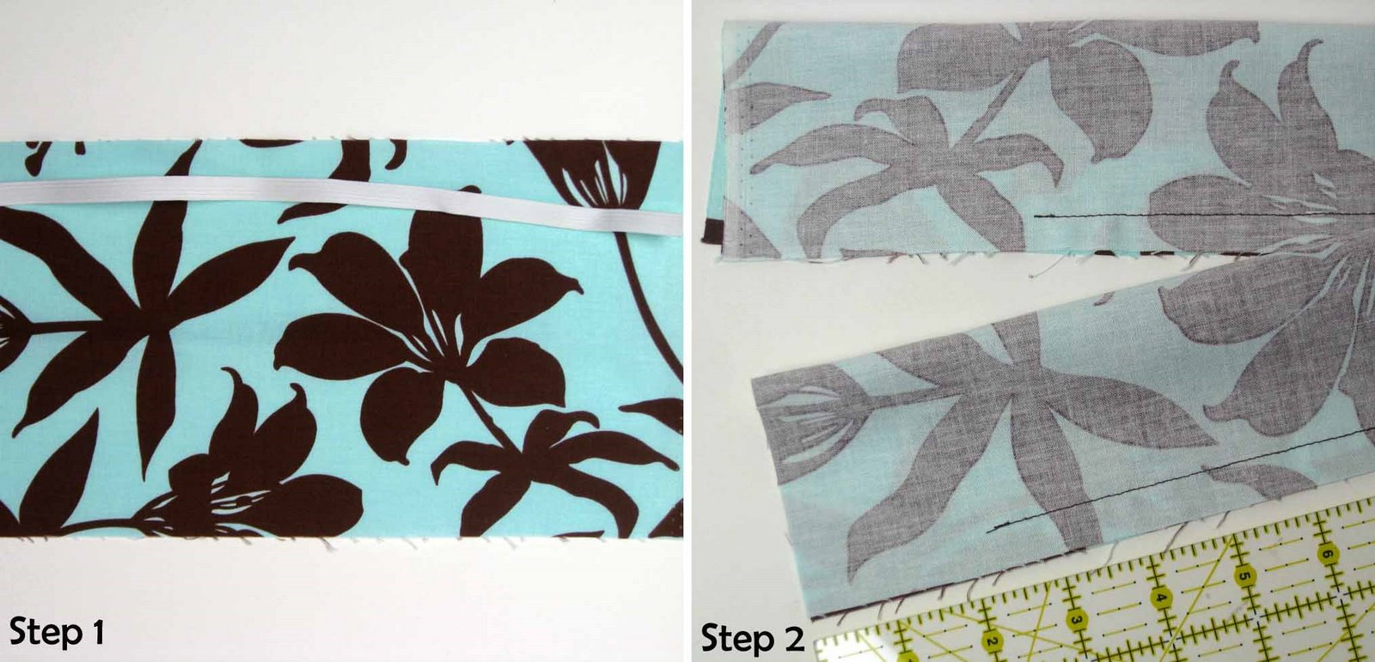
1. “Right” Side
The patterned side of fabric that will be showing when you are done sewing your project. Sometimes called the “Pretty” side.
“Right” Side
“Wrong” Side

Slide 18
2. “Wrong” Side
The back side of fabric that will be on the inside of the project you are sewing. Sometimes called the “Ugly” side.
“Right” Side
“Wrong” Side

Slide 19
3. Backstitch
To machine stitch two or three stitches BACKWARDS on the same line at the beginning and end of a seam to secure the stitches.
4. Basting Stitch
Long, temporary stitches used to hold pieces of fabric together.
Regular Stitch Length
Basting Stitch Length

Slide 20
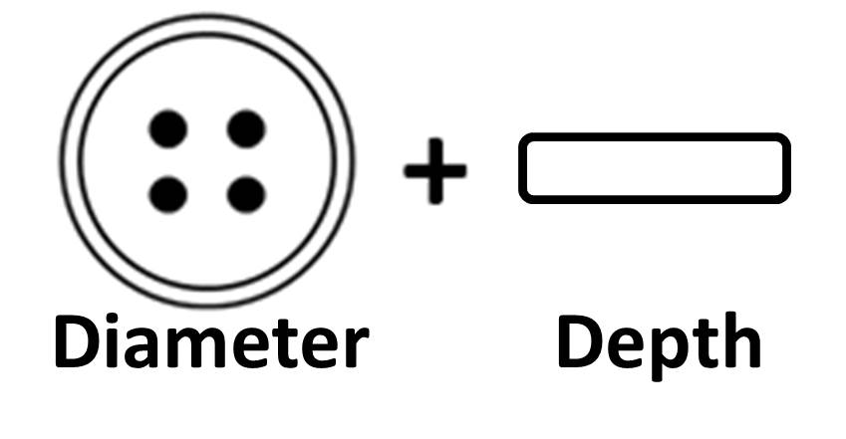
5. Buttonhole
A sewn slash in a garment used with a button as a fastener. Represented by these symbols:
6. Buttonhole Formula
Formula for measuring the correct length of a buttonhole: Button Diameter + Button Depth

Slide 21

7. Casing
A tunnel through which elastic or cording is threaded.
8. Casing Formula
formula for measuring the correct width of a casing: Elastic/Cording Width + 1/4“ + Seam Allowance

Slide 22
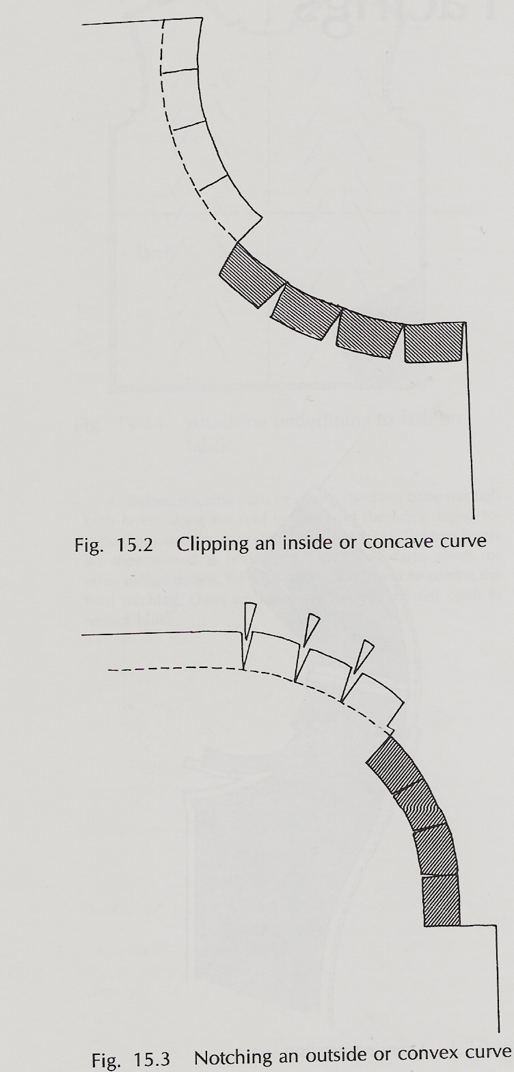
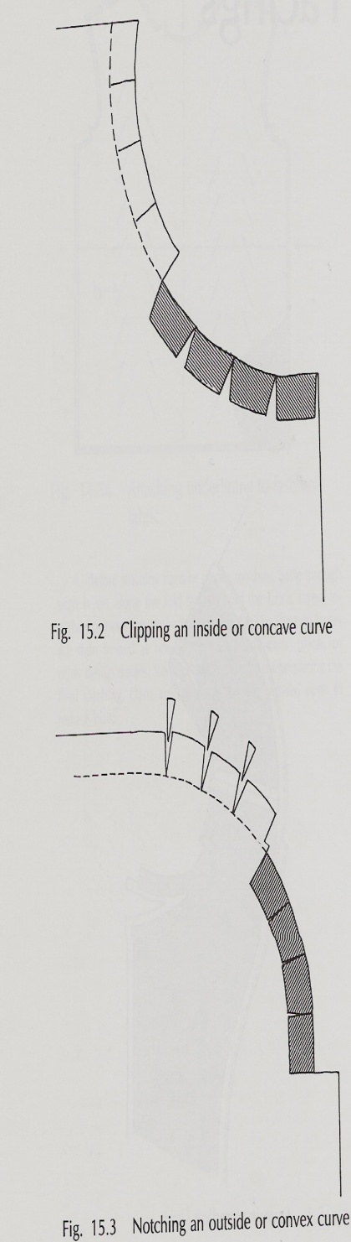
9. Clipping
A short cut made in the seam allowance-but not through the stitching-to allow for “bendability”.
10. Notching
Cutting V-shaped wedges out of the seam allowance to reduce bulk.

Slide 23
11. Cutting Line
The solid line on pattern pieces that you cut around.
12. Stitching Line
The dashed line on a pattern that shows where the stitching should be.

Slide 24
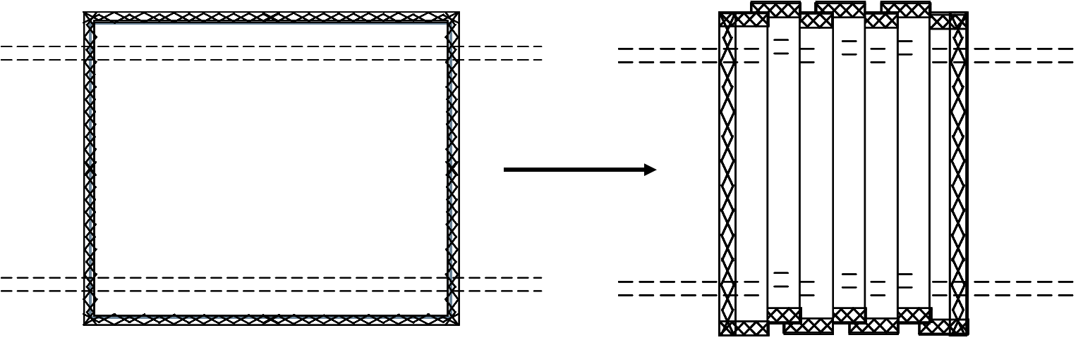
13. Gathering
Two to three parallel rows of basting stitches to create fullness in a garment.

Slide 25
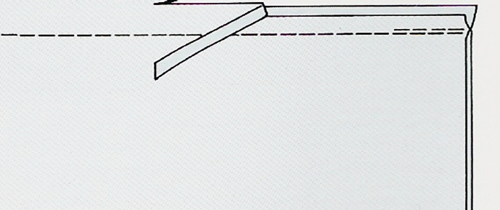
14. Grading / Layering
Trimming layers of the seam allowance to decrease bulk.

Slide 26
15. Grainline
Arrowed line indicating how to place the pattern piece on the material. This usually runs PARALLEL to the selvage.
16. Hem
The raw edge of any fabric, usually an article of clothing, turned back to the wrong side and stitched down.

Slide 27
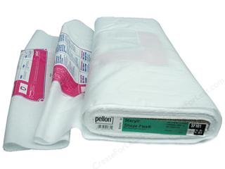
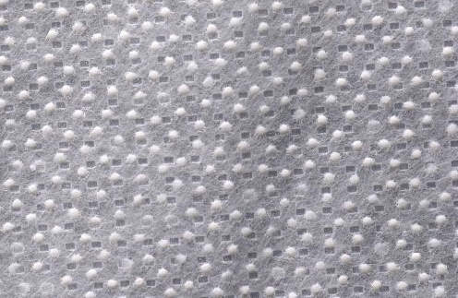
17. Interfacing
A non-woven fabric used to strengthen and stabilize other fabrics. (It usually has a fusible, heat-activated side.)

Slide 28
18. Miter
Pressing a corner, then refolding the point diagonally to form a square edge

Slide 29
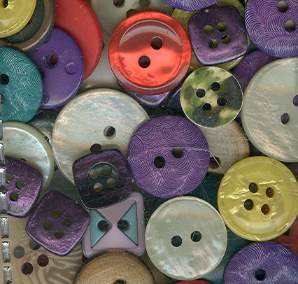
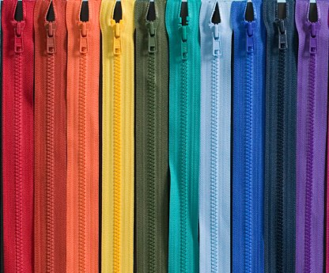
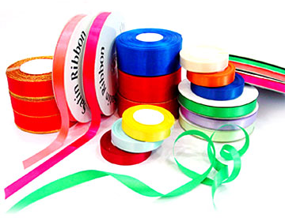
19. Notion
All items, other than fabric and patterns, needed to complete a sewing project. (Ex: buttons, zippers, trims, etc.)

Slide 30
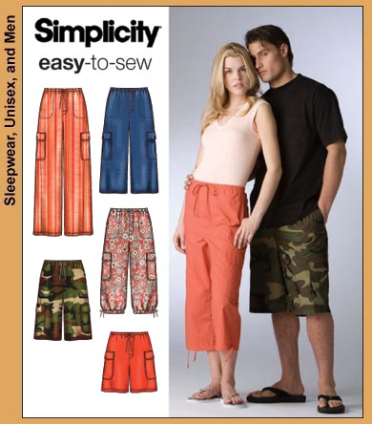
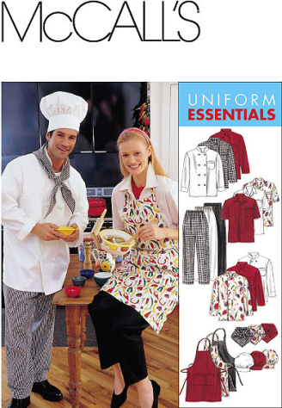
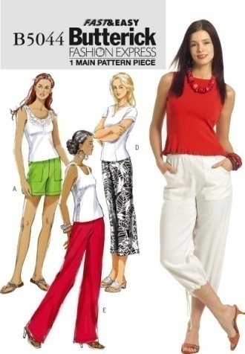
20. Pattern
Indicates what you will be making-includes size chart, garment views, notions needed, suggested fabrics and material quantities.
21. Ease
Added to commercial patterns for style, fit and wearing comfort.

Slide 31
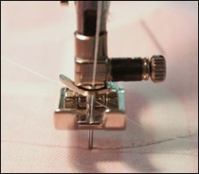
22. Pivot
At the end of a stitching line, leaving the needle down in the fabric, lifting the presser foot, turning or pivoting the fabric. After lowering the presser foot, the stitching will continue in a different direction. This technique is helpful when turning corners on a project.

Slide 32
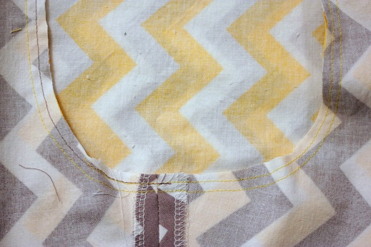
23. Reinforced Stitch
An extra row of stitching about 1/8” inside the original seam to reinforce an area of high stress, such as a crotch seam or underarm seam. Shortening the stitch length can also reinforce a seam.

Slide 33
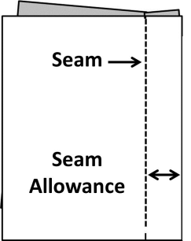
24. Seam
The stitched line that is created by sewing.
25. Seam Allowance
The distance between the edge of the fabric and the stitched line.

Slide 34
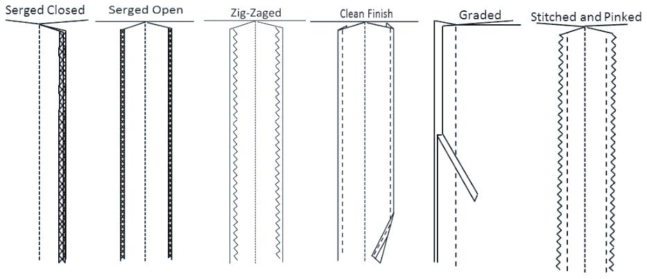
26. Seam Finish
Methods of finishing seam allowances so that they won’t fray or unravel.

Slide 35
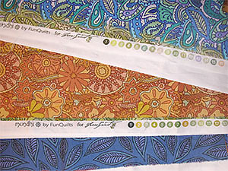
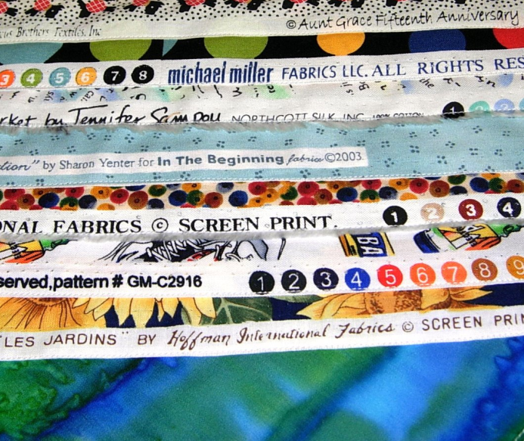
27. Selvage
The tightly woven edges on fabric that runs lengthwise down the fabric.
The grainline will run PARALLEL to the selvage.
Selvage

Slide 36
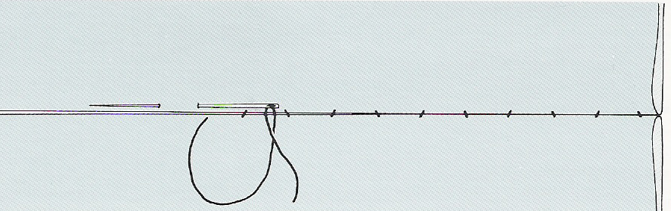
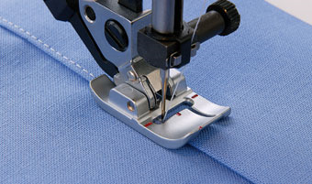
28. Slipstitch/Blind Stitch
A hand stitch that is almost invisible on both the right and the wrong side of the project.
29. Top-Stitch
A row of stitches about 1/4” away from the seam on the top or RIGHT side.

Slide 37
Pattern Symbols

Slide 38
Pattern symbols are an important part of sewing. Learning how to read and use pattern symbols will help you to create a professional looking project, save you time and also make sewing it together much easier.
Pattern symbols should be transferred from the paper pattern piece to the fabric AFTER the fabric has been cut out, but BEFORE the paper pattern is removed.

Slide 39
1. Grainline
Arrowed line indicating how to place the pattern piece on the material. This usually runs PARALLEL to the selvage.
2. Place-On-Fold Line
An arrow with bent corners to indicate pattern must be placed and cut on a folded edge of fabric.

Slide 40
3. Notches
Diamond shaped symbols that extend beyond the cutting line on the pattern. They are used to match up pattern pieces.
4. Double/Triple Notches
Used to match up pattern pieces. Double and triple notches usually symbolize the front and back of a pattern piece.

Slide 41
5. Dart
Folds sewn into fabric to help provide a three- dimentional shape to a garment.
Single Dart
Double-Ended Dart

Slide 42
6. Button
A small fastener usually made of plastic. It is most commonly used in clothing.
7. Buttonhole
A sewn slash in a garment used with a button as a fastener.

Slide 43
8. Triangles / Circles / Squares
Symbols most commonly used for placing sleeves, pockets or decorations.

Slide 44
Grainlines

Slide 45
Grainlines in woven fabric are important to understand because they can affect the final outcome of your project. Grainlines can affect the stretch and fit of clothing and the lining up of printed designs. The direction of the grainline arrow will show you how to place your pattern pieces.

Slide 46
A. Crosswise Grain
Perpendicular to the selvage edge of fabric-has a little bit of stretch.
Perpendicular to Selvage

Slide 47
B. Bias
Diagonal angle on fabric-provides the MOST amount of stretch in the fabric.
Bias

Slide 48
C. Lengthwise Grain
Parallel to the selvage edge of fabric-has the LEAST amount of stretch.
Parallel to the Selvage

Slide 49
D. Place-On-Fold
An arrow with bent corners to indicate pattern must be placed and cut on a folded edge of fabric.
D.

Slide 50
E. Selvage Edges
The tightly woven edges on fabric that runs lengthwise down the fabric.
E.

Slide 51
F. Raw Edges
The cut edges that will ravel and fray .
F.

