Slide 1
Bell Work

Slide 2
Bell Quiz #3
1. Communicable diseases:
A. Are not passed from one person to another
B. Are usually fatal
C. Are passed from one person to another
D. Cannot be prevented or treated
2. Which type of environment is developmentally beneficial for a 12 month old?
A. A playpen full of stimulating toys
B. A bedroom full of book, crafts, and educational toys
C. Free access to a child proof house
D. A bathtub with boats and paints
3. In what position should a newborn be placed to sleep?
A. With a pillow
B. On its stomach
C. On its back
D. On a fluffy, warm blanket with stuffed animals

Slide 3
Bell Quiz #3
4. All of the following are advantages of breast-feeding except:
A. Newborns can get all of the nutrients needed from breast milk
B. There is less chance of developing allergies
C. The baby has a stronger immune system
D. Both mom and dad can take part in feeding the baby
5. A good rule of thumb when bathing a baby is:
A. Start with the dirtiest areas and end with the cleanest
B. Begin giving baths as soon as the baby is born
C. Have all the needed supplies in the room, but not close
enough to reach them without leaving the baby’s side.
D. Start with the cleanest areas on the body and end with the
dirtiest areas
6. The safest place, in an automobile, to put a car seat is in the:
A. Front seat next to the driver
B. Back seat next to the window
C. Front seat next to the window
D. Center of the backseat

Slide 4
Infant Feeding Quiz
Do the infant feeding quiz

Slide 5

Unit 4: Infant Cognitive Development

Slide 6
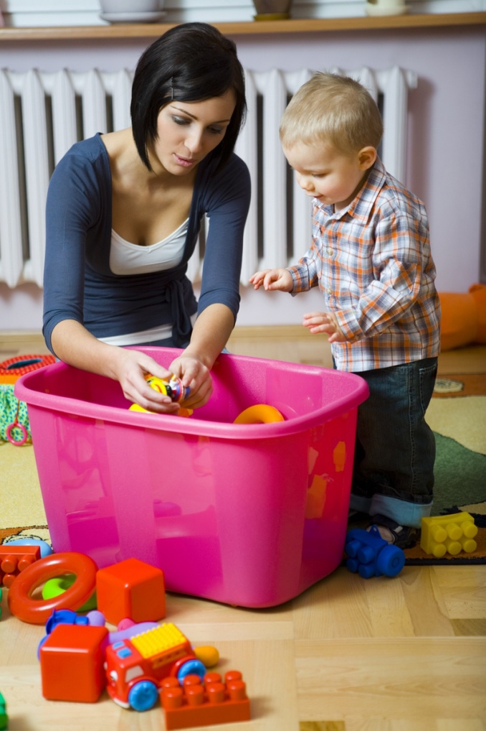
2. Infants learn primarily through their senses (perceptions).
  This is why they put everything in their mouth.
  Examples of others, the environment, and how they are shown love and respect also attribute to learning.
An infant’s brain will triple in the first 2 years of life based on the child’s environment.

Slide 7
3. COGNITIVE DEVELOPMENT
Milestones that show a growing Cognitive Development
Remembering
  Information from the senses is interpreted based on past experiences.
Making Associations
  Relating an action to a result
Understanding Cause and Effect
  The idea that one action results in another action or condition.
    Close your eyes and it gets dark, open them and it gets light
Paying Attention
  Attention Span - The length of time the baby can concentrate on a task without getting bored or distracted grows longer.
    Generally bright babies have a short attention span, they tend to lose interest quicker.

Slide 8

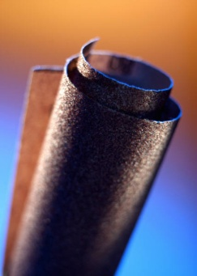
4. Theorist Jean Piaget
From birth to 2 years old the infant is in the
Sensorimotor Stage/period
  learning about the world through their senses and own actions.

Slide 9
6 steps to Sensory Motor
Step 1: Birth
  Infants are only aware of themselves
  They do not understand themselves as a separate person
Step 2: 1-4 Months
  Learning to combine reflexes
  Hand to mouth coordination
Step 3: 4-8 months
  Respond to stimuli
  Improve hand-eye coordination
Step 4: 8-12 months
  Intentional behavior
  Cause and affect – certain actions have certain results
  Imitate others
  Follow objects with their eyes
  Object permanence develops
Step 5: 12-18 months
  Trial and error
  Can find hidden objects
  Understands that objects exist independently from themselves
Step 6: 18-24 months
  Begin to experiment mentally as well as physically
  They think about what they are going to do before they do it.

Slide 10

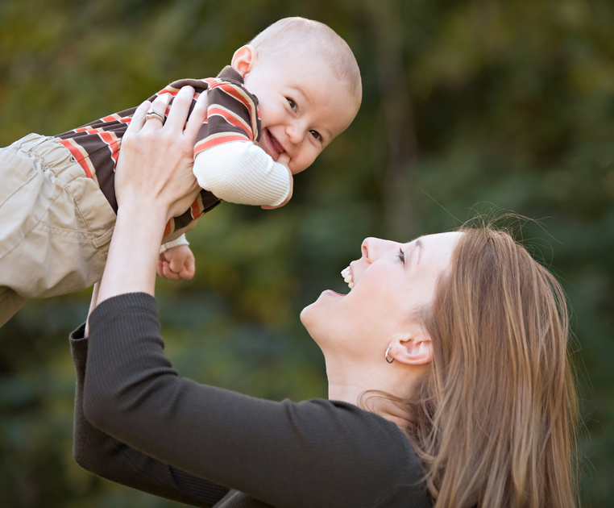
5. Object permanence
Peek-A-Boo
Knowing that an object still exists even when it is out of sight.
Develops about 12-18 months.
“Out of sight out of mind”
  pertains to a child who has not yet developed object permanence.

Slide 11
Object Permanence Clip
http://www.youtube.com/watch?v=PuP53BbIY0A&safety_mode=true&persist_safety_mode=1
http://www.youtube.com/watch?v=lKZ9IPRKkkU&feature=related&safety_mode=true&persist_safety_mode=1

Slide 12
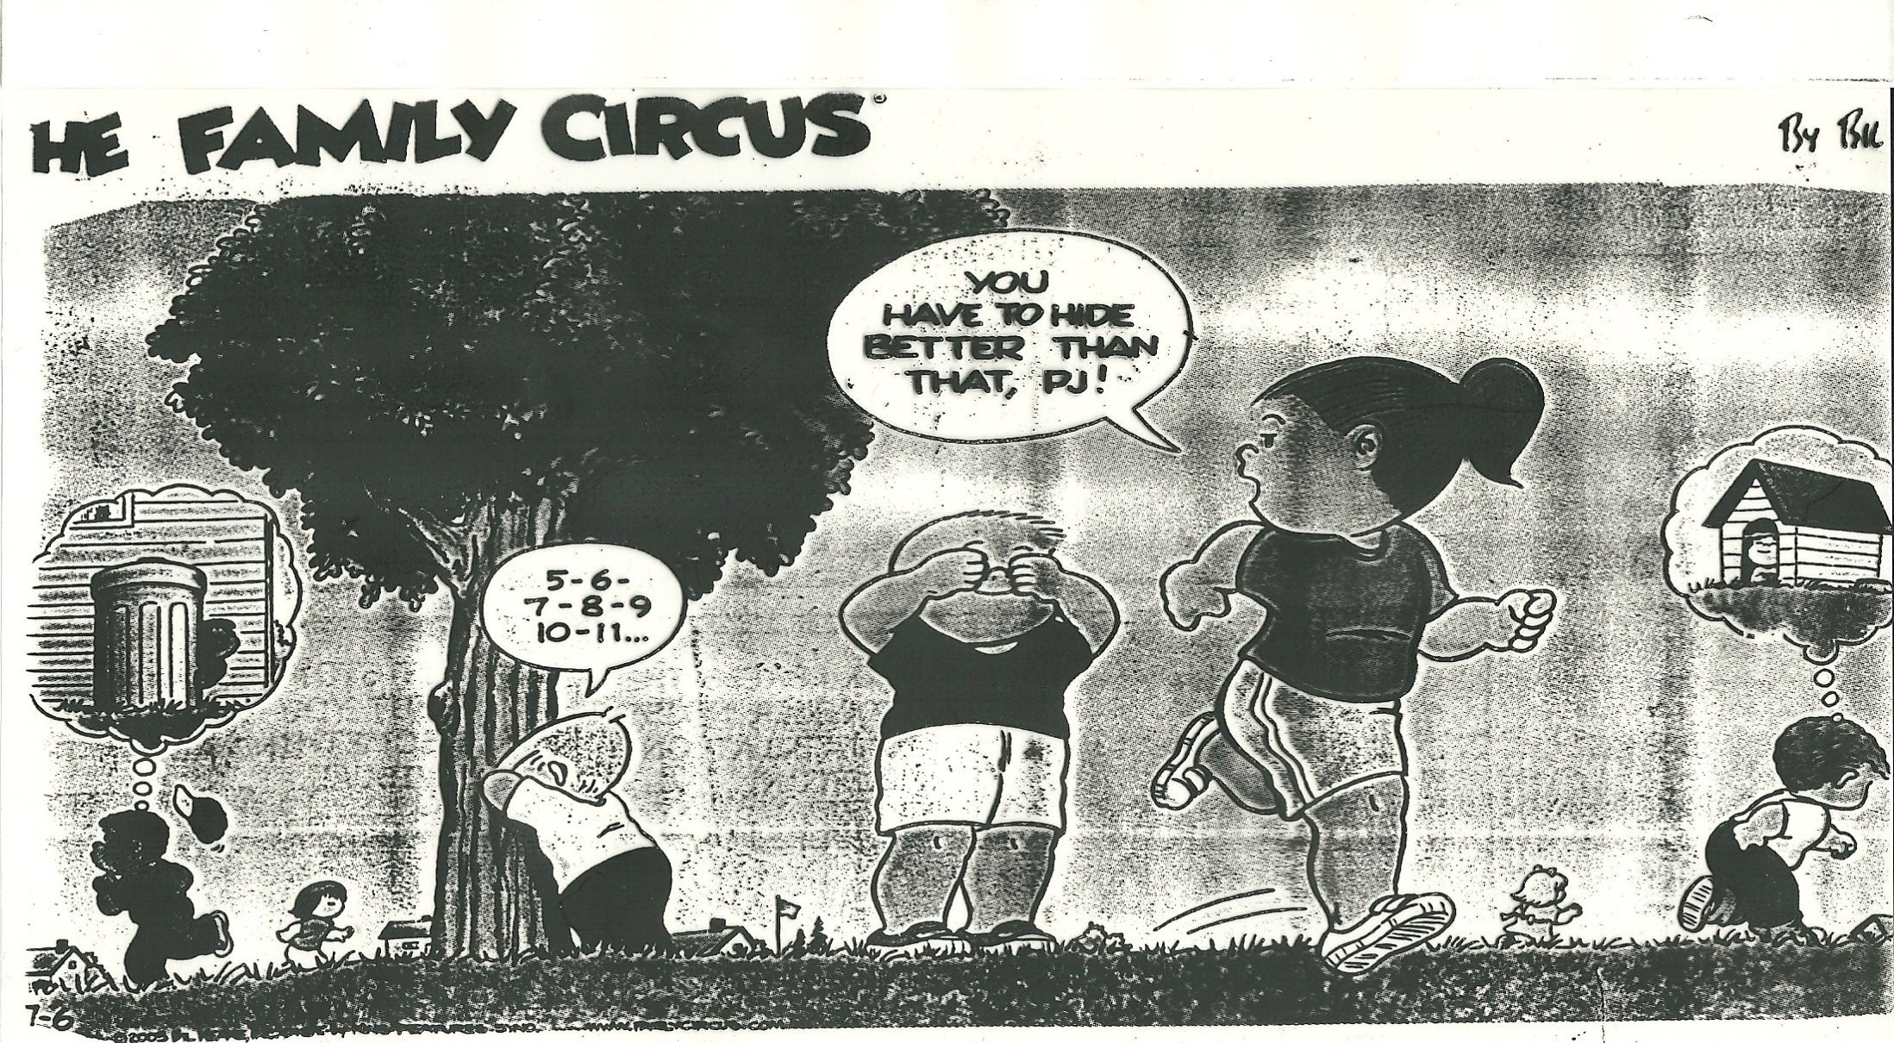

Slide 13

  6. Encourage Learning in an infant by:
  Giving attention, time, and knowledge
1. Learn about the development of a child – age appropriate learning, development, activities, etc..
2. Give your time and attention –
  talk to them, play games, read to them, take them places,
3. Babies are motivated to learn when they receive positive reinforcement and feedback for actions.
4. Express your love continually –
  develops self-confidence, security, and encourages the child to risk, try, and learn
5. Children learn when caregivers share and talk about their experiences.

Slide 14
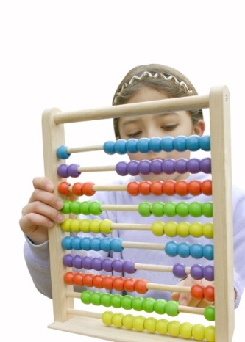
7. Stimulation for children ages 0-3 years old is critical for brain development.
1. Stimulate an infant’s senses:
  touch, hear, taste, see, smell (listen to these words on next slide)
2. Provide objects the baby can manipulate:
  a variety of textures and different shapes are more important than the number of toys.
3. Provide activities that develop the gross and fine motor skills
4. Encourage listening experiences:
  music, voices, stories, rattles, squeaky toys, their own voice
Nursery Rhymes

Slide 15
THIS MAKES SCENTS
Close your eyes and listen to the following words. What images are conjured up in your mind?
  Popping corn
  Bread baking
  Chocolate cake
  Clean sheets
  A spring day
  A Christmas tree
  Aftershave
  The locker room
  Coffee brewing
  Maple syrup
  A library

Slide 16
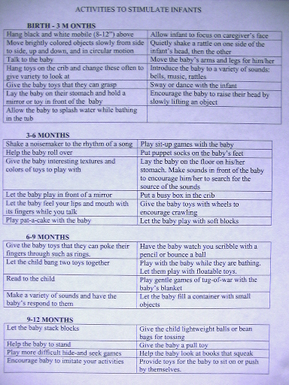

Slide 17
FUN WITH MOTHER GOOSE
Who went up the hill?
Who lost her sheep?
Who could eat no lean?
Who ran away when the boys came out to play?
Who sat on a wall?
Who was under the haystack fast asleep?
Whose cupboard was bare?
Who had a wife and could not keep her?
Who called for his pipe, bowl, and fiddlers?
Who lived in a shoe?
Who was frightened of spiders?
Who jumped over the moon?
Who ran up the clock?
Who kissed the girls and made them cry?
Who was in the counting house counting his money?
What time was it when the mouse fell
down in Hickory Dickory Dock?
Who stuck in their thumb and pulled out a plumb?
Who jumped over a candlestick?
How many men were in a tub?
What ran away with the spoon?
Who could eat no fat?
Who couldn’t put humpty dumpty back
together again?
Who was in the parlor eating bread and honey?

Slide 18
Fun with Mother Goose - answers
Jack and Jill
Little Bo Peep
Jack Sprat’s wife
Georgie Porgie
Humpty Dumpty
Little Boy Blue
Old Mother Hubbard
Peter Peter Pumpkin Eater
Old King Cole
An old Woman
Little Miss Muffet
The Cow
The mouse
Georgie Porgie
The king
1 o’clock
Little Jack Horner
Jack
Three
The dish
Jack Sprat
All of the king’s horses and all the king’s men
The Queen

Slide 19
Sing a song of nursery rhymes
(tune: 99 bottles of pop on the wall)
Sing the alphabet to this tune between each nursery rhyme and
Sing each nursery rhyme to this tune.
Little Jack Horner
Little Jack Horner sat in a corner eating his Christmas pie.
He stuck in his thumb and pulled out a plum, and said what a good boy am I!
JACK and JILL
Jack and Jill went up the hill to fetch a pail of water. Jack fell down and broke his crown and Jill came tumbling after.
Little Bo Peep
Little Bo Peep has lost her sheep and doesn’t know whereto find them.
Leave them alone and they’ll come home. Wagging their tails behind them.
Humpty Dumpty
Humpty Dumpty sat on a wall.
Humpty Dumpty had a great fall.
All the king’s horses and all the king’s men, Couldn’t put humpty together again.
Baa Baa Black Sheep
Baa Baa black sheep have you any wool?
Yes sir, yes sir, three bags full.
One for my master, one for the dame, and one for the little boy that lives down the lane.
Hickory, Dickory, Dock
Hickory, Dickory, Dock.
The mouse ran up the clock. The clock stuck one.
The mouse ran down. Hickory, Dickory, Dock.

Slide 20
8. Nursery Rhymes are great for developing cognitive skills they provide:
  language development, reading skills, math, social studies, creativity, dramatization, comfort and support, socializing, motor skills, rhythm, etc…
  A child that knows 8 Nursery Rhymes by 4 years old will be a better reader.

Slide 21

9. Reading
A parent should begin reading to a child before the child is born.
  Builds relationships,
  Develops communication between the child and the reader
  Develops cognitive skills
  Children who are read to learn to talk and read sooner
  Become readers themselves
  Are more self-confident

Slide 22
Sign up for your storybook day
Pick a day to bring a favorite children’s book to read to the class.
Worth 50 points
My turn today

Slide 23
1 year olds- short simple books with large uncomplicated pictures. Picture books with objects that they can name and books with rhymes
2 year olds – simple stories they can relate to. Enjoy Hearing the story over and over again
3 year olds – longer stories with a plot, realistic stories, stories that help them to use their imagination, and books about how things work and why things happen.
Show books

Slide 24
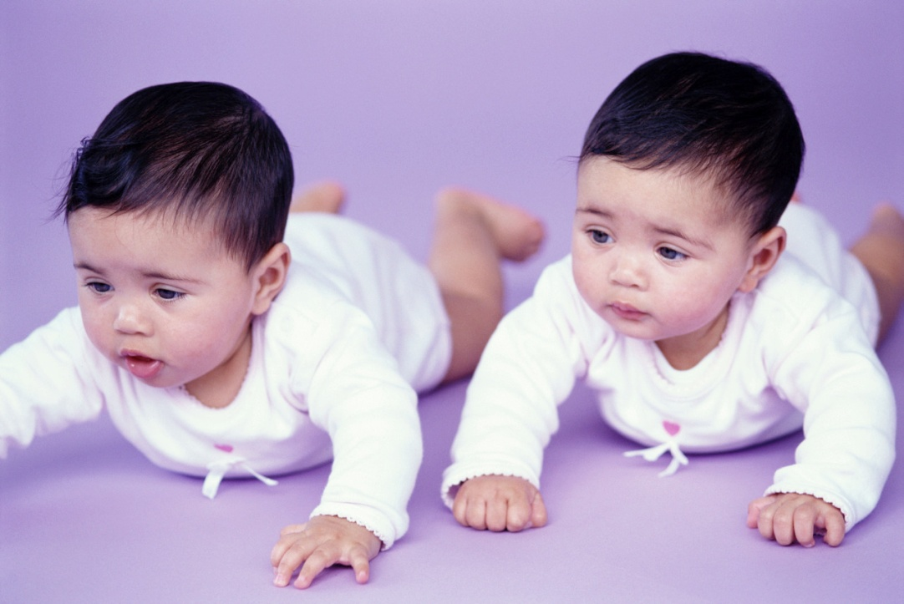
Do the Cross Crawl – Brain Technique
10. Crawling as an infant helps the child to develop their reading and math skills.
  As they crawl, neurons in the brain are connected that enable higher learning proficiency .
  If the child skips crawling or does not crawl long, provide toys that get them crawling around ie:cars

Slide 25
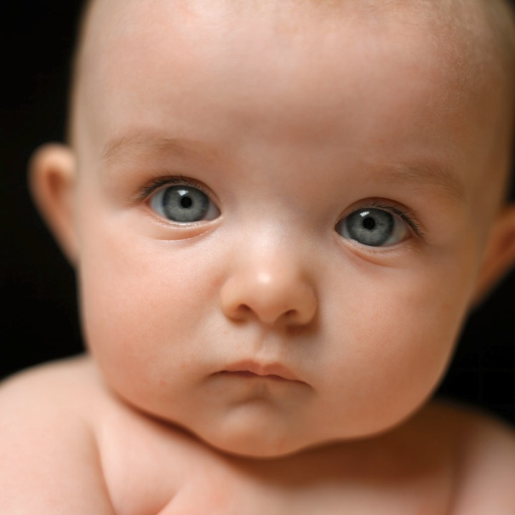
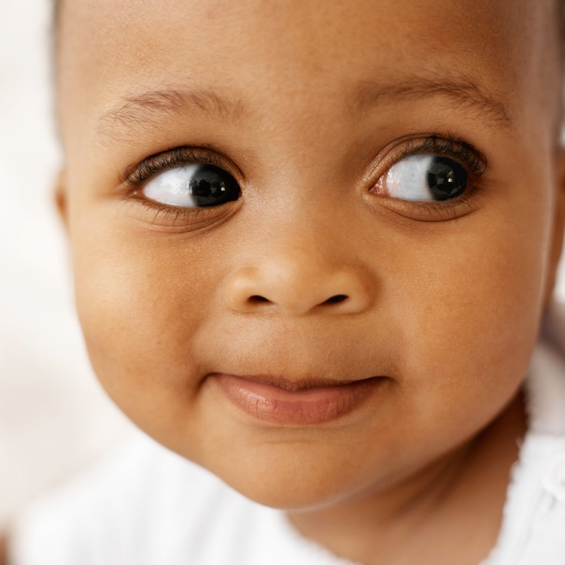
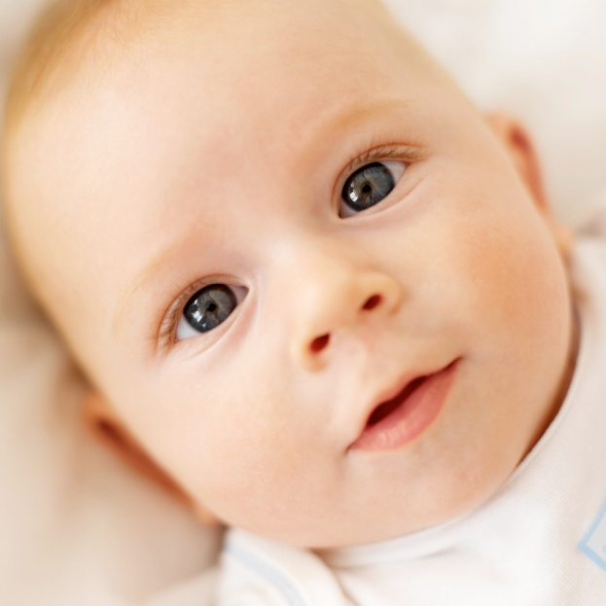
11. Communication
Crying is a baby’s first means of communication, but by the end of the first year, a baby makes special sounds and may even say some words to get their point across.

Slide 26
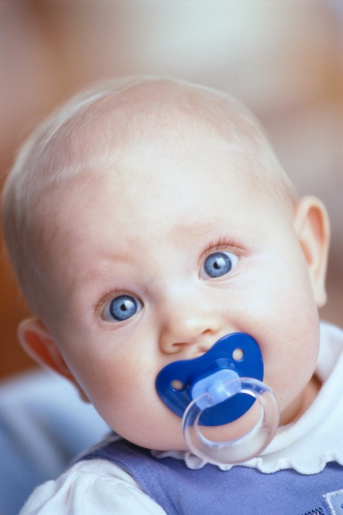
The progression of communication and language development is enhanced by how involved the caregiver is.
1-6 months: crying, cooing, gurgle, squeal, experiment with sounds by changing shape of mouth
7-12 months: babbling (ma ma ma) , more different sounds, respond to own name, adding action to words, connecting words to meanings
12 -24 months single words and putting a few words together

Slide 27
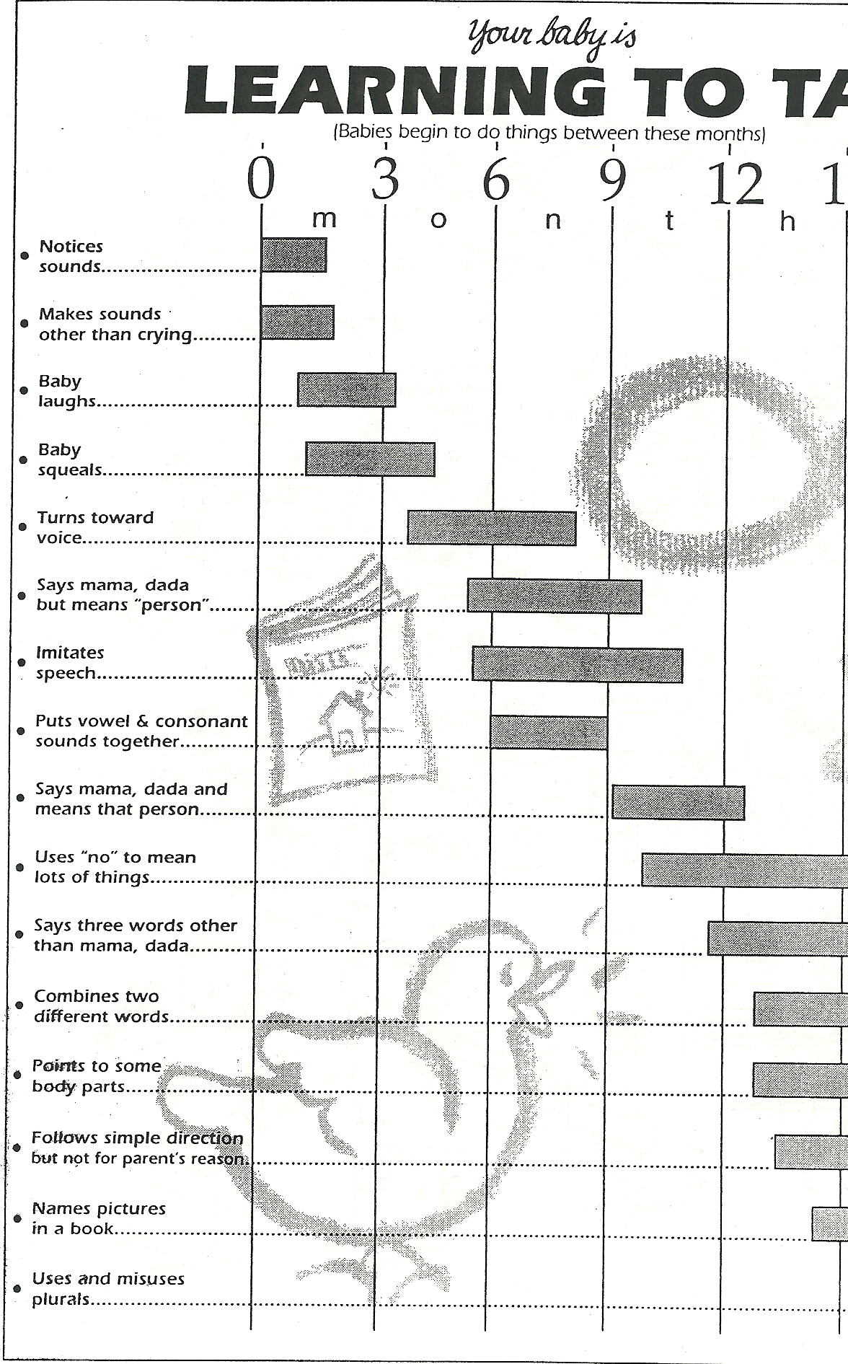

Slide 28
Some language development guidelines?
Learning a Foreign Language
1. Talk to the baby even when the child doesn’t appear to respond – listening/hearing is essential to language development
  Continually talk about objects, actions, surroundings, etc..
  Use simple words, not baby talk
  Use Parentese: talking slower, rhythmical, with exaggerated expressions, simple, and in a higher pitch only during the first year of language development.
  Speaking correctly teaches the child correct speech patterns.
Travel Log
Correct dialogue

Slide 29
Infant Parent Communication
Baby talk
Better Talk
See da yiddle kiddy?
Here’s baby’s baba.
Let’s see smiles for mummykins.
Does my baby want to pway?
Did you get an owie?
Does baby have a tum-tum hurt?
Look at da oink-oink.
Did you go tinkle?
See the kitten.
Here is your bottle.
Can you give me a big smile?
Let’s play a game.
Did you cut your finger?
Does your stomach hurt?
See the pig.
Is your diaper wet?

Slide 30
2. Allow the child to talk to you and to respond back to you.
  Encourage babbling by responding to and imitating the baby’s sounds
  Give positive feedback for sounds and words
3. Be an excellent listener – give your complete attention when they speaking.
  Make eye contact with the child when you or they are talking.

Slide 31
Reflection #4
What is your first memory of you childhood? Explain

Slide 32
Last Day Infant lab child activities
Must Do
Your choice
Clothing evaluation form.
Place in notebook
Complete at least 2 activities.
Complete the DAPLA analysis form for 2
Place in your notebook

Slide 33
Reality Baby Time!!
Reality Movie and Forms

