Slide 1
Design Details
Dress Styles, Neckline Styles, Collar Styles, Sleeve Styles, Shirt Styles, Pants, Jackets & Coats

Slide 2
Dress Styles
Dresses have the been the main item of female clothing in the Western Hemisphere for centuries.
Dresses were once called a robe or gown.
Sheath, shift, empire, dropped waist, shirtwaist, princess

Slide 3
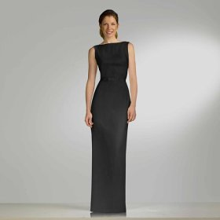
Sheath Dress
A close fitting dress that is shaped by darts

Slide 4
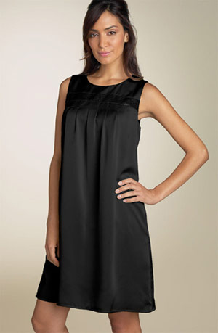
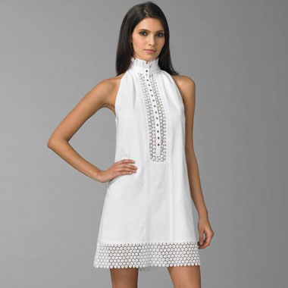
Shift Dress
A loose fitting dress

Slide 5
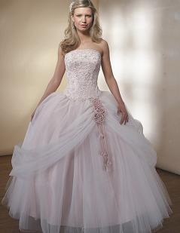
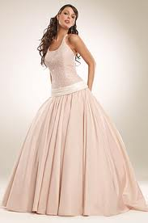
Princess Dress
A close fitting, flared dress that is shaped by seams

Slide 6
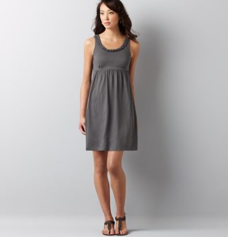
Empire
Waistline right under the bust

Slide 7
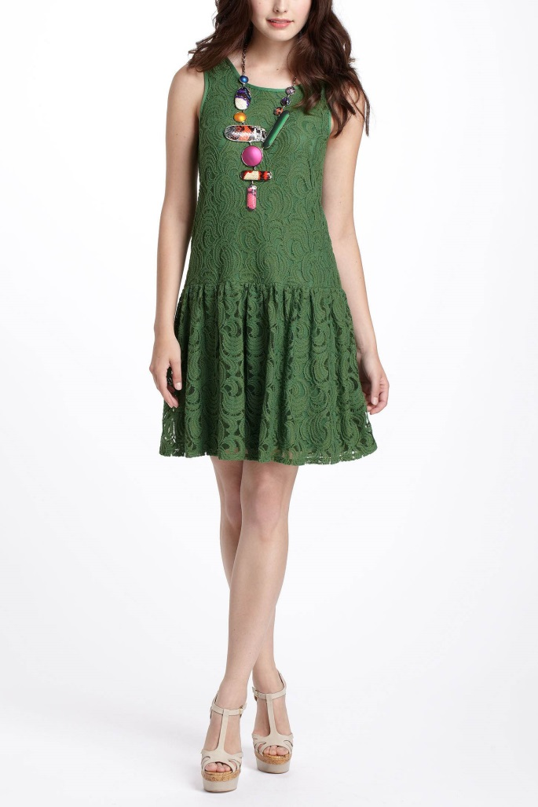
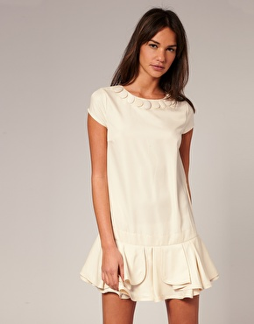
Dropped Waist

Slide 8
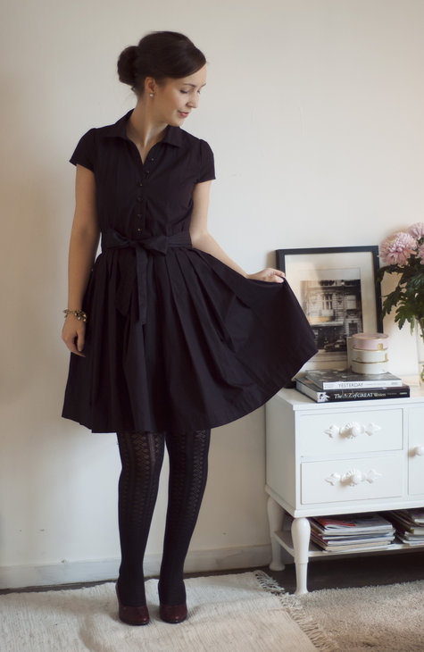
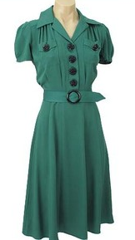
shirtwaist

Slide 9
Neckline Styles:
A neckline refers to the area around the neck and shoulders.
Before the 20th century, garments from the same period all had similar necklines.
Today fashion features many different types of necklines in a season.
Jewel, scoop, crew, boat, sweetheart, cowl

Slide 10
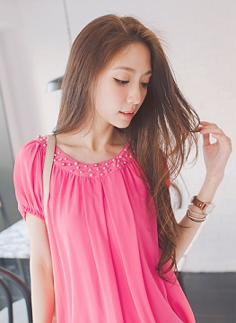
Neckline Styles:
Classic Styles:
Jewel: Round neckline that makes a good background for jewelry.
Crew: High, round neckline finished with a knit band.
Cowl: Part of the dress that is cut on the bias for better drape.

Slide 11
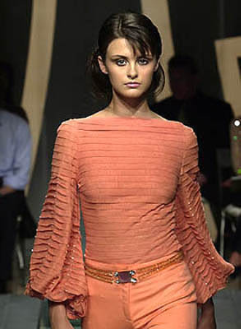
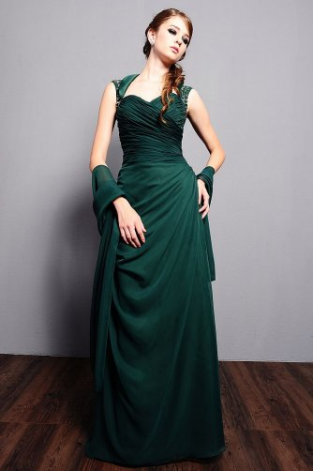
Neckline Styles:
Classic Styles:
Boat (Bateau): French word for boat.
Sweetheart: Moderately low and heart shaped in front.
Scoop

Slide 12
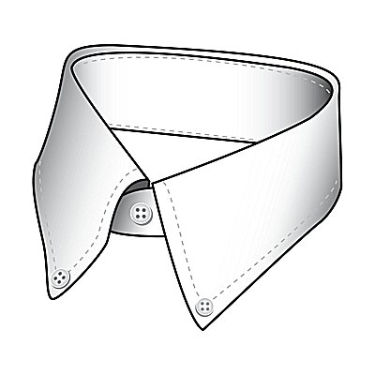
Collar Styles
A collar is a separate piece of fabric that is attached to the neckline of a garment.
It can be small or large, stand-up or fold-over, soft or stiff.
Most collars are permanently attached.
Shirt, button-down, peter pan, mandarin, notched

Slide 13
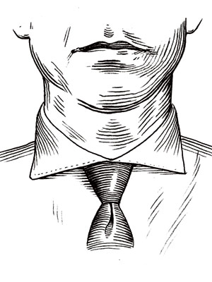
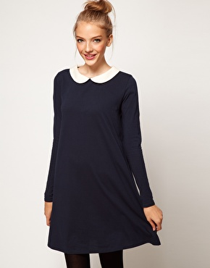
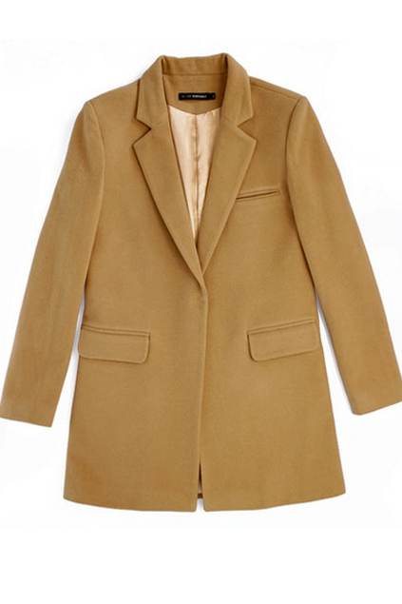
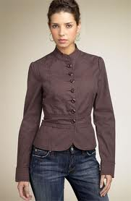
Collar Styles
Classic Collar Styles:
Button Down Collar
Peter pan
Notched Collar
Mandarin

Slide 14
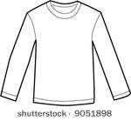
Sleeve Styles:
Primitive clothing had sleeves that were cut with the garment in one piece.
In the middle ages, the set-in sleeve became popular.

Slide 15
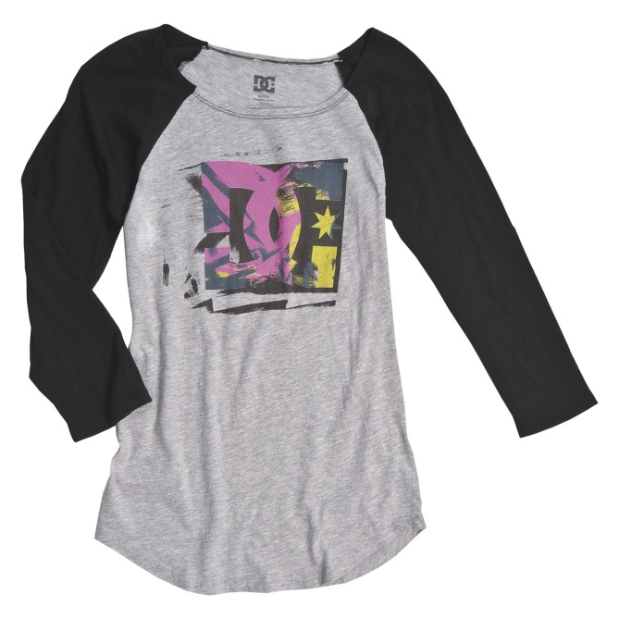
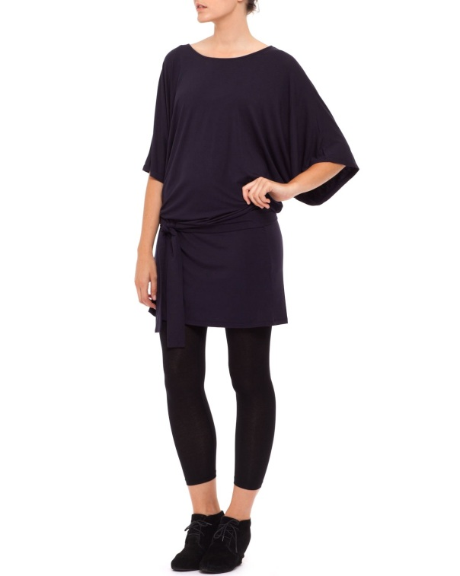
Sleeve styles
Raglan Sleeve: Front and back diagonal seams that extend from the neckline to the armhole.
Dolman Sleeve (kimono): Cut in one piece with the front and the back of the garment.

Slide 16
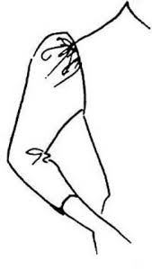
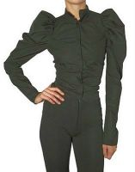
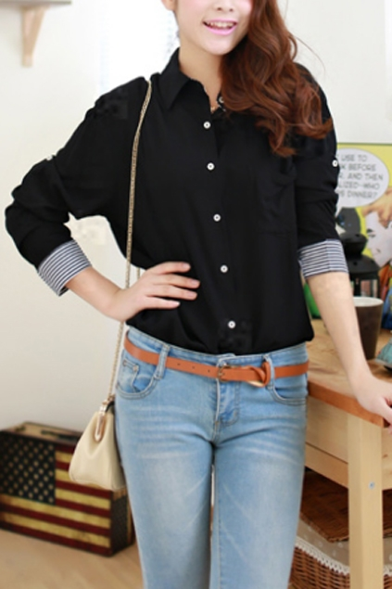
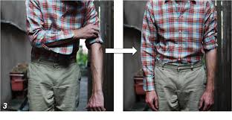
Sleeves
Leg-o-mutton
Shirt cuff
French cuff

Slide 17
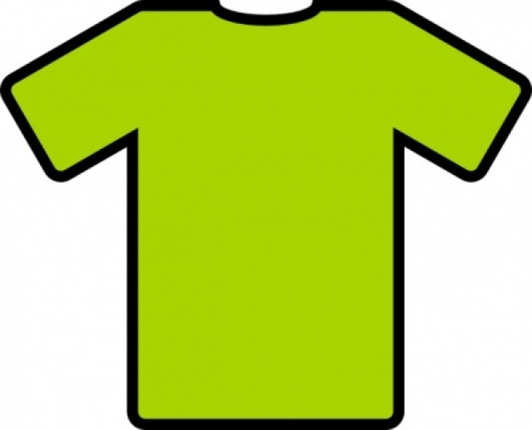
Shirt Styles:
The term shirt is usually used to describe a piece of clothing that is more tailored than a blouse.
T-shirt, Henley, polo, dress, fitted, tuxedo

Slide 18
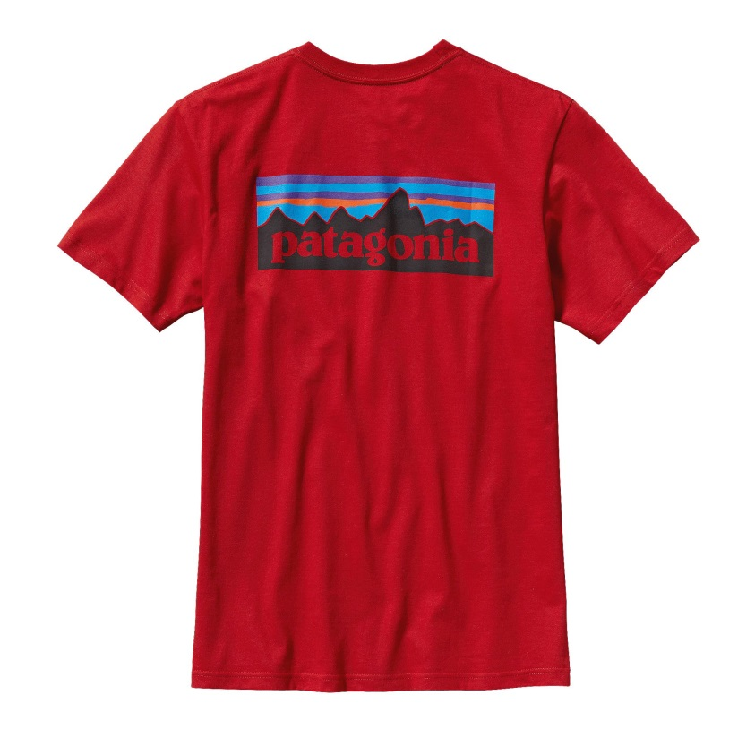
Shirts
T-shirt
Henley
Polo

Slide 19
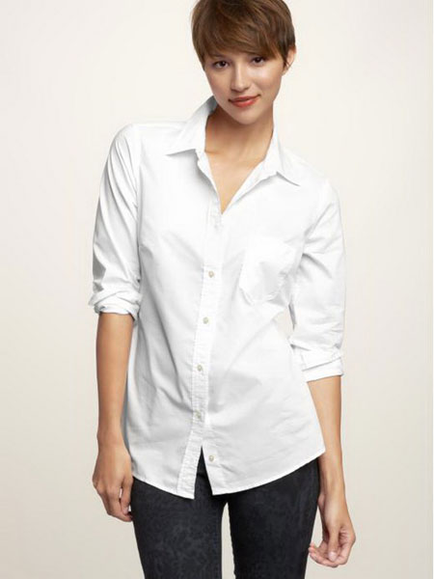
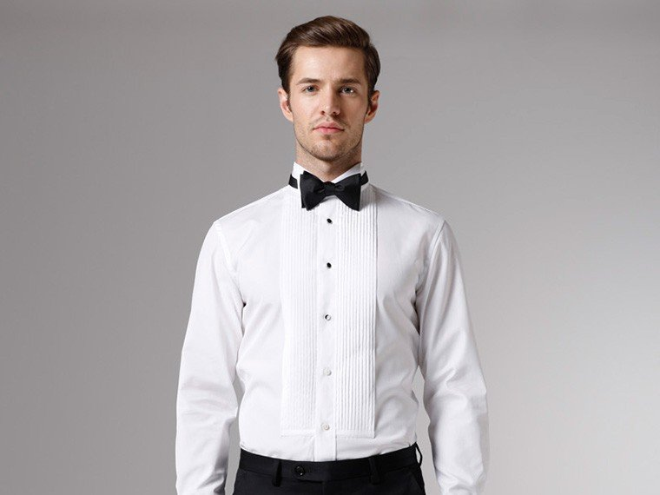
Shirts
Dress
Fitted
Tuxedo

Slide 20
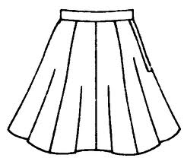
Skirt Styles
Today a skirt is described as a separate piece of clothing that can be worn with any style on top.
From Medieval times until the 18th century, dresses were usually made with separate skirts and bodices.
In the 1870’s, women began to wear tailored suits with separate skirts and jackets.
Straight, a-line, yoke, gored, gathered, wrap

Slide 21
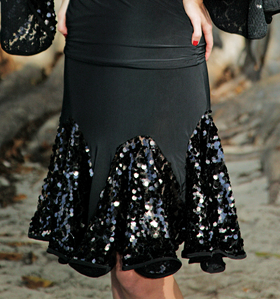
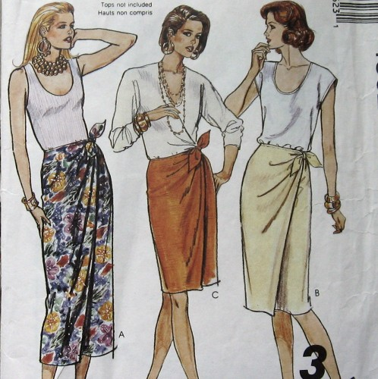
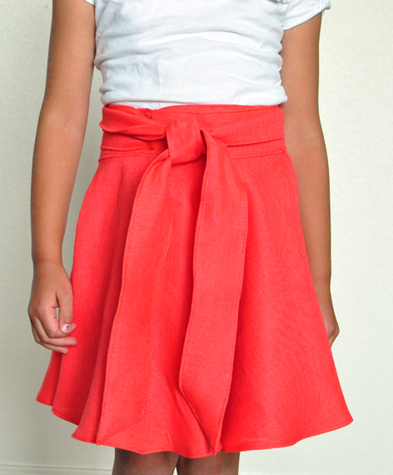
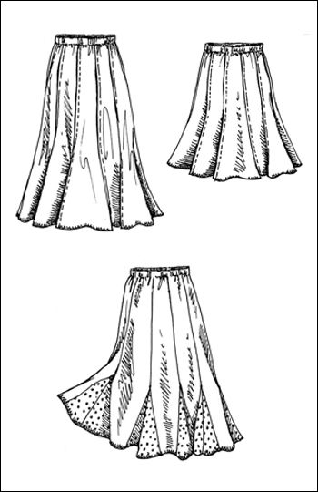
Skirt styles
Gored
Wrap

Slide 22
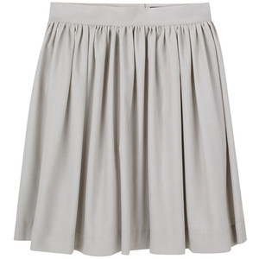
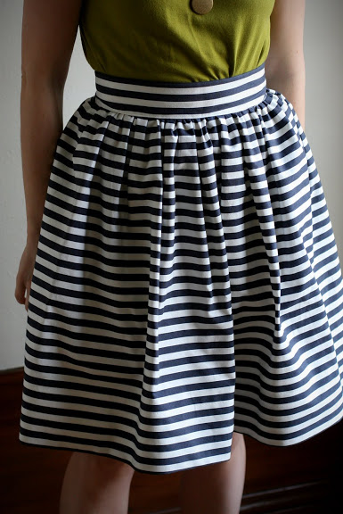
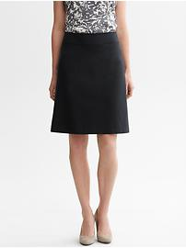
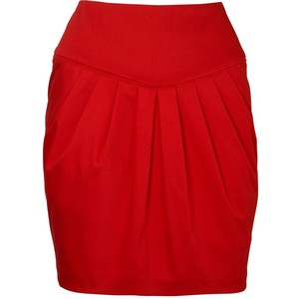
Skirts
Gathered
Yoke
A-line

Slide 23
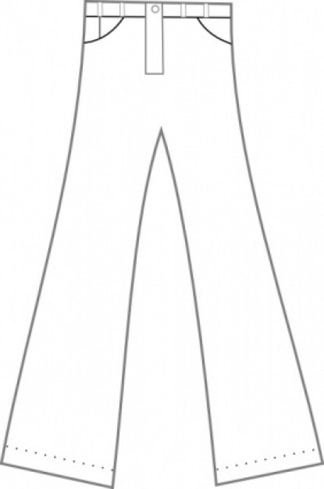
Pants
In ancient times, Persian and Anglo-Saxon men wore pants.
However, the pant was not used again until the late 1800’s.
At that time, “pants” meant outer garment worn by men and boys.
Flared, bootcut, straight, tapered

Slide 24
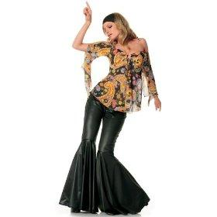
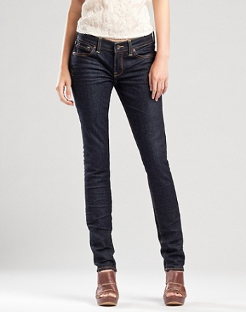
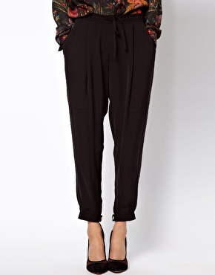
Pants
Flared/Bootcut
Straight (skinny)
Tapered

Slide 25
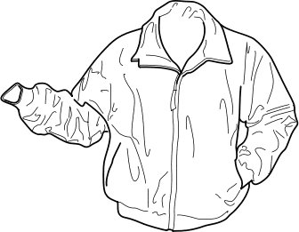
Jacket and Coat Styles
Coat, comes from the English word, cloak, which means large piece of fabric.
Jacket, comes from the French word, jaquette, which means little coat.
Today a jacket usually means an outer layer of clothing that is hip length or slightly longer or shorter.
Blazer, double breasted, bolero,
tuxedo, Chanel, trench, pea

Slide 26
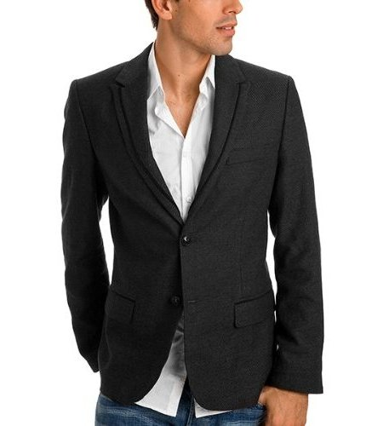
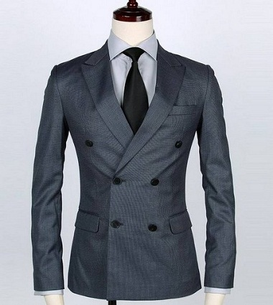
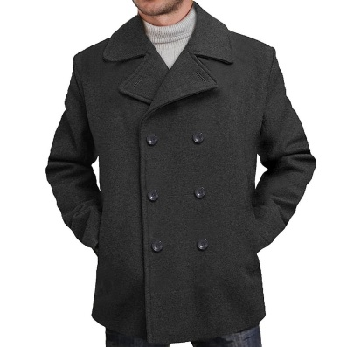
Jacket and Coat Styles
Blazer: a solid colored jacket that can be single or double breasted.
Double Breasted
Pea

Slide 27
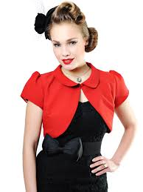
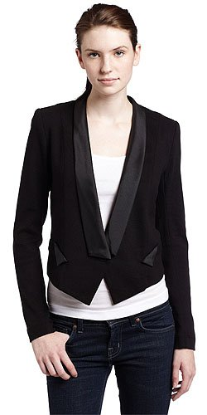
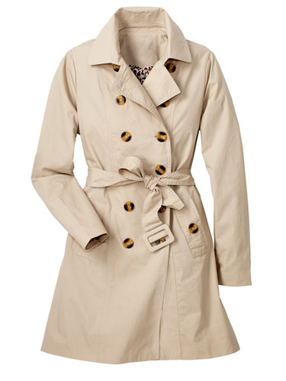
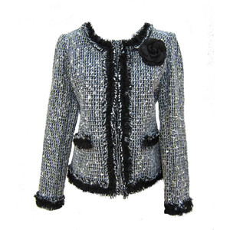
Jackets
Bolero
Tuxedo
Trench
Chanel

Slide 28
Paper Dolls
Pick 6 different Design Details from this lecture that you will incorporate into your own designs.
Take 3 cardstock dolls and incorporate 4 design details for each outfit. Identify on the back of the outfit what design detail you incorporated.
Must be colored and showcase your nicest work.

Slide 29
“My Own Line”
You need to get used to designing and drawing outfits! We will be doing a big project called “My Own Line” where you will develop your own line of designs like a real fashion designer. Use this paper doll assignment as a good practice for projects that are coming up!

