Slide 1
Fashion History
1950
1960
1970
1980
1990
2000

Slide 2
1950’s: Hourglass Silhouette
The silhouette of the 50’s is the Hourglass- accented lower half.

Slide 3
1950’s Influence of History
Baby Boom
Rock n’ Roll
Cold War

Slide 4
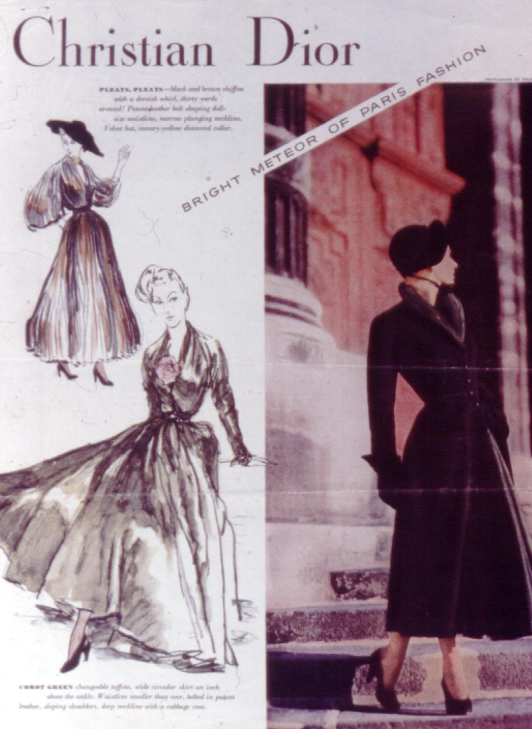
The New Look
In 1947, a French designer, Christian Dior launched what he called “The New Look.” The war was over, the men had returned home, and The New Look gave women a softer, more feminine look and curve. This look was stylish, elegant, and reflected the opposite of wartime restrictions. The hemlines fell to just above he ankle and skirts were incredibly full. Yards and yards of fabric were used as well as petticoats with crinoline and flounces of lace. The shoulder pad was dropped with a thud and the sloping, soft shoulder replaced the squared, manly look. The bustline was accented; the waistline was high and cinched in again.

Slide 5
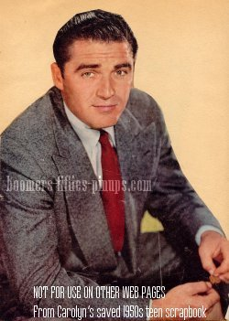
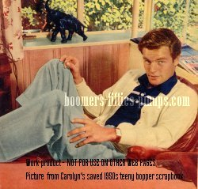
1950’s Men’s Fashion
Cardigan Sweaters
Hats
Flannels suits:
Charcoal Gray
Navy
Brown

Slide 6
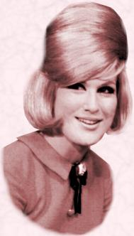
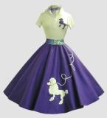
1950’s- Teenage Fashion
Separation of the Generation
Poodle skirts, bobby socks, sweater sets, saddle shoes, capri’s (clam diggers)
Jeans, t-shirt, leather jacket, converse- greaser
Chino’s, button down shirt, loafers
Hairstyles included: ponytails and beehives.

Slide 7
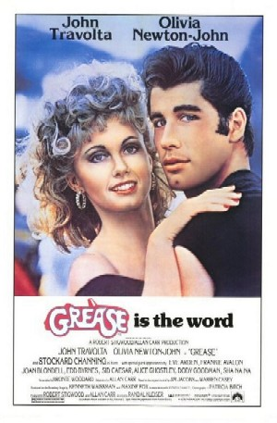
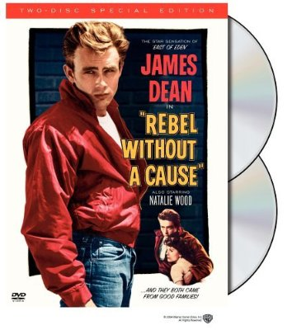
Movies that represent the 50’s
Rebel Without a Cause
Grease

Slide 8
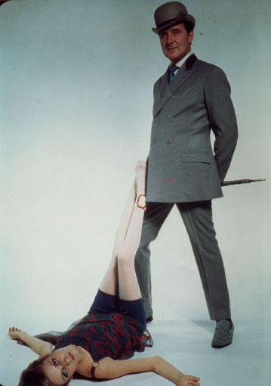
1960’s: Tubular Silhouette
Twiggy was the top model. She was long and lean, which was a break from the fleshed Edwardian beauty seen in some form up through the 1950’s

Slide 9
1960’s Influence of History
Civil Rights
See slide following
Vietnam Conflict (1961-1975, American Involvement)
See slide following
British Invasion
It was called the “British invasion” but it wasn’t a reference to the military, but rather an invasion of American culture. The music, fashion, hairstyles, and make-up, to name a few were transferred across the Atlantic and took the 60’s by storm.
The “Mod Look” brought to the United States by the Beatles and other musical groups.

Slide 10
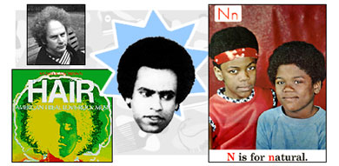
Movements of the 60’s Civil Rights
The Civil Rights Movement sparked an impressive move to ethnic fashion. Blacks and whites alike found interest in the African colors and prints. Afro hairstyles were worn by most blacks and some whites used perms to get the Afro hairstyle. Some Afros could be measured at 3 inches above the scalp going straight up and straight out. Most were shorter and more natural looking. The expression of the day was “Black is Beautiful.”

Slide 11
The Peace Movement
The Peace Movement (or anti-Vietnam War Movement.) The Vietnam War was not anywhere as popular or supported as the two world wars had been. This war had the opposite effect on the country; instead of pulling the country together to save resources, the country was pulled apart. Everyone took sides. The teenagers who revolted against the war and the “established” way of living, and working were called “hippies.”
The hippie dress was a throw back to the beatniks of the 1950’s. It was a casual, sometimes sloppy dress. The main focus was self-expression. Whatever you wanted to wear, you wore. The hippies were not a majority of the teenagers, it should be noted, although some of the fashions spilled into the mainstream teen fashion.

Slide 12
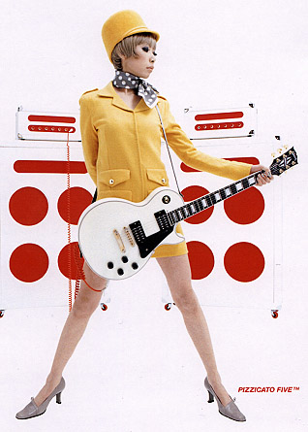
1960
Everything seemed to go. The length might be mini, micro-mini, midi, or maxi. Even mixing these lengths was fashionable; a mini skirt with a maxi coat or vest.
The “warbabies” or Baby Boomers, infants born immediately after the war ended in 1945, were maturing. By 1960 teenagers were a powerful group. In France, by the 1960’s one-third of the population was under the age of 20. In the United States, fully one-half of the population was under 25. This enormous group of energetic young also had their own minds for fashion and were not dictated to by Paris or by anyone else.

Slide 13
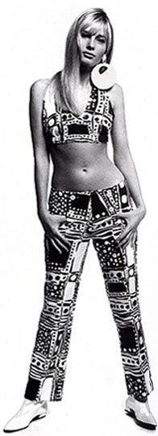
1960’s
The 60-70’s catered to the youth both in advertising and production in the clothing industry. Teenagers had money to spend (3.5 billion on apparel in 1965,) and enjoyed keeping up with the latest trends.
During these years two sets of fashion developed side by side: fashion for the young and fashion for the rest of society.
The binki makes it’s first appearance.

Slide 14
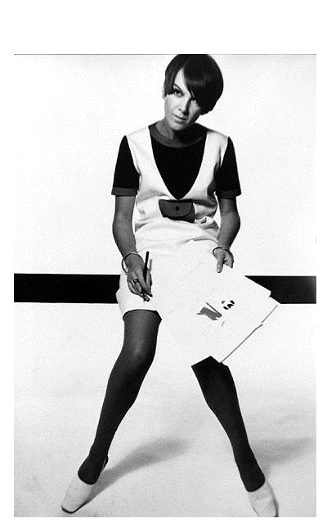
The Invention of the MINI skirt
The mini was one fashion that hit early in the 60’s. It was the design of Mary Quant from Wales. She is regarded as the mother of the mini and high boots; shoulder bags and the “poor boy” sweater. “Pop” and “Mod” were terms also borrowed from the British to describe fashion of this time.
Another word used to describe the 60’s is psychedelic. It was at least true for the colors and fabrics of that time.
Floral patterns reflected the “flower power” theme of the hippie movement. Daisies, mums, and other flowers adorned everything from fabrics to wallpaper, from busses to vans. The colors were bright and bold.
Mary Quant

Slide 15
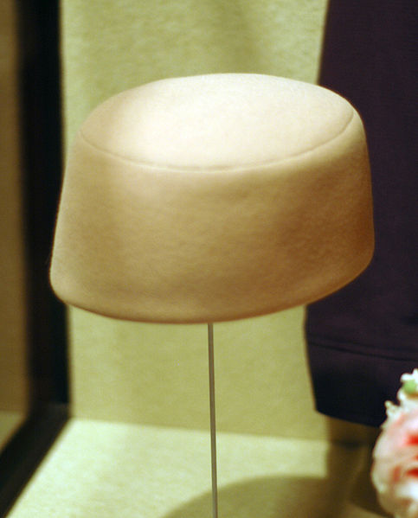
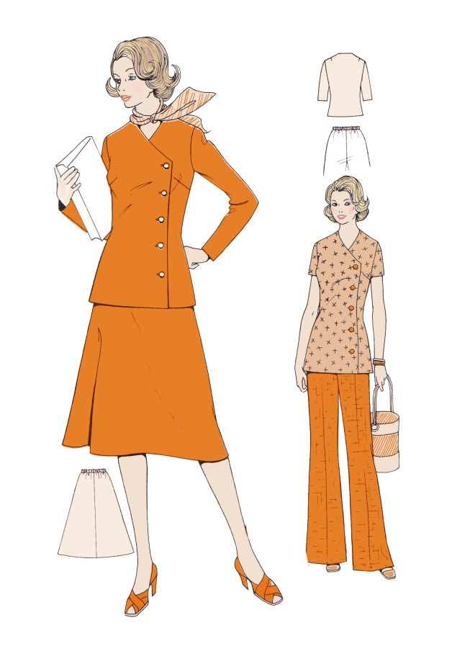
1960 Fashion
Jackie Kennedy Look
Pillbox hat

Slide 16
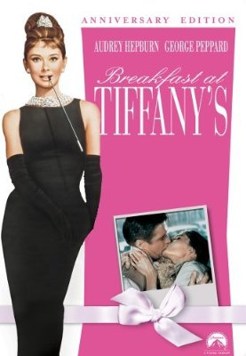
Movies about the 60’s
Breakfast at Tiffany’s
Forest Gump
Hairspray

Slide 17
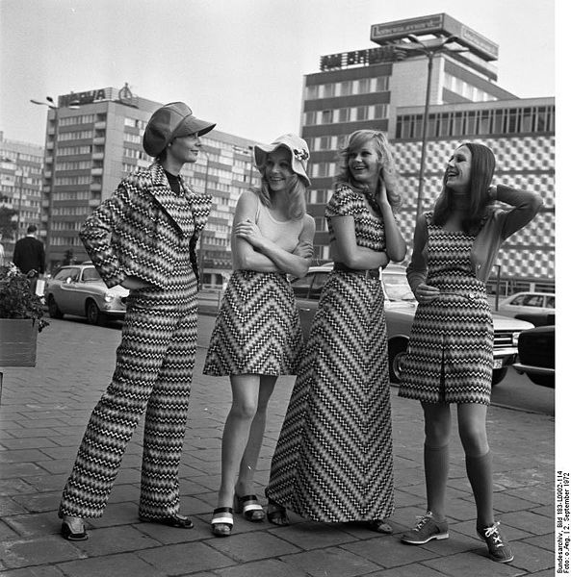
1970’s: A-line Silhouette

Slide 18
1970’s Influence of History
Hippy to Disco
Energy Crisis
Watergate
Some men’s suits were fashioned in 100% polyester and marketed as the wash and wear suit. It was called the “leisure suit” and had a brief moment in time. It was very casual with buttons down the front, patch pockets, and bell bottoms. It was comfortable and easy to care for, as well as being wrinkle-resistant.

Slide 19
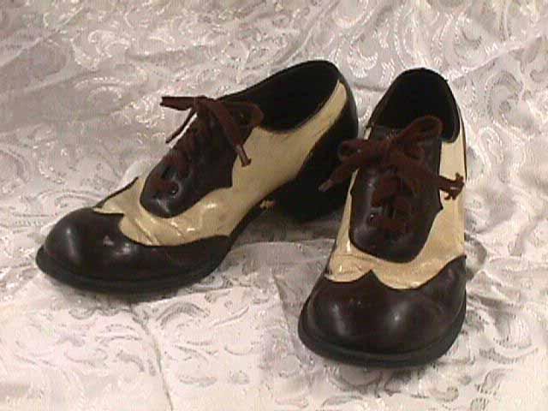
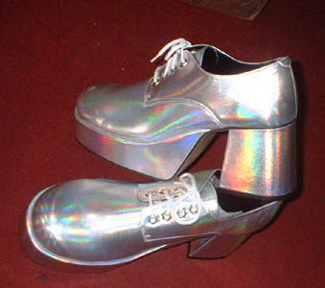
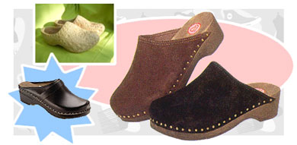
1970’s SHOES
For women: platforms and clogs.
For men soft leather or leather with contrasting designs.

Slide 20
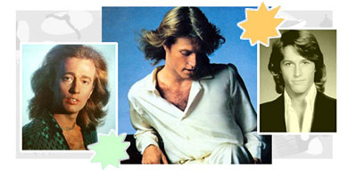
Hippies
The hippie influence was still seen in bright beads, embroidery on shirts, Levi pants and jackets, and tie-dyed fabrics. Long hair was a hot topic; first seen as a sign of rebellion, and later accepted as fashionable, “in moderation.” Sideburns were worn long; beards and moustaches were popular for both teenagers and their parents.
Bee Gees

Slide 21
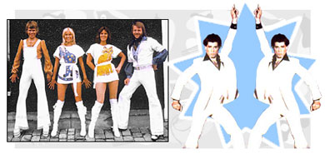
Disco Fever
Teen styles were extreme. Pants were worn skin tight; hip hugger pants and skirts were worn with hip belts; a wide bell bottom style was popular n pant legs and sleeves. In the early 70’s cuffs on trouser style pants for both men and women were reintroduced.
Pant legs got wider and wider and were worn long enough to cover the shoe and scrape the floor. Platform shoes got higher and higher with very chunky heels.

Slide 22
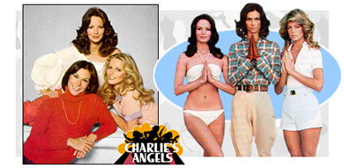
1970’s Hair
Hair for teenage girls… the longer and straighter the better. Orange juice and soup cans were recycled into curlers to straighten out hopelessly wavy or curly hair. If the cans didn’t work, then girls tried to iron their hair straight. Full bangs were worn long enough to cover the eyebrows, but not long enough to merge with the false eyelashes.

Slide 23
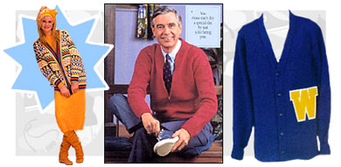
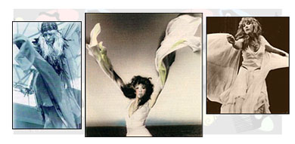
From Conservative to Dramatic
Angel sleeves shown below are yards of fabric added on the sleeve for a dramatic look.
In contrast, cardigans
are also in style during
this time, especially on
Mr. Rodgers!

Slide 24
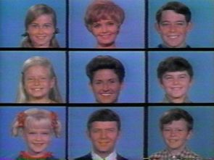
Movies that represent the 70’s
Brady Bunch

Slide 25
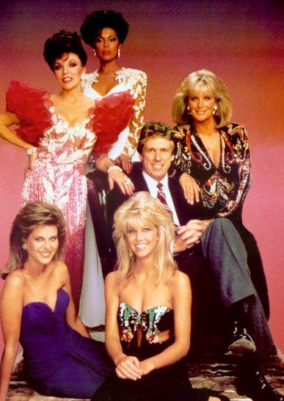
1980’s: European “V” Inverted Triangle
This was the decade when women wanted it all; husband, children, career. And time for self expression. All of these needs required special clothes
Shoulders were severely padded in the mid 80’s. Shoulder pads appeared in everything; blouses, sweaters, robes, t-shirts, and dresses. Exaggerated lapels and flared jackets were also stylish.

Slide 26
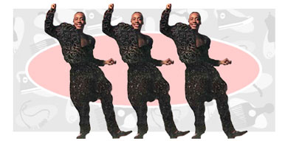
1980’s Influence of History
Me Generation
YUPPIE
Conspicuous Consumption
Conservatism

Slide 27
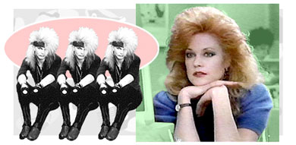
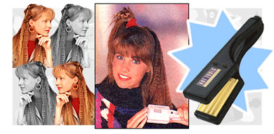
1980’s - the HAIR!
The bigger the better would explain the hair of this period. Hairspray and ratting were an everyday need to obtain the height of the time. Bangs were very popular and often lifted many inches above the scalp.
Crimping hair was very popular as well.

Slide 28
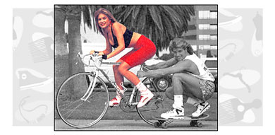
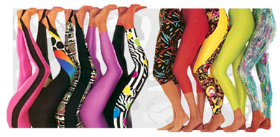
1980’s Fitness Craze
Spandex was in; comfort and function were paramount. Lycra in bright colors worn with “leggings” and thick socks pushed down to the ankles in puddles, was the preferred fabric for aerobic exercises.
The old “gym shoe” was replaced with 100 or more different kinds of specialized sports shoes. Whatever you planned to do, there was a special shoe to do it in.

Slide 29
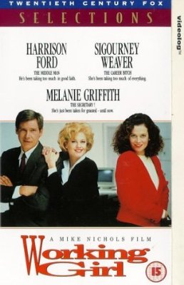
1980’s Working Girl
During the 1980’s many women continued in or joined the work force. In order to be taken seriously by some, women needed a better fashion image at he office. The “power suit” was designed. It was a broad-shouldered lapel jacket worn with a white or light colored blouse (feminine but not too sexy or lacy)’ a skirt was worn with the jacket. Pants were seen as too casual. The power color for the power suit could be navy, black, gray, burgundy, but not brown. Pump shoes were appropriate; not too high for the heels but not completely flat either.

Slide 30
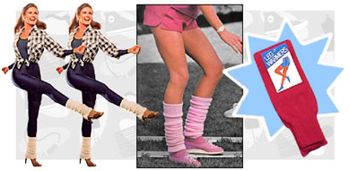
1980’s Valley/Material Girl
Colors in women’s dresses were very rich; fabrics were fluid and flowing. Rayon, improved by new technology during the 70’s was a very popular fabric. Ramie was a popular natural fabric added to cotton or acrylic for luster.
The oversized shirt, sweater, and sweatshirt look was in. Some were huge through the shoulders, bustline, and waist, and narrowed to the thighs. Some tops were worn long and belted.

Slide 31
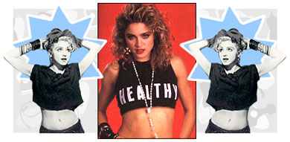
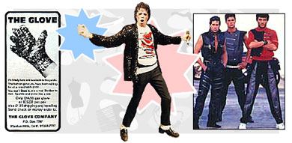
80’sThe Stars Shine Again
Fashions focused on many music stars styles.
Rock star, Madonna, release a video in 1985 wearing ripped jeans, lace, and lacy bustier. That launched the camisole craze worn with jeans, pants, or skirts and jackets. The Punk Look!
Michael Jackson was a hit with his breakdancing and one gloved hand.

Slide 32
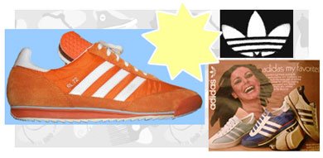
80’s - Couture
The fashion industry became more international.
Many designers turned out up to 20 collections a year.
Mass-market fashion and catalogs got much better.
AIDS thinned out many talented fashion designers.

Slide 33
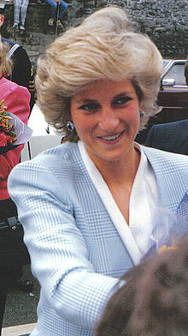
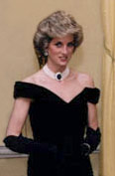
80’s Looking towards a Princess
The Princess of Wales, Dianna was the world’s top cover girl.

Slide 34
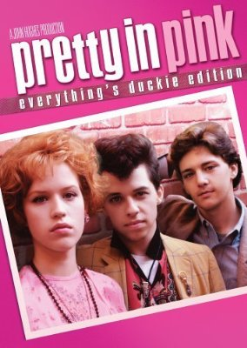
Movies from the 80’s
Some Kind of Wonderful*
Pretty in Pink*

Slide 35
1990’s: Triangular Silhouette

Slide 36
1990’s Influence of History
Age of Electronics
Cell phones become very inexpensive and everyone starts to buy in. They are not only for communication but become an accessory and have their own accessories! Bags and purses are created to carry the new found necessity.
Technology
Internet

Slide 37
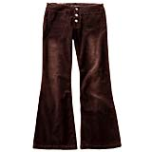
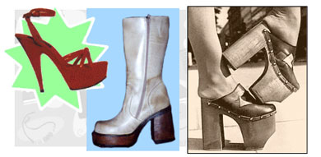
1990’s – A-Line
Like the sixties any length of skirt was in. Long flowing a-line skirts become fashionable again.
The 90’s borrows fashions from the 60’s and 70’s especially.
Platforms return!
Bell-bottoms and flares are back!

Slide 38
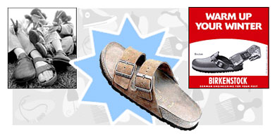
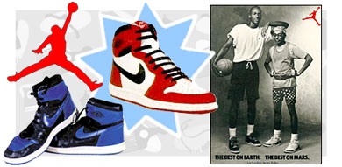
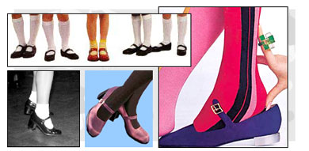
90’s – Shoe Obsession
Shoes are bought for every purpose. The decade starts with a natural carefree Birkenstock and comfortable sport shoes and ends with platforms and Mary Janes.

Slide 39
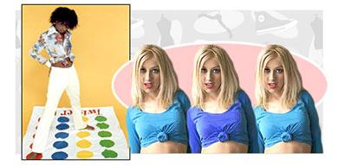
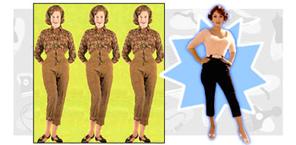
90’s – The Bare Midriff
Shirts are cut short and the hip huggers of the sixties return. This time the hip huggers leave skin to be seen.
The fifties are seen in the return of “clam diggers” now called capris.

Slide 40
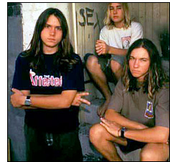
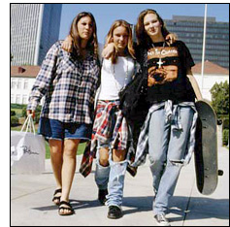
Grunge

Slide 41
Movies from the 90’s
Clueless
She’s All That

Slide 42
2000’s:
What fashions have been seen this decade?
As this decade comes to a close, what are your predictions for the next decade?

