Slide 1
FRUITS

Slide 2
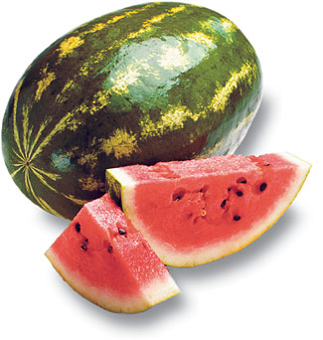
Nutrition
Fruits are 75 – 95% water
Low in fat, sodium and protein
Excellent source of fiber (especially the skins!)
Vitamins/Minerals Fruits Provide:
Vitamin C (Citrus, melons, strawberries)
Vitamin A (Deep yellow and green fruits)
Potassium (Bananas, raisins, figs)

Slide 3
Nutrition, Continued
Choose whole or cut up fruits more often than fruit juice.
Air, Heat and Water Can Destroy Nutrients in both Fruits and Vegetables.
Always wash fruits and vegetables to remove pesticides that might remain on the skin.

Slide 4
Guidelines for Selecting Fruits
Firm
Free From Decay
Crisp
Smooth
Dense
Free From Bruises
Good Color
Good Smell
In Season (Will Be Cheaper)

Slide 5
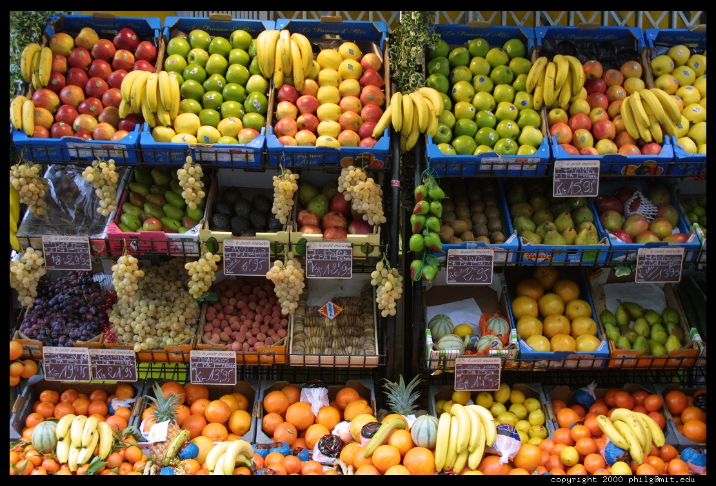
Purchasing and Storing Fruits
Purchasing
Most fruits are sold by weight or by count
Fruits are packed in crates, bushels, cases, lugs, or flats
Storing Fruits In:
Cold (Refrigerator)
Dry
Give Them Space

Slide 6
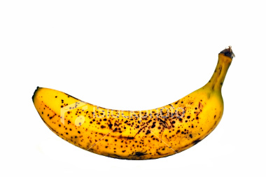
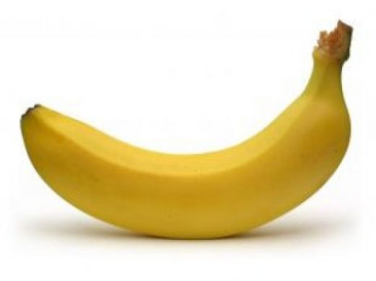
Ripening
Ripening happens when starches found in the fruit break down into sugar (Bananas in the fridge)
This leads to deterioration or spoilage:
Color Lightens
Texture Softens
Decreases in Acidity
Increases in Sweetness

Slide 7
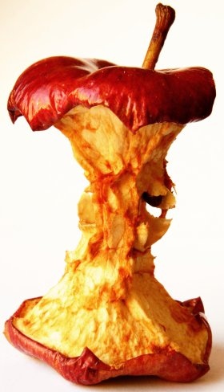
Browning
Browning occurs when the cut surfaces of food reacts with oxygen.
This is called OXIDATION.
To prevent this, cover cut fruits with a liquid containing Ascorbic Acid (Vitamin C).

