Slide 1
Babies and Fathers
In CD file

Slide 2
Bell Work
“Success is often achieved by those who don’t know that failure is inevitable.”
Coco Chanel

Slide 3
Unit 1, Quiz #1
1. Soothing a crying newborn helps it develop a sense of:
A. Self-actualization
B. Trust
C. Independence
D. Being spoiled
2. Which type of cry is the most demanding?
A. Hunger
B. Pain
C. Bored
D. Needing to be changed

Slide 4
Unit 1, Quiz #1
3. When frustrated by a crying infant, all of the following are good for the caregiver to do except:
A. Call a friend/relative to come over and help or just to
talk to them
B. Get frustrated and become out of control
C. Put the baby down in a safe place, close the door, and take a break
D. Run the vacuum, dishwasher, washer and dryer, etc..
4. According to the Abuse Formula, who is a potential abuser?
A. A crazy person
B. Not you
C. A caregiver who is under stress
D. A caregiver with no experience in taking
care of a child

Slide 5
Unit 1, Quiz #1
5. What is SIDS
  A. Shaking baby syndrome
  B. Silly idiots doing something
  C. Sudden infant death syndrome
  D. A normal part of infant development

Slide 6
Health and Wellness Guidelines and Safety Guidelines

Slide 7
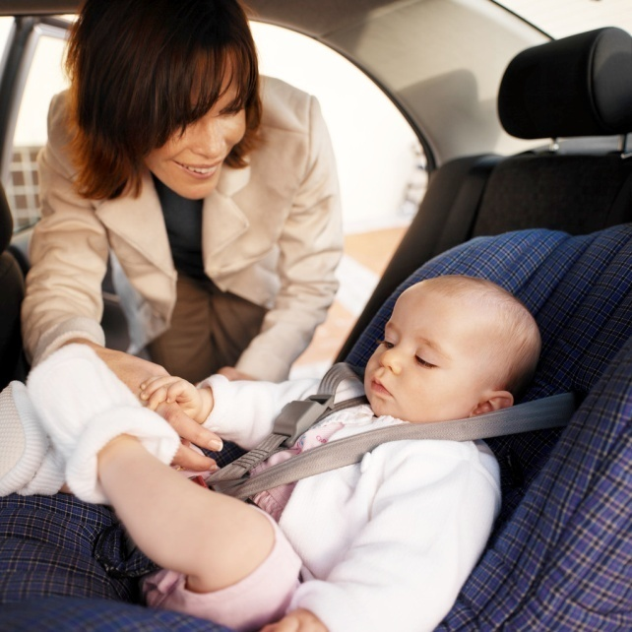
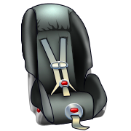
Health and Wellness Guidelines
1. Where is the best place in the car for a car seat?
  Rear facing, back seat, and in the middle of the seat.

Slide 8
2. Explain what ages use what type of car seats?
Explain current safety belt laws.
  Infants – Infant seat from birth to approx 20 lbs and 12 months
  Toddler – Convertible seat from 20 lbs and 12 months until about 40 lbs and 4 years old
  Preschooler - Booster Seat from about 40 lbs and 4 years old until about 8years old, 80 pounds and 4ft 9” tall

Slide 9
Car Seat Video Clip
http://www.youtube.com/watch?v=mU8xiMIINhA&safety_mode=true&persist_safety_mode=1
http://www.youtube.com/watch?v=D8wENE3HdZY&safety_mode=true&persist_safety_mode=1

Slide 10
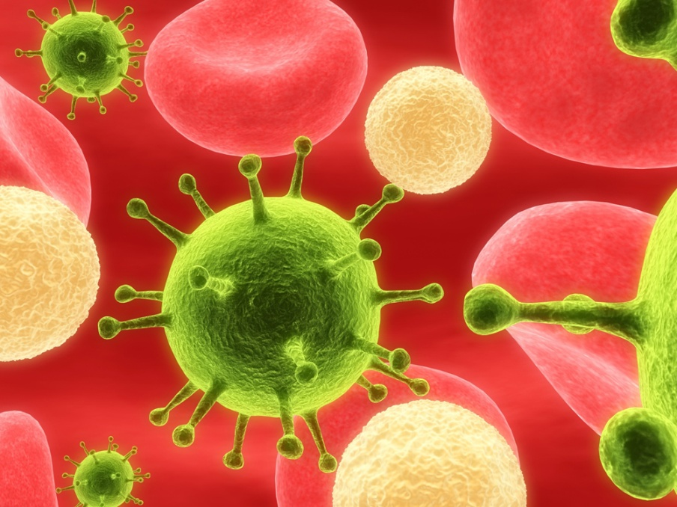
3. What are communicable diseases?
Diseases that can be passed on to other people.
  Polio,
  Chicken pox,
  Hep A and B,
  Rubella

Slide 11

4. Why do kids receive immunizations?
  To prevent communicable diseases from being passed on to others

Slide 12
5. What are the 6 main immunizations that children receive?
Polio, DPT, MMR, HIB, Hep B, Chicken Pox

Slide 13
Immunizations
Kids receive immunizations to prevent communicable diseases from being passed on to other.
Immunization=is the process by which an individual's immune system becomes fortified against an agent
Communicable Diseases:
  Diseases that can be passed on to other people.
    Polio, Chicken Pox, Hep A and B, Rubella

Slide 14
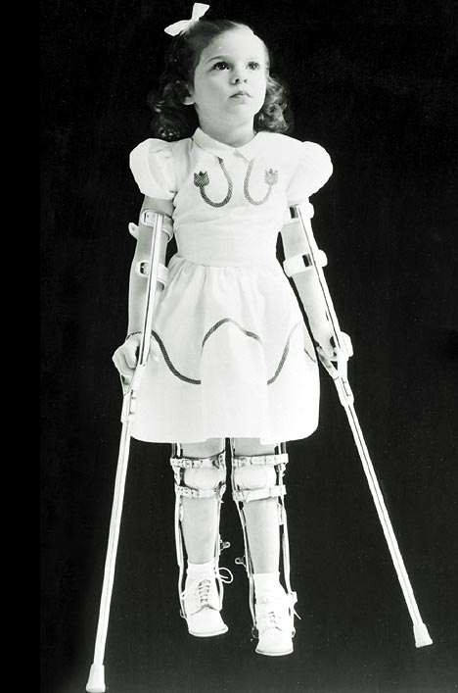
Six Immunizations for Children
Polio~ viral disease that
can damage the nervous
system and cause paralysis
Polio virus enters the body through the mouth, usually from hands contaminated with the stool of an infected person
Cases in the US are rare now

Slide 15
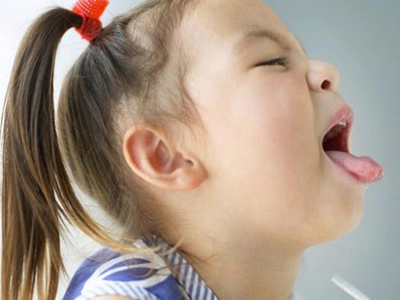
DPT
Immunization to protect against Diptheria, Pertussis (whooping cough) and Tetanus.
Given in a series of shots at 2,4,6 and 18 months of age, and 4-6 years of age

Slide 16
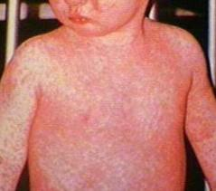
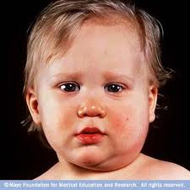
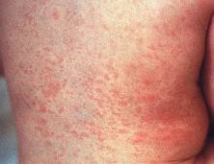
MMR
The MMR vaccine is an immunization shot against measles, mumps and rubella

Slide 17
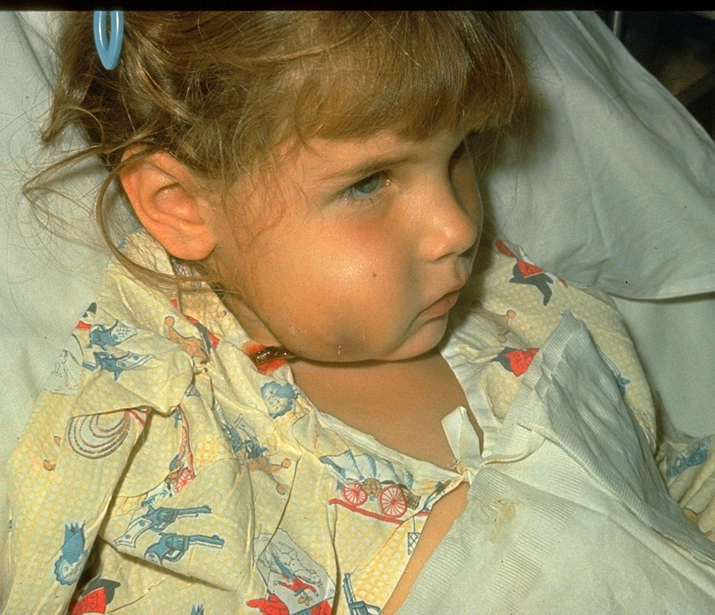
HIB
Hib is a bacterial infection which mainly affects children under five and can lead to life-threatening meningitis and pneumonia. Safe and effective Hib conjugate vaccines were first licensed in the early 1990s and are now being introduced in GAVI-eligible countries

Slide 18
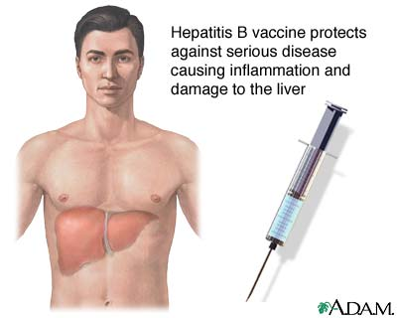
Hep B
Hep B is a vaccine developed for the prevention of Hepatitis B virus infection

Slide 19
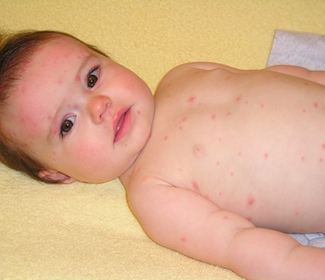
Chicken Pox
chicken pox is a highly contagious illness caused by primary infection with varicella zoster virus (VZV). It usually starts with vesicular skin rash mainly on the body and head rather than at the periphery and become itchy raw pockmarks which mostly heal without scarring

Slide 20
Common Reactions
Fever
Cranky
Red Bumps

Slide 21
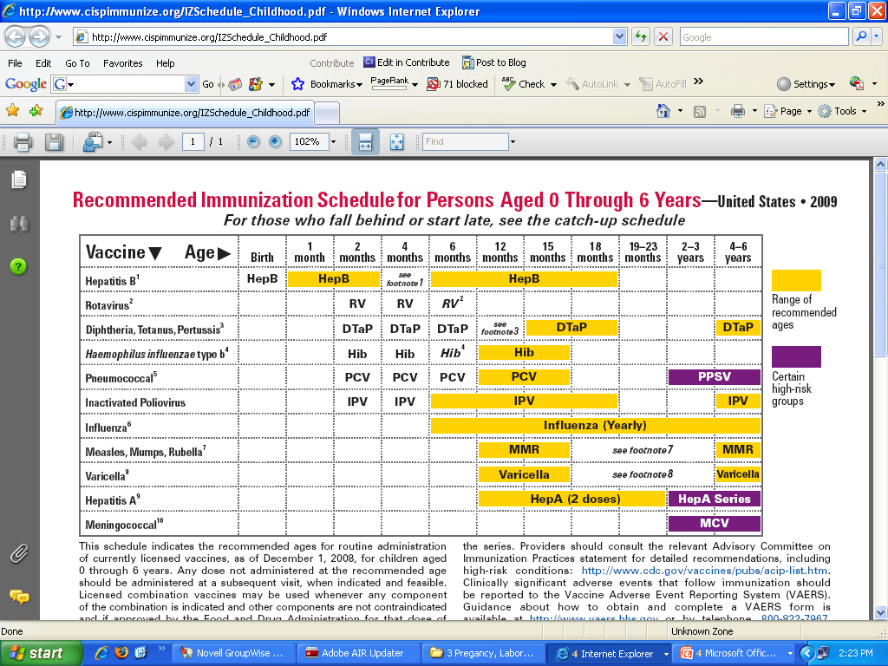

Slide 22
For Photos
http://www.aap.org/pressroom/aappr-photos.htm

Slide 23
Immunizations
6. Explain common reactions that children may have to the immunization shots.
  Fever,
  Cranky,
  Red bumps

Slide 24
7. Explain the common childhood situations, signs and symptoms and care.
Bee Sting
Insect Bite/Plan Irritation
Burn
Convulsions
Poison
Cut/ Bleeding
Fever

Slide 25
13. Safety in the bath
never leave the baby,
support the head,
wash the diaper area (dirtiest area) last,
use a washcloth to rinse the hair,
no need for special soaps,
no need to wash daily.
wait to bathe until the cord has fallen off,
have all supplies right next to you.

Slide 26
15. Toy Safety Guidelines
Age appropriate
Avoid small parts
Shatter proof
Bright colors
Sounds, shapes, colors ~learning

Slide 27
16.
Allow the child to have freedom to explore and opportunities to develop in all 5 areas by Childproofing the house before the child learns how to
  CRAWL

Slide 28
Feeding the baby
Advantages/disadvantages of breastfeeding
Advantages/disadvantages of formula feeding
  Get into 4 groups~ you have 5-7 minutes to make a list of advantages/disadvantages for your assigned topic.
  You will put your lists on the board.

Slide 29
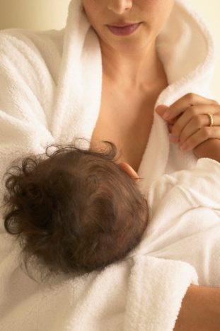

12. Feeding Options
Breastfeeding
  Healthy for baby, easier to digest, always ready to give the baby, can’t overfeed the baby, helps baby’s immune system, helps mom lose weight
  Illness and stress of mom can lessen milk supply, mom’s diet affects milk, lacks iron and fluoride, no one else can help feed

Slide 30
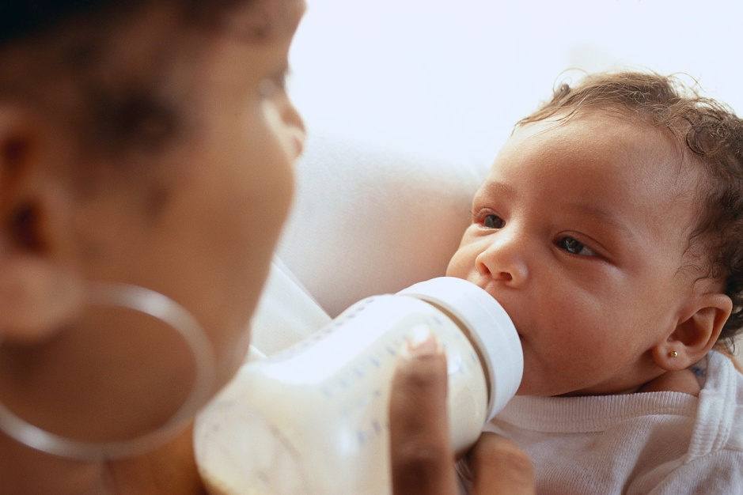
Formula
  Higher in Iron, easier to leave baby, no special clothing for mom, not affected by mom’s diet and life.
  Difficult to digest, prep time, expensive

Slide 31
First Year of Life Booklet
Physical Development
Emotional/Social Development
Cognitive Development
You will need:
  Cover
  6 sheets of paper

Slide 32
DAPLA Time
Yarn Art
  Using one piece of yarn create a design on any color of construction paper.

Slide 33
Reflection #3
How will you/your wife feed you future newborns? Explain your reasoning

Slide 34
8. What is Shaken Baby Syndrome (SBS) and how can it happen?
Brain tissue easily damaged as it moves inside the skull.
Jostling an infant back and forth and playing horsey ride and tossing the kid up in the air can all cause shaken baby syndrome.

Slide 35
You knew your baby would cry. But, did you know how frustrating that crying could be when you have tried everything to comfort your baby, and she just keeps crying? Dealing with a crying baby can be very hard, and parents often don't realize just how frustrating it is until they are in a stressful situation. No one thinks they will shake their infant, but research shows crying as the number one trigger leading caregivers to violently shake and injure babies.
No matter how frustrated you get...
Never Shake a Baby

Slide 36
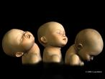
What Happens:
The brain rotates within the skull cavity, injuring or destroying brain tissue.
When shaking occurs, blood vessels feeding the brain can be torn, leading to bleeding around the brain.
Blood pools within the skull, sometimes creating more pressure within the skull and possibly causing additional brain damage.
Retinal (back of the eye) bleeding is very common

Slide 37
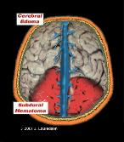
Immediate Consequences:
Breathing may stop or be compromised
Extreme irritability
Seizures
Limp arms and legs or rigidity/posturing
Decreased level of consciousness
Vomiting; poor feeding
Inability to suck or swallow
Heart may stop
Death

Slide 38
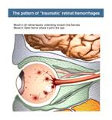
Long-Term Consequences:
Learning disabilities
Physical disabilities
Visual disabilities or blindness
Hearing impairment
Speech disabilities
Cerebral Palsy
Seizures
Behavior disorders
Cognitive impairment
Death

Slide 39
Why…
Babies' heads are relatively large and heavy, making up about 25% of their total body weight. Their neck muscles are too weak to support such a disproportionately large head.
Babies' brains are immature and more easily injured by shaking.
Babies' blood vessels around the brain are more susceptible to tearing than older children or adults.

Slide 40
When…
Often, perpetrators shake an infant or child out of frustration or anger. This most often occurs when the baby won't stop crying. Other triggering events include toilet training difficulties and feeding problems.

Slide 41
9. What are some effects of SBS on a Child?
Cause brain damage.
Sever shaking can cause possible death.

Slide 42

10. What is Sudden Infant Death Syndrome? (SIDS)
Sudden unexplained death of an apparently healthy child. Generally occurs in the first year of life.

Slide 43
Factors Related to SIDS
Use page 4B & 4C in your packet

Slide 44

11. Give some prevention strategies for SIDS.
Having the infant sleep on its back is the most recommended.
Do not smoke or be around smokers,
No stuffed animals or soft bedding.
  Environment
    Sleep positioning
    Breastfeeding
    Co-sleeping
    Secondhand smoke reduction
  Sleeping area
    Bedding
    Sleep sacks
    Pacifiers
    Air circulation with fan use
    Bumper pads

