Slide 1
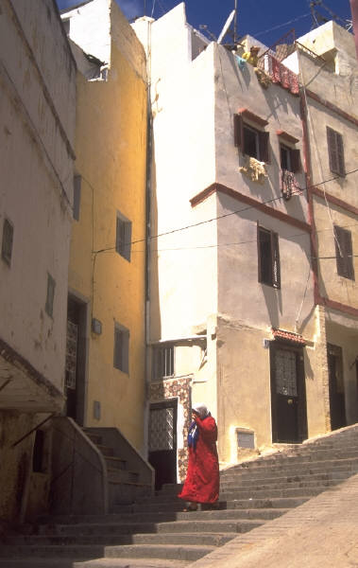
Housing Needs

Slide 2
Think about the house you are living in right now, why did your parents pick that house?
The three main reasons to choose a home
Location
Climate
Cost

Slide 3
Lets talk about cost…
Your house or rent payment should be approximately 25-35% of your monthly take home income
If a family makes 3,000.00 a month, how much should they spend on housing?
If a family makes 12,000.00 a month, how much should they spend on housing?

Slide 4
Other factors to consider when buying a house…
Buying vs. Renting
Local Climate
Topography
Population (age of neighbors)
Culture
Public service availability

Slide 5
City/County Zoning Laws
What is a zoning law?
Regulating the way in which land may be put use.
Some areas may regulate building height, lot coverage, and similar characteristics, or some combination of these.
Most cities regulate whether or not land can be used for commercial or residential property

Slide 6
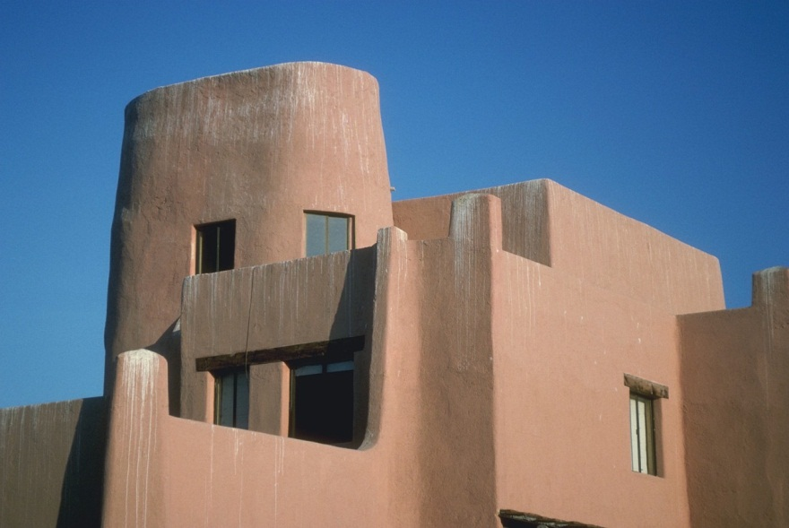
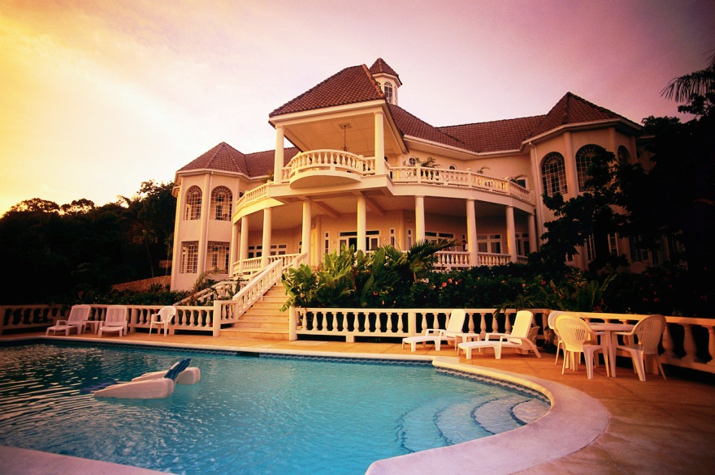
Housing Choice
There are many different choices of housing…. Here are a few different types.

Slide 7
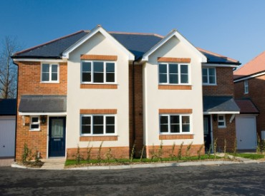
#1 Multi-Family Dwellings
Duplex-Two identical units usually connected together (usually more spacious)

Slide 8
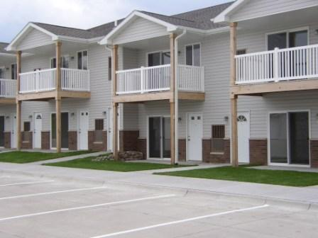
Apartments—Individual units in one large building.

Slide 9
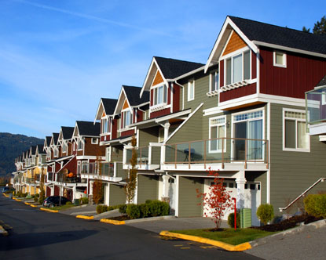
Condo—Like an apartment but people generally own their own condo.

Slide 10
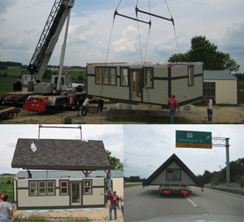
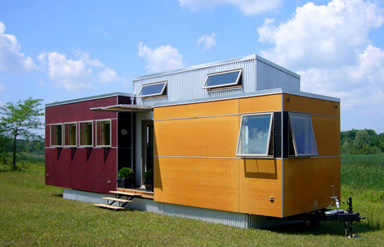
#2 Single Family Dwellings
Prefabricated home-are dwellings manufactured off-site in advance, usually in standard sections that can be easily shipped and assembled.

Slide 11
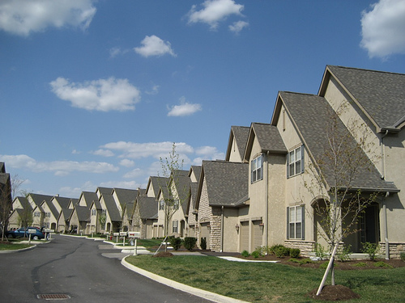
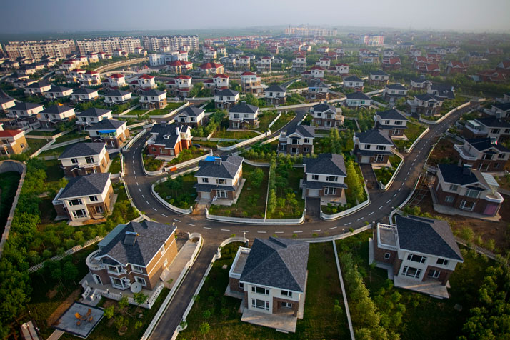
Tract home-(also known as cookie-cutter housing) is a style of housing development in which multiple identical or nearly-identical homes are built to create a community.

Slide 12
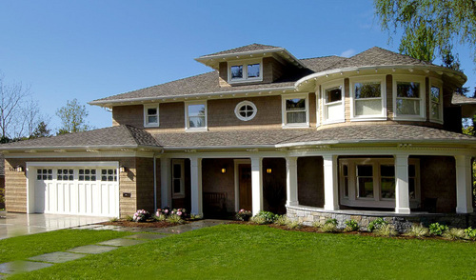
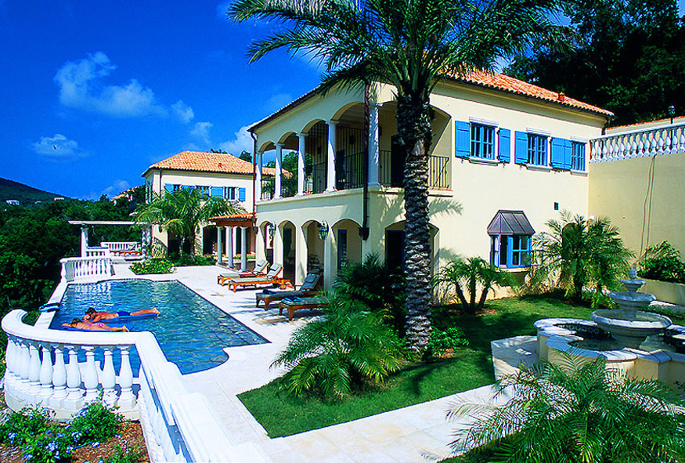
Custom House-custom construction allows the homebuyer to make changes to the house plan.

Slide 13
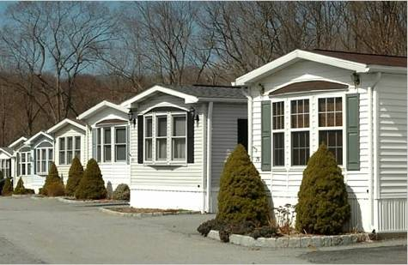
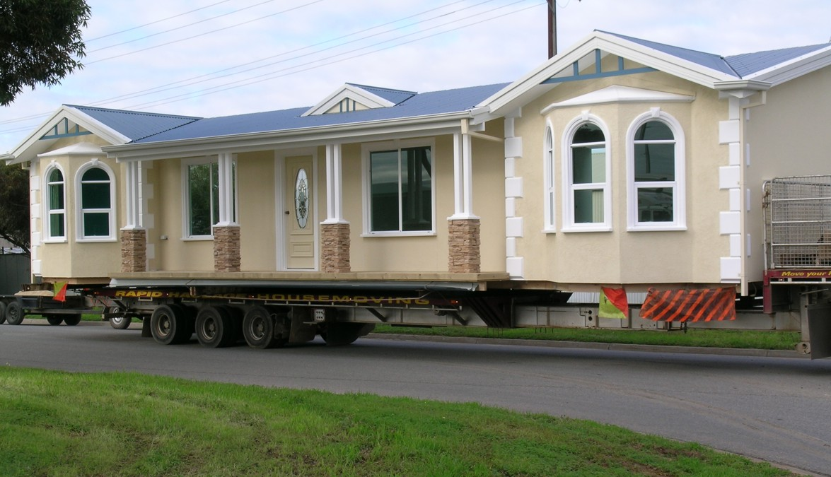
Mobile home-A dwelling that sits on wheels and may be moved.

Slide 14
Autism housing
https://www.youtube.com/watch?v=w6sqPhmy81o
Nature home
https://www.youtube.com/watch?v=OW-k0hWAR-M
Shipping Containers
https://www.youtube.com/watch?v=4drX256QV_Y

