Slide 1
Kitchen Planning and Arrangement
Elements of a well designed kitchen

Slide 2
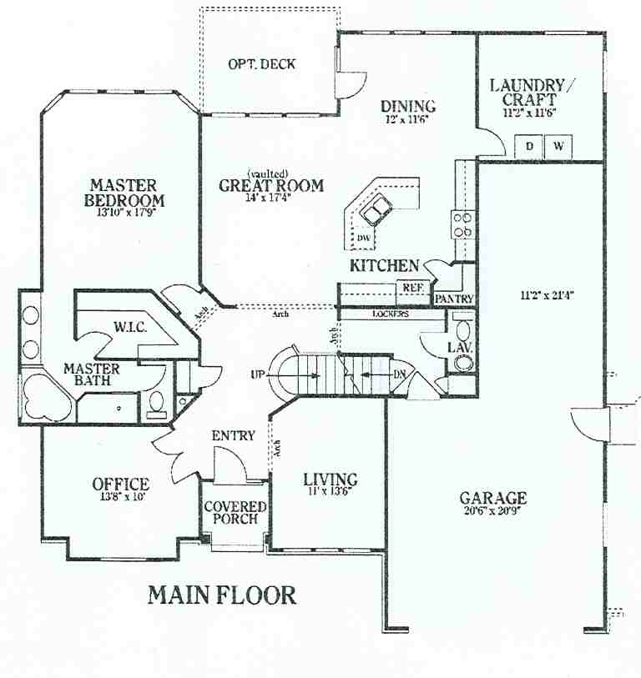
Heart of the Home
Why is it important?
A place where families and friends gather
Should be in the same cluster as the other rooms in the service area
Near the service entry and the dinning area

Slide 3
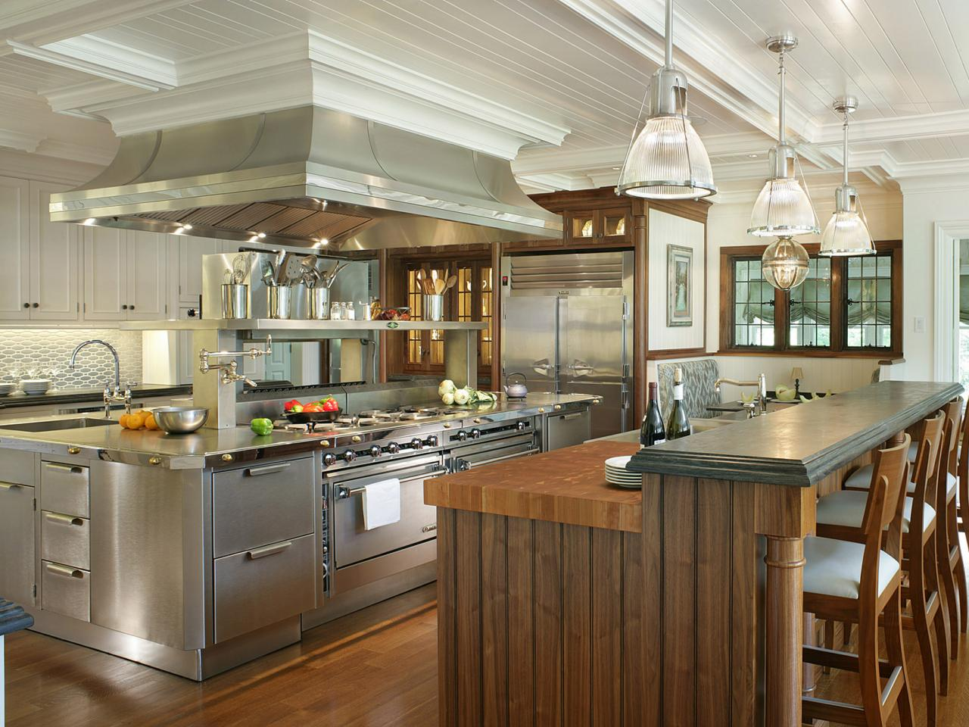
Well-Designed Kitchens Include:
Adequate storage
Lighting
Counter Space
Consideration of:
Traffic flow
Amount of use

Slide 4
Work Centers
There are three basic work centers
Food prep and storage center
Clean up center
Cooking and serving center

Slide 5
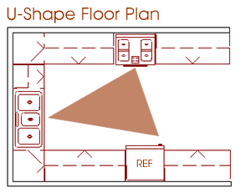
Work Triangle
Imaginary line that connects the fridge, sink, and range
Should be no less that 12 feet
No more than 26 feet
Measurements are taken from the center of each appliance
This is necessary to evaluate the efficiency of the kitchen and its work centers
Avoid cross traffic

Slide 6
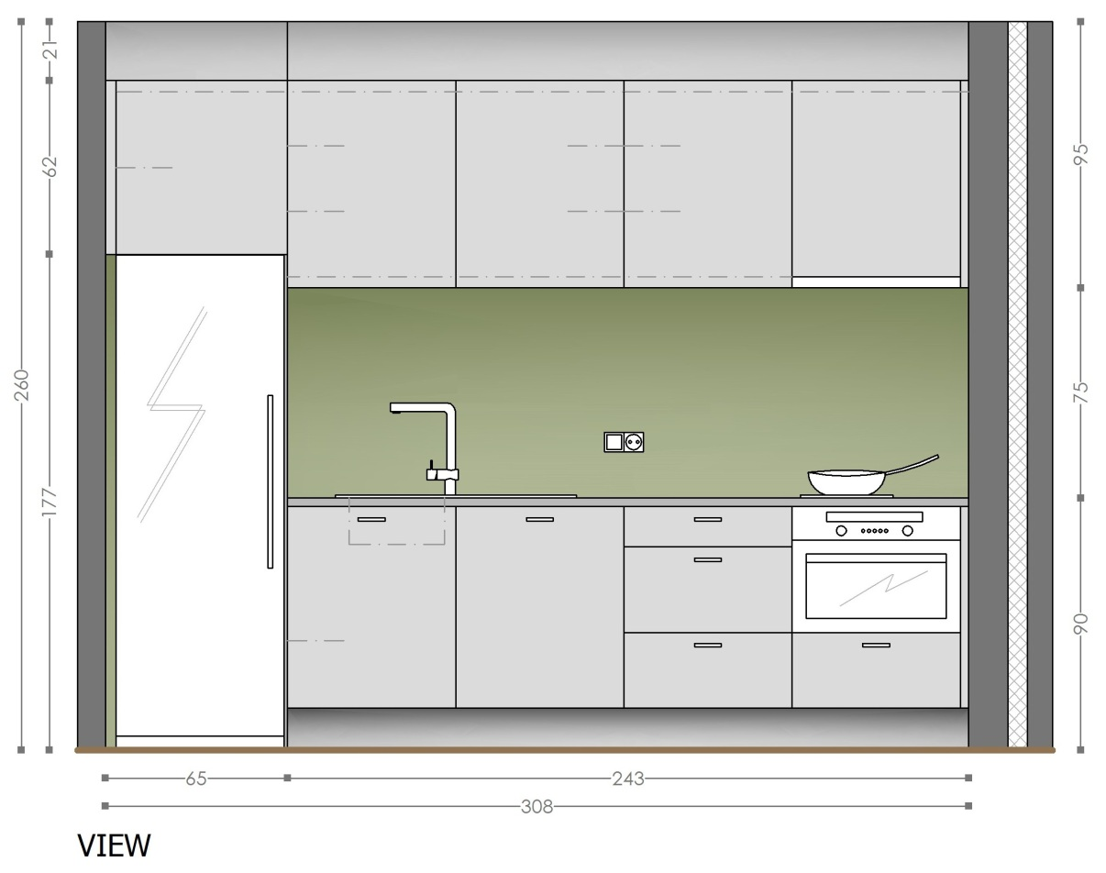
One Wall
Saves apace
Often seen in apartments
Limited storage and counter space
Most economical

Slide 7
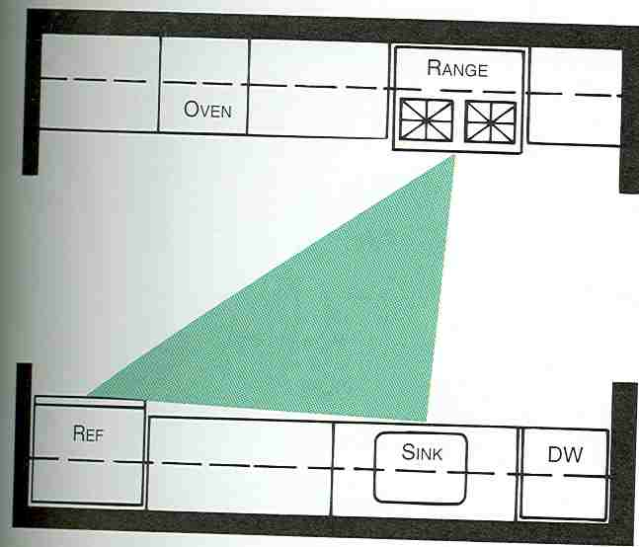
Corridor/Galley
Compact and efficient work triangle
Chef is interrupted if both sides of the kitchen are open
Work triangle may only allow one person to work in the kitchen at one time

Slide 8
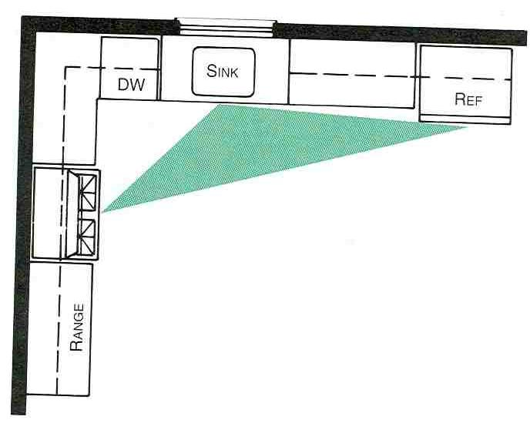
L-Shape
Work triangle is not interrupted by traffic
More than one person can work at a time
More continuous counter and cabinet space
Corner storage might not be fully accessible

Slide 9
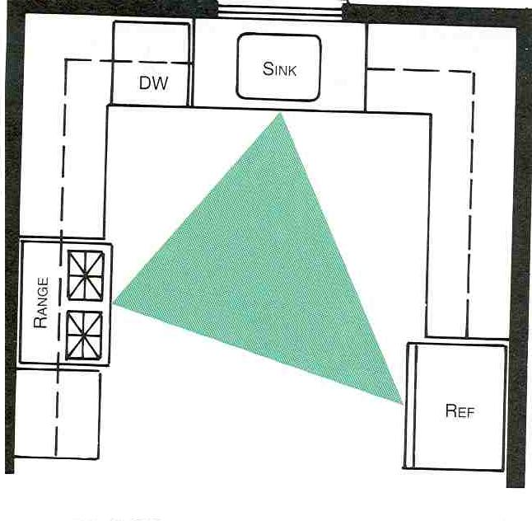
U-Shape
Usually has more continuous counter space than other layouts
A major appliance can be placed on each wall so that the sides of the work triangle are equal
Corner storage issues
This kitchen is the most efficient of the kitchen layouts

Slide 10
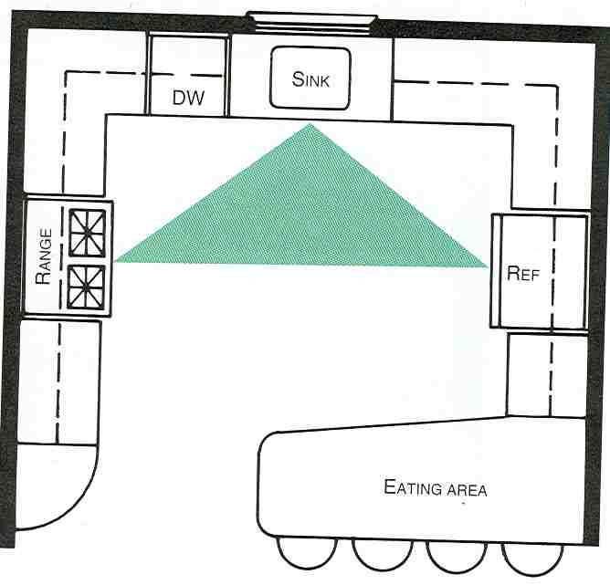
Peninsula
Can be multiple types of kitchen layouts with a connected bar
Typically used for eating and serving food

Slide 11
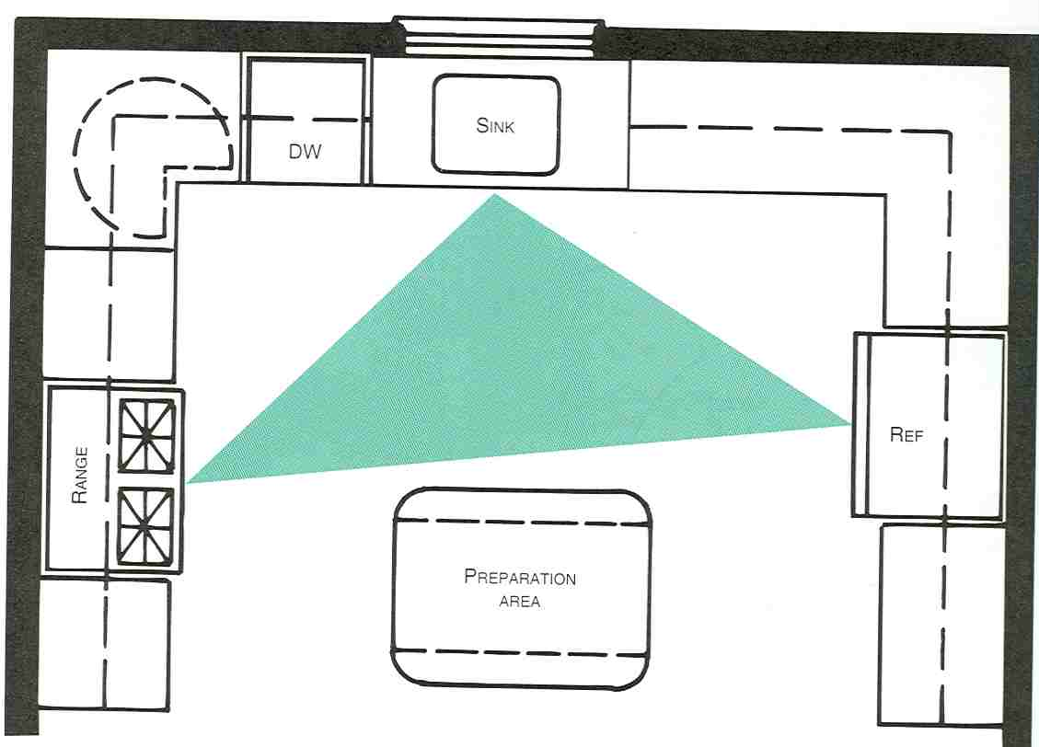
Island
Can be L-Shape or U-Shape with a free standing cabinet/counter top
Separate from the rest of the counters and cabinets

Slide 12
Assignment
Look through the magazines and find 2 different kitchens.
Mount with ¼” border.
Add description telling what kitchen layout it is.
What about it makes it a good design?
What challenges might the design have?
What Elements and Principles of Design does the kitchen that helps with the design.

