Slide 1
Pattern
Elements of design

Slide 2
What is pattern?
A combination of several design elements – lines, shapes, colors arranged in or on textural material

Slide 3
Benefits of pattern
Adds interest to plain surface of fabric
Helps coordinate two or more solid colored items
Create a point or area of emphasis
Create illusions (enhance or disguise)
Become a visible expression of personal style

Slide 4
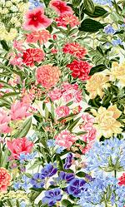
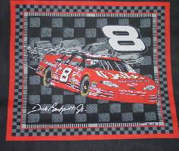
Sources of inspiration
Nature
Man-Made

Slide 5
Realistic
Imitate or duplicate nature
Appears photographic

Slide 6
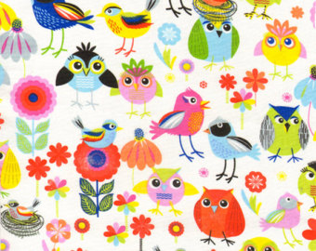
Stylized
A conventionalized impression or interpretation of natural or man-made objects
Simplified detail
Objects are still recognizable

Slide 7
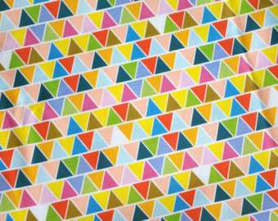
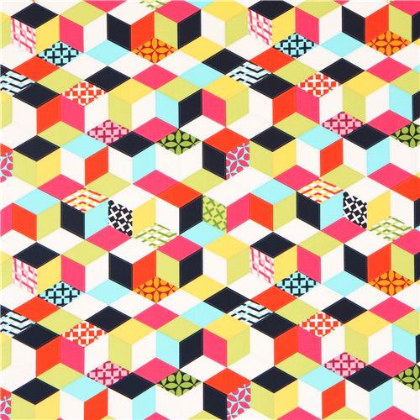
Geometric
Strict use of lines in recognized geometric shapes
Stripes, checks, plaids,
Dots and circles
Squares, rectangles, triangles, diamonds

Slide 8
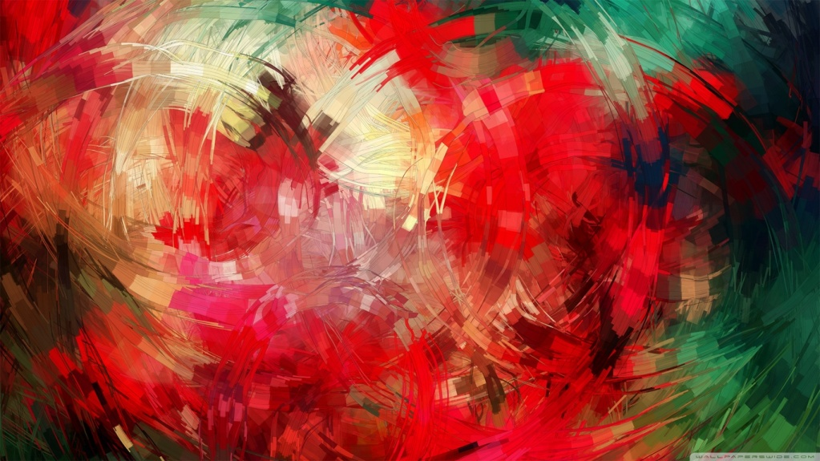
Abstract
From artists imagination
Appear as a blur or splashes of color
Unrealistic, free-form, or flowing lines

Slide 9
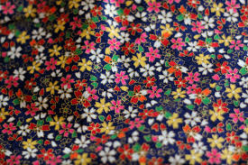
All over pattern
Appear the same from any direction you look at them

Slide 10
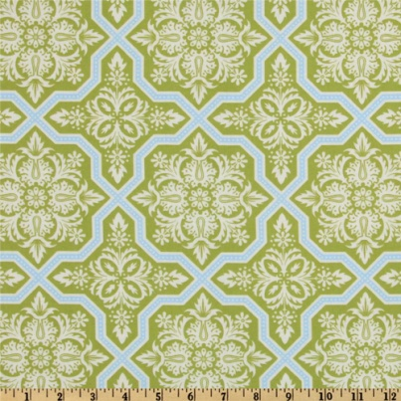
4 way arrangement
Appear the same from four directions given a 90 turn

Slide 11
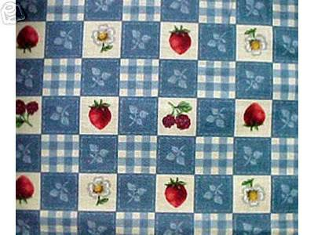
2 way arrangement
90 degree turn
Appear the same from only two directions
180 degree turn

Slide 12
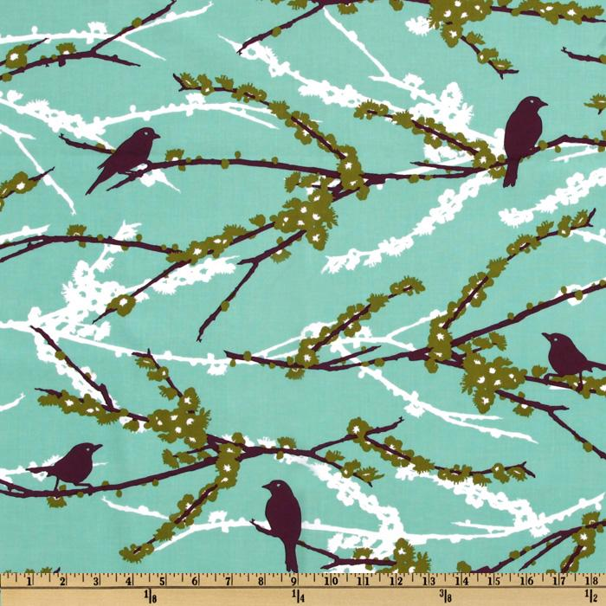
1 way arrangement
Appear right side up from one direction only.
Has a recognizable top and bottom
Words & numbers, people, animals, functional objects

Slide 13
Assignment
You are a designer and your boss has given you your next assignment. The project is a line of bags. You need to create a line that incorporates the different types of pattern. Using paper shapes, pencils, and markers design 4 bags; one for each type of pattern: naturalistic, conventional/stylized, geometric, abstract.
Make note of what your inspiration was for that pattern.
Answer the questions at the bottom of the page.

