Slide 1
The Principles of Design
Fashion Strategies

Slide 2
Outline
Proportion (Scale)
Balance
Emphasis
Rhythm
Harmony
Notes:
The basic principles of design include the following:

Slide 3
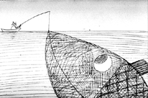
Proportion
Proportion is the relationship between objects, or parts, of a whole.

Slide 4
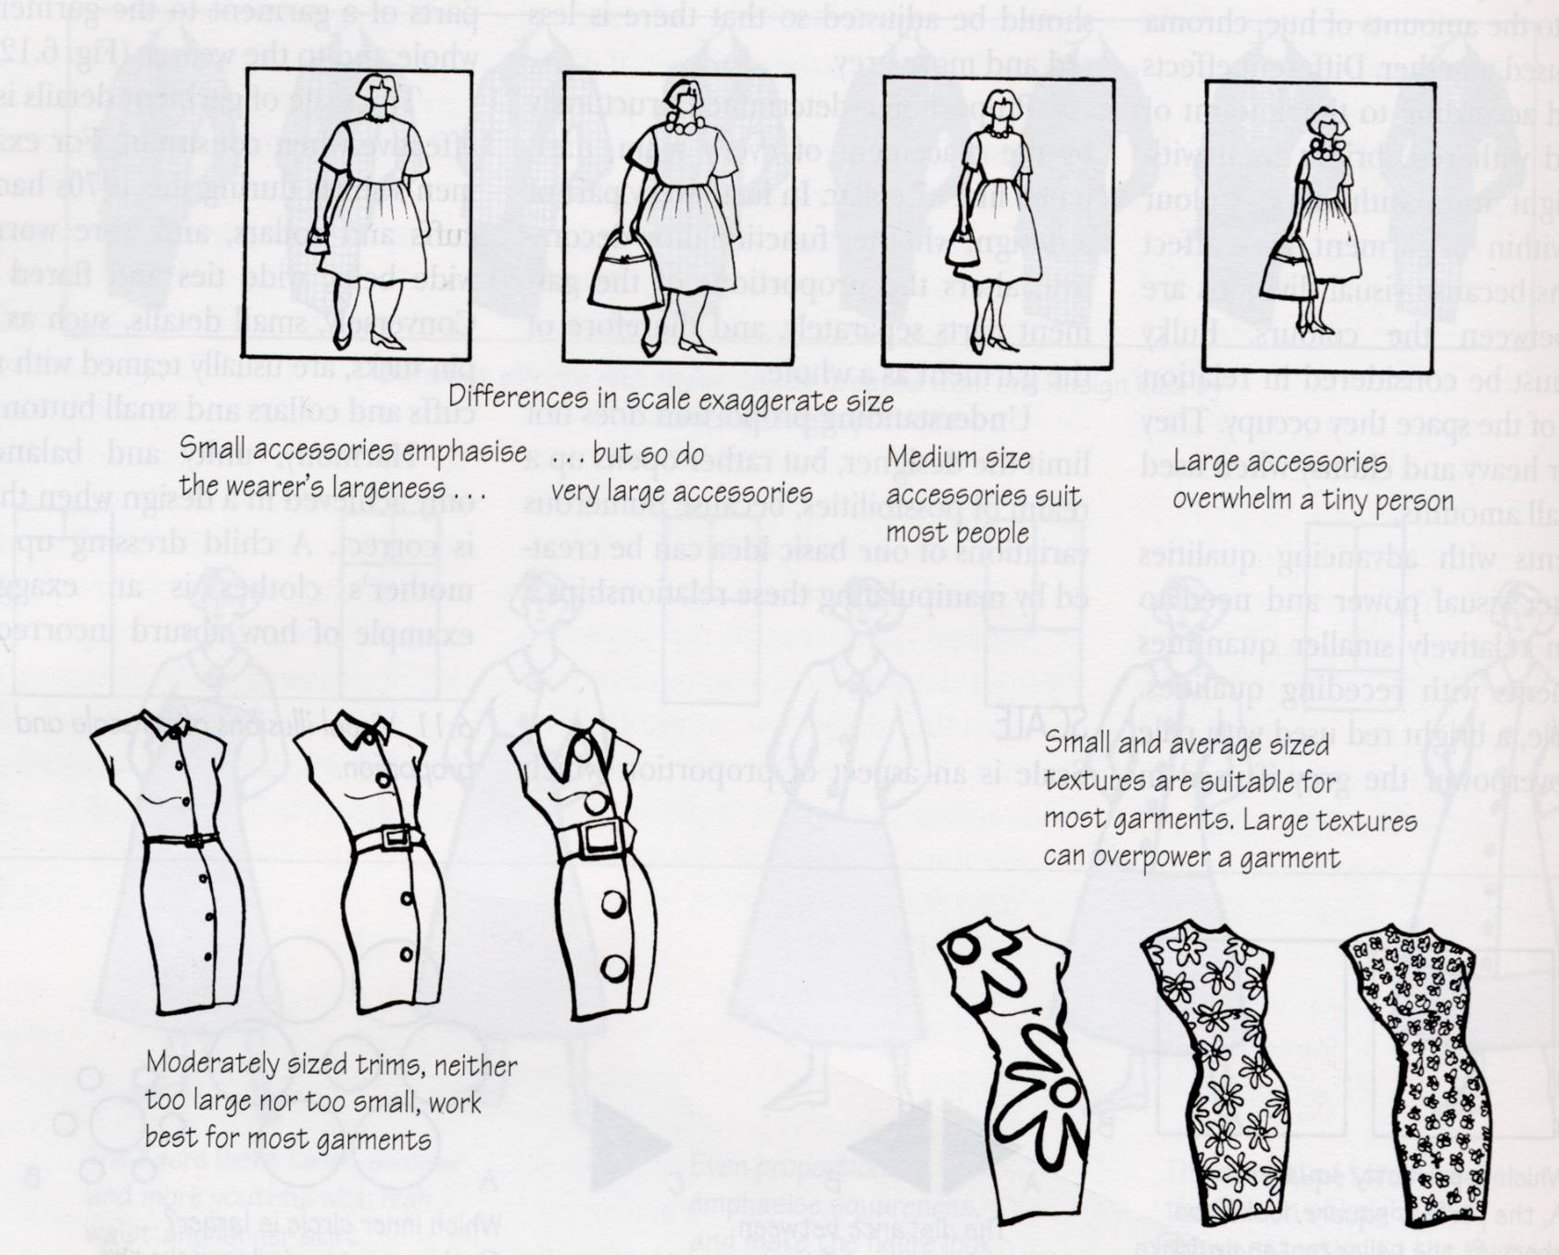
Proportion
Elements seem to be an appropriate size for the space they fill.

Slide 5
Proportion
The ratio of one part to the whole.
Things just look right.
Notes:
Proportion is the ratio of one part to another part or to the whole. It involves shape, size, and visual weight of an object.
Things just look “right”.
Greek proportion. The golden section/mean/ratio, an ancient system of proportion. In this system when a line is divided into two unequal segments so the ratio of the short segment to the long segment is the same as the long segment to the total length of the line.
Palladian proportion. This method sought relationship between each part of a building. Palladio felt that the rooms of a building should share common ratios with the exterior of the building. (Based on geometric whole numbers, such as 2:3, 3:5, 5:8, 4:7).
Measured proportion. This system, developed by Le Corbusier, used ratios from the golden section for smaller dimensions, and measurements of parts of the human body for larger dimensions. (Each determined ratio then needed intuitive adjustment.)
Fibonacci series. He was a mathematician who found that (1,2,3,4,5,6,7,8,9) were the most satisfactory for his calculations. (They are not exact figures but they are close.) This system is similar to the Golden section in that, as each number is added to the next, the third number is a combination of the first two.
Unequal amounts are more pleasing to the eye than equal amounts.

Slide 6
Proportion
The ratio of one part to the whole.
Things just look right.
Notes:
Proportion is the ratio of one part to another part or to the whole. It involves shape, size, and visual weight of an object.
Things just look “right”.
Greek proportion. The golden section/mean/ratio, an ancient system of proportion. In this system when a line is divided into two unequal segments so the ratio of the short segment to the long segment is the same as the long segment to the total length of the line.
Palladian proportion. This method sought relationship between each part of a building. Palladio felt that the rooms of a building should share common ratios with the exterior of the building. (Based on geometric whole numbers, such as 2:3, 3:5, 5:8, 4:7).
Measured proportion. This system, developed by Le Corbusier, used ratios from the golden section for smaller dimensions, and measurements of parts of the human body for larger dimensions. (Each determined ratio then needed intuitive adjustment.)
Fibonacci series. He was a mathematician who found that (1,2,3,4,5,6,7,8,9) were the most satisfactory for his calculations. (They are not exact figures but they are close.) This system is similar to the Golden section in that, as each number is added to the next, the third number is a combination of the first two.
Unequal amounts are more pleasing to the eye than equal amounts.

Slide 7
Balance
A VISUAL DISTRIBUTION OF “WEIGHT” IN THE WAY DETAILS ARE GROUPED.

Slide 8
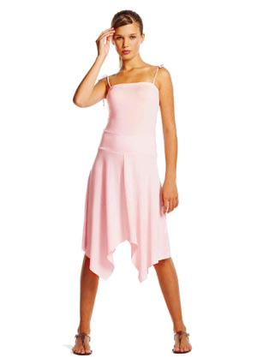
Symmetrical Balance
One side is a mirror image of the other side
Notes:
Symmetrical or Formal Balance is the arrangement of forms on one side of an imaginary central dividing line, axis or plane is the mirror image of the other side.
Associated with the beauty of nature.
Repose and dignity.

Slide 9
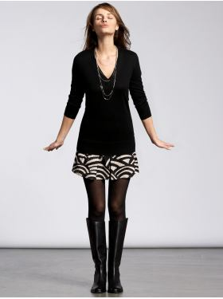
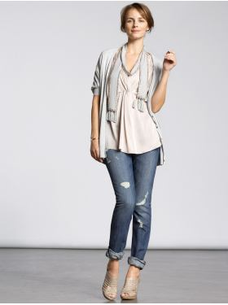

Slide 10

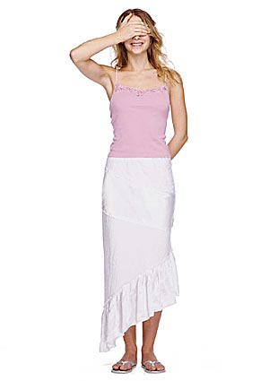
Asymmetrical Balance
Objects on each side of the central dividing line are different.
More exciting and dramatic
Notes:
Asymmetrical or Informal Balance brings elements that are not matching into equilibrium.
Asymmetrical balance can be achieved through placement, shapes, colors, sizes, and other aspects of objects.
Uneven hem or one shoulder shirt are examples

Slide 11
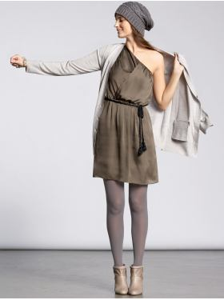
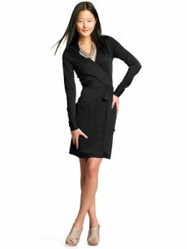

Slide 12
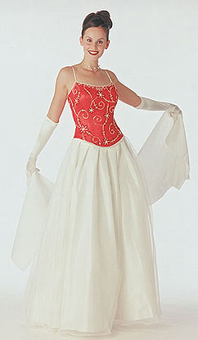
Emphasis
Emphasis creates a center of interest
Also referred to as a Focal Point
Notes:
Emphasis is the feature that is seen first and that repeatedly draws attention.
On her dress you immediately notice the red top. It is where your eye is drawn first. This is the focal point.

Slide 13
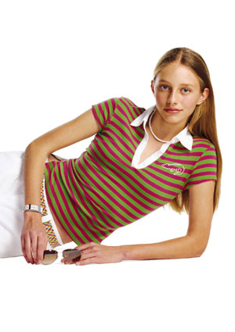
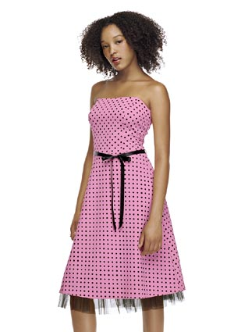
Rhythm- Repetition
When a design element is repeated
Notes:
Repetition is created when a design element is repeated.
Can be achieved through color, line, form, or texture.
Can sometimes lead to monotony, so it must be balanced against the need for variety.

Slide 14
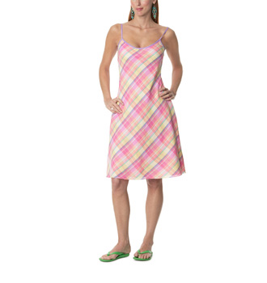
Rhythm- Opposition
When lines meet to form a right angle
Checks and plaids
Square necklines
Square pockets
Notes:
Another example of Repetition.

Slide 15
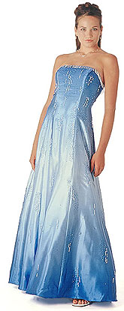
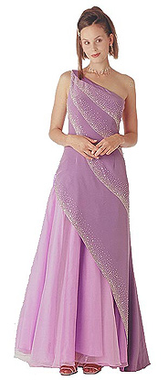
Rhythm-Gradation
Elements grow intensity or size
Light to Dark
Thin to Thick
Small to Large
Notes:
Gradation: a gradual change in color value from dark to light or by a regular change from smaller to large parts that all have the same shape.
Blue dress: gradation in color-dark to light.
Lilac dress: Her dress does from thin sections at the top to thick sections at the bottom.

Slide 16
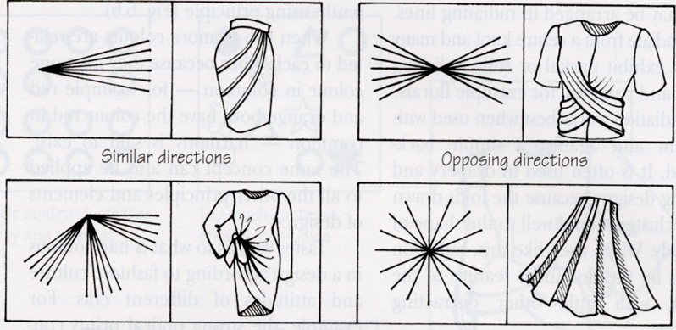
Rhythm- Radiation
Lines flow out from a single point.
Notes:
Radiation: lines flow out from a central point.

Slide 17
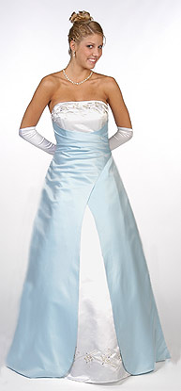
Rhythm- Transition
Curved lines carry the eye.
Notes:
Transition is achieved when curved lines carry the eye over an architectural feature or piece of furniture.

Slide 18
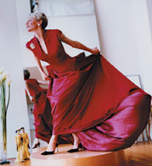
Harmony
Harmony is achieved when Unity and Variety are effectively combined.
Notes:
This room demonstrates Unity with enough Variety to keep it from being monotonous.

Slide 19
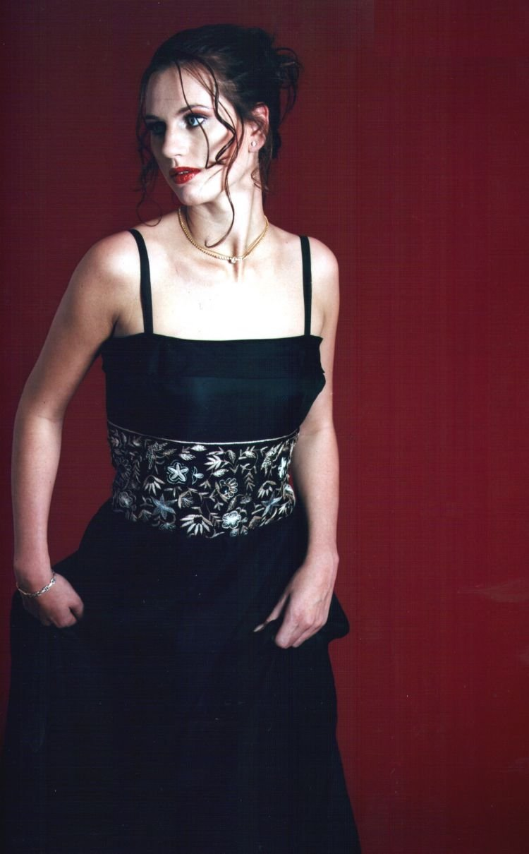
Harmony- Unity
The design is seen as “whole”.
Unity can be achieved through matching and coordinating
Notes:
Unity allows the viewer to see a design as a whole rather than seeing it as a collection of different elements. Ideally, everything relates so well that nothing can be added, taken away, or altered without changing the totality.
Unity can be achieved through matching and coordinated fabrics, closely related colors, stylistic consistency, etc.
Can carry a threat of monotony.

Slide 20
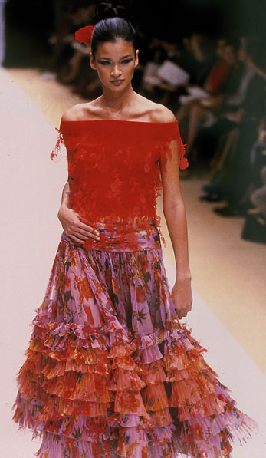
Harmony- Variety
Variety can relieve monotony by giving the eye a number of different details to look at.
Notes:
Variety can relieve monotony by giving the eye a number of different shapes, textures, colors, or details to look at.
All the varied components of an interior must relate to each other and to the overall theme of the design.
Contrast can heighten values through comparison. A light color will seem lighter when placed near a dark color, a large object larger in contrast with something small.
Variety and contrast can help to punctuate harmony and unity.
This room may not have enough variety. Although there is Unity, there is not much to look at.

Slide 21
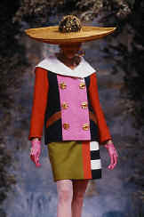
Harmony
Is it harmony?
What do you think?
Notes:
Unity allows the viewer to see a design as a whole rather than seeing it as a collection of different elements. Ideally, everything relates so well that nothing can be added, taken away, or altered without changing the totality.
Unity can be achieved through matching and coordinated fabrics, closely related colors, stylistic consistency, etc.
Can carry a threat of monotony.

Slide 22
Conclusion
As you can see the Principles of Design
overlap some but through practice and
exposure you will see these principles come to
life all around you.

