Slide 1
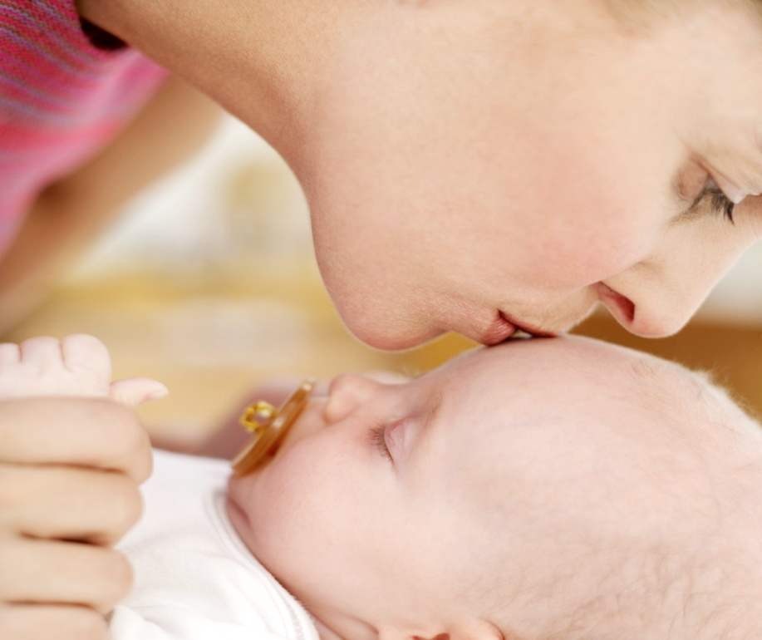
1st YEAR EMOTIONAL and SOCIAL DEVELOPMENT

Slide 2
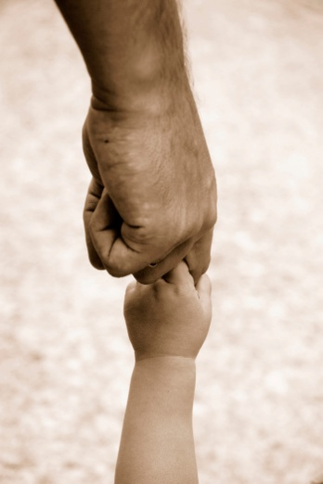
Emotional Development
Begins at birth.
The process of learning to recognize and express one’s feelings and to establish one’s identity as a unique person.
It deals with a child’s changing feelings about themselves, others, and the world around them.
How a baby learns the meaning of love.
Tone of voice, mood, care, facial expression, affection, closeness…

Slide 4
2. Nurturing and bonding, as it relates to infants, is showing love and concern, respect, support, understanding, responding, consistency, etc…..
This bond is called attachment
a special closeness in a relationship

Slide 5
4. Failure to Thrive is what happens to babies when they have no one to love and nobody to love them.
It causes slower development in all of the 5 areas of development.

Slide 6
Attachment Video Clip
Bonding and Attachment Video~ The First Years Last Forever
http://www.youtube.com/watch?v=QYi-ta_xXSQ&feature=related

Slide 7
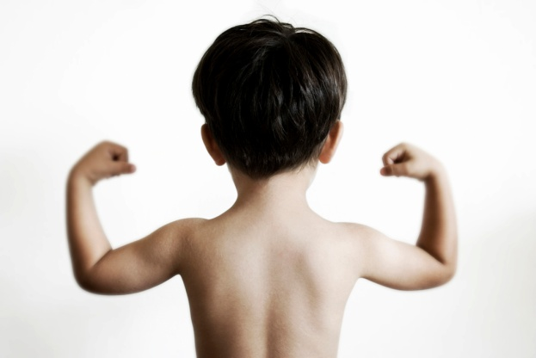
Erick Erickson
Trust vs. Mistrust stage.
To develop Trust in an infant:
Show love and concern, giving respect, supporting, understanding, responding quickly, be consistent, be sensitive to their needs, provide a routine and schedule, holding, cuddling, playing, talking to them, loving them
Through this, infants feel:
safe, secure, confident, happy, loved, stronger, independent, smarter, higher self-concept, etc…

Slide 8
Your shower routine?
Consistency and routines are necessary for a child to identify the expected behavior and to trust their parents, caregivers, and the world they live in.
Mistrust
Receive inconsistent care
Receive little love and attention
Fear and suspicion toward the world and everyone in it.

Slide 9
Trust Cycle
Happy Infant
Relaxed and happy parents
Parents meet the infant’s needs
Happy Infant
Parents do not meet the infant’s needs
Unhappy, frustrated, and disappointed parents
Unhappy, fussy, and demanding infant
TRUST
MISTRUST

Slide 10
Infant Personalities
3 common infant personalities:
a. Sensitive child
b. Placid child
c. Aggressive child
Identify the characteristics of each temperament and how a caregiver can handle this.

Slide 11
SENSITIVE CHILD
♥ Slow to warm up to people
♥ Was usually fussy and irritable as a baby
♥ Reluctant to try new things or experiences
♥ New experiences may end in failure, pain or embarrassment. The child may then lose self-confidence, resulting in uncertainty and insecurity
♥ More sensitive to sounds and changes in the environment, colors, and changes in moods of people
♥ Can grow up to be sensitive to other people and work as counselors or therapists. May also use their sensitivity in the fields of music, art, or drama
Caregivers Can:
♥ Help this child establish self- confidence by being patient, encouraging, and by providing lots of reassurance.
TEMPERMENT TYPES INFANT PERSONALITIES

Slide 12
PLACID CHILD
☺ Easy going
☺ Less upset by change in routine
☺ Adjusts easily to new people and situations
☺ Happy, cheerful, patient, quiet
☺ Goes through life with a minimum of fuss and upset
☺ Can grow up to be peacemakers, any job that requires an even temper; will get along with co-workers
Caregivers Can:
Needs love and encouragement to push themselves toward achieving their goals
May need to be challenged, if not, they could end up being a couch potato
TEMPERMENT TYPES INFANT PERSONALITIES

Slide 13
TEMPERMENT TYPES INFANT PERSONALITIES
AGGRESSIVE CHILD
Constantly active and on the go, loves activity
Awake more than other babies
Responses are extreme (kicks more strenuously ) and temper tantrums are normal
Strong-willed, eats more vigorously, cries more loudly
Often larger than other babies
Not concerned with failure, will try again and again
Needs lots of constant parenting
Can use aggressiveness in play, sports, or leadership (positive and negative)
Caregivers Can:
With a nurturing parent, the child can grow up to be a responsible leader of people.
Parents must impose reasonable limits
Child needs lots of love and praise
Child needs to be made aware of the feelings and interests of others
If the aggressive nature is not limited or channeled in a positive direction, this child could get into a lot of trouble

Slide 14
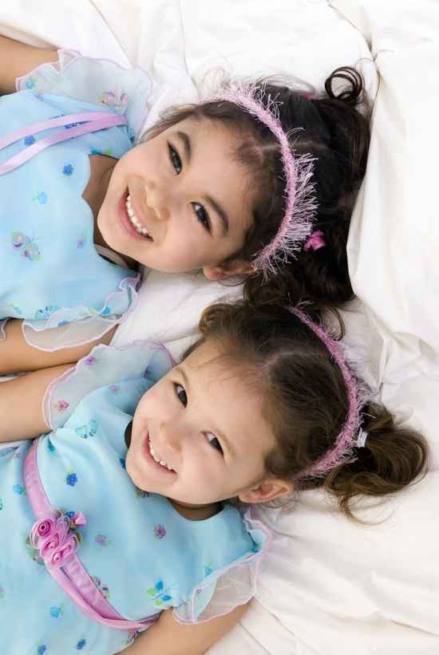
Infant Social Development
1. Social development is
learning the rules of play
Learning how to interact with others
Learning to express oneself to others

Slide 15
Infant Social Development
2. Newborns prefer to look at the human face – their main form of socializing

Slide 16
Infant Social Development
3. Through play:
a child learns about and develops all areas of development.
they learn about themselves, other people, and the world around them.

Slide 17
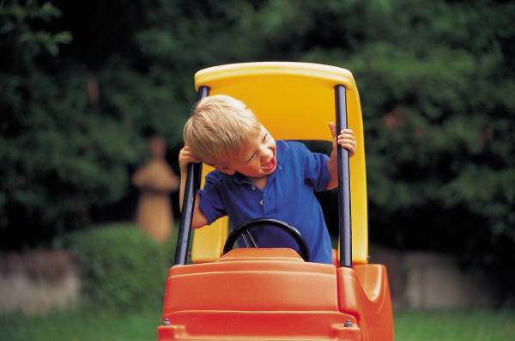
TYPES OF PLAY
SOLITARY PLAY
Solitary Play is independent play or playing alone, having no interest in anyone else or what other’s are doing.
Examples: cars, blocks
On –Looker PLAY
On-looker Play is watching others play. May talk to others, but not involved with them.
Wants to be close enough to interact, but still keeps to them self.
Examples: duck duck goose game

Slide 18
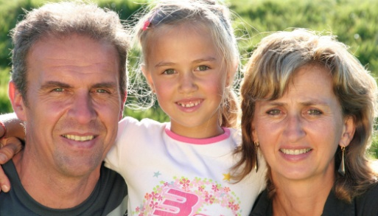
4. Stranger Anxiety is fear of a strange or unfamiliar face.
Happens about 18 months.
Expressed through crying and withdrawal
It occurs because of the infants progressing cognitive development and understanding of the world.
5. Separation Anxiety is when a child is uncomfortable being away from parents or primary caregiver.
Appears about 6 months and then again (even stronger) at 18 months.

