Slide 1
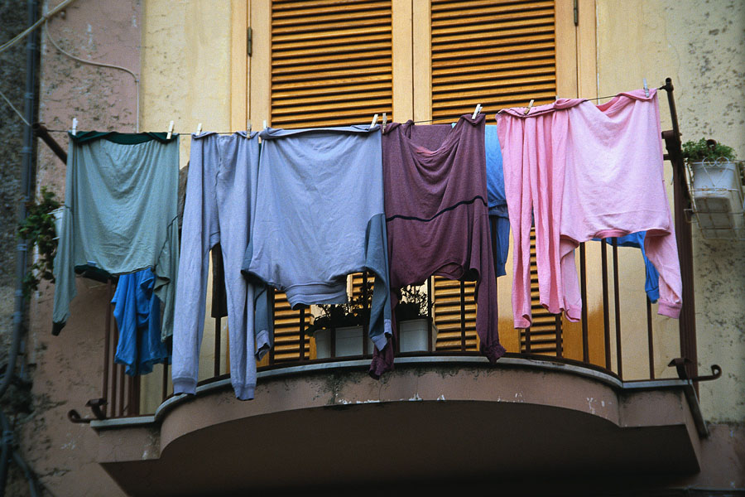
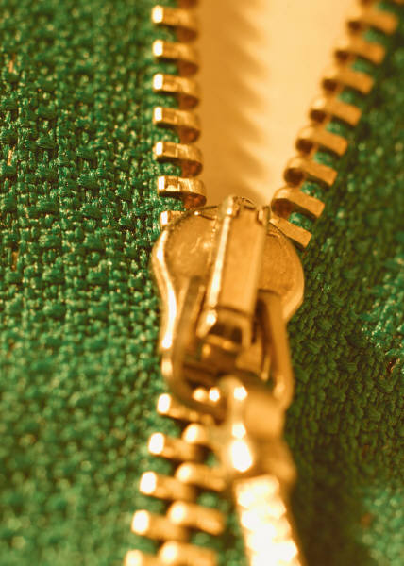
The Needs of Clothing

Slide 2
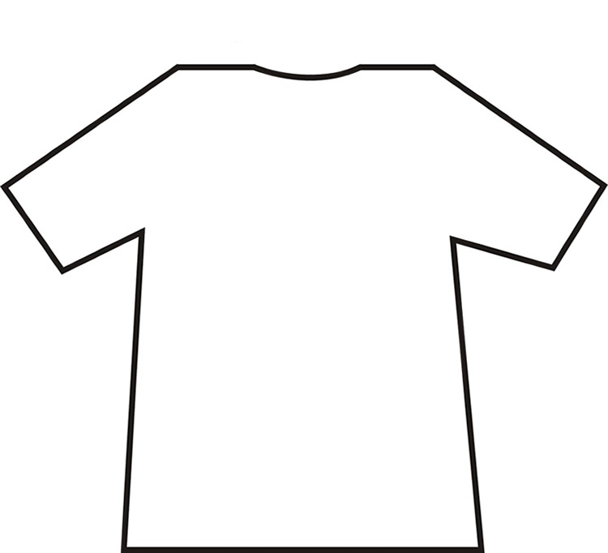
Why do we wear clothes?
?

Slide 3
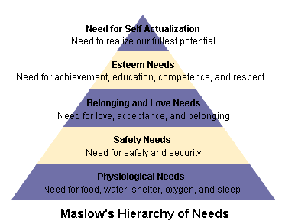
http://allpsych.com/personalitysynopsis/maslow.html
Notes:
Maslow was a famous psychologist at the turn of the century. His theory is that the level below must be met before the next level can be reached (like steps). Clothing helps humans meet needs at each level.

Slide 4
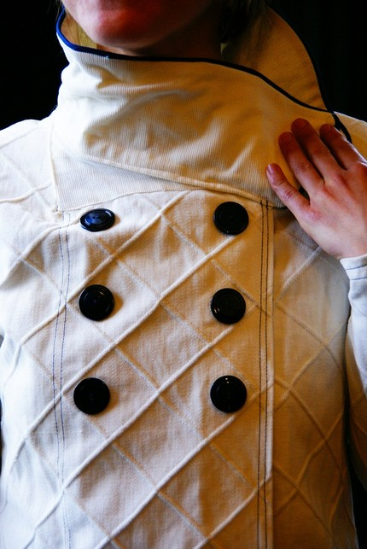
Protection
Protection for the body
Weather—hot, cold, rain, snow, sun, wind
Environment—dirt, insects, sharp objects, germs
Occupational hazards—acids, lint, fumes, chemicals, radiation, fires
Examples: coat, gloves, hat, boots, bulletproof vest, sunglasses

Slide 5
2) Security- Safety
Protection from danger
Bullet proof vests
Camouflage
Reflective gear
Helmets, pads
Notes:
Safety is about protection. Sometimes it is difficult to tell the difference between physical and safety issues. The best example I can think of is sunglasses. We won’t die immediately from the sunlight but it is certainly something we want to protect ourselves from.

Slide 6
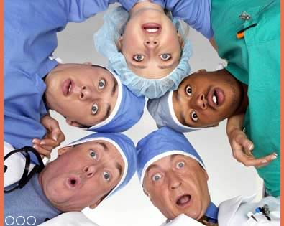
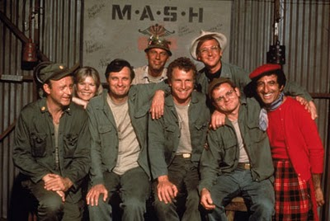
Occupational
Clothing required for a particular occupation or setting
Example: Policeman, McDonalds, Nurse …

Slide 7
3) Identification - Belonging
Establishing who someone is or what they do
Uniforms – outfits or articles of clothing that are alike and specific to everyone in a certain group
Dress Code – clothes that fall with in a certain range of options acceptable according to written or unwritten rules
Peer association
Notes:
Everyone wants to fit in somewhere. We use clothes to send signals that we are acceptable in certain groups.

Slide 8
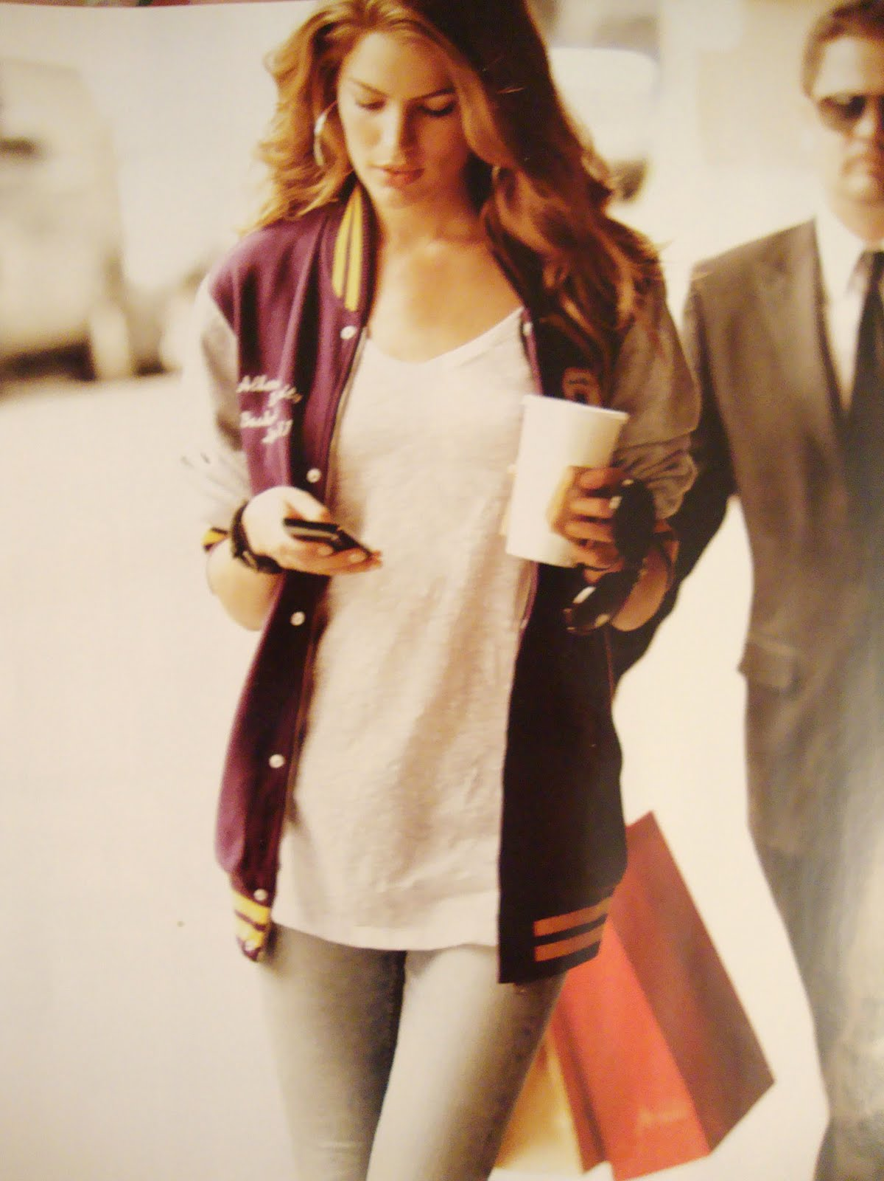
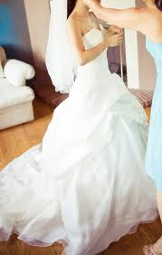
Identification
The process of establishing or describing who someone is.
Examples: cheerleading uniform, wedding dress, school t-shirt…

Slide 9
4) Status –Esteem
His or her position or rank in comparison to others
Recognition, prestige, social acceptance, peer approval
Designer labels/haut couture
High end jewelry
Insignias or emblems

Slide 10
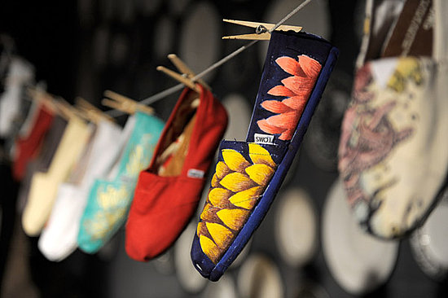
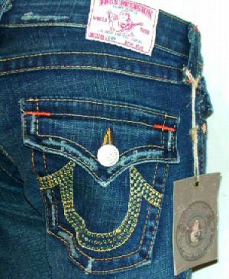
Social
An article of clothing that makes us feel more socially accepted.
Examples: name brand clothing, dressing the same as everyone else

Slide 11
Modesty - esteem
The covering of the body according to the code of decency of that society
Generational
Situational
Cultural
Notes:
Modesty is fluid. What is acceptable to one group or in one setting is completely unacceptable in another. For example – try wearing a bikini to church!

Slide 12
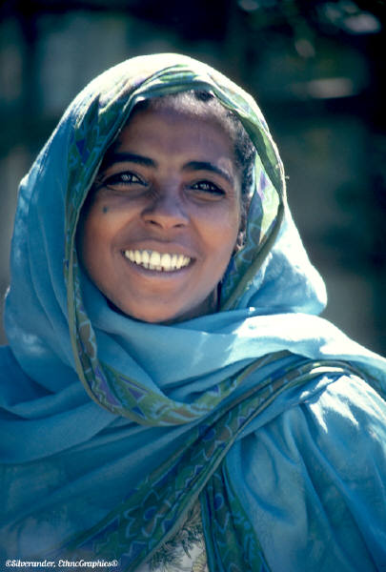
Modesty
The coverage of clothing to retain acceptability in society.
Examples: everyday wear, differing in cultures across the world

Slide 13
5) Adornment - actualization
Decoration, adding beauty
Beauty is a quality that gives pleasure to the senses (visual)
Enhances psychological feeling of well-being
Use of creativity
Expression of individuality
Notes:
Clothing allows us to feel pretty, special, glamorous... You choose the word. It allows us to express personality and creativity. Going too far in this expression results in extreme fashion that might be ridiculed.

Slide 14
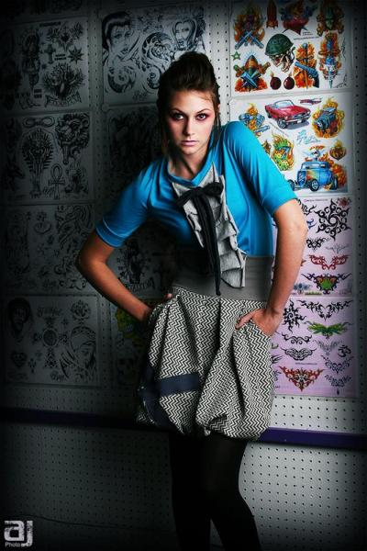
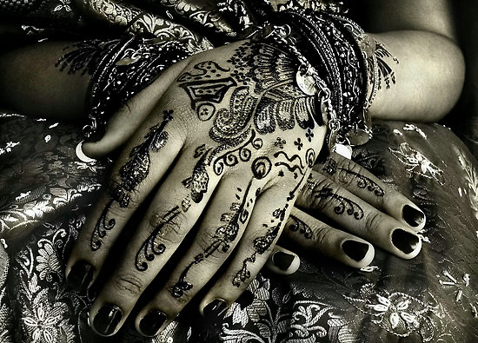
Adornment
An article of clothing that adds decoration to the body
Example: different colors, different prints, jewelry, fringe or beads

Slide 15
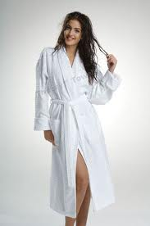
Psychological
Clothing worn to make us feel a certain way
Examples: fuzzy bathrobe, sweat pants, little black dress

Slide 16
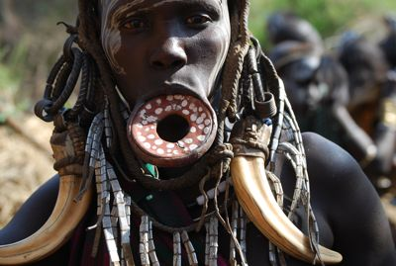
What’s the need?
Fur pelts were worn around the body for warmth
Corsets were worn under dresses to make women appear slimmer through the waistline
Decoration of animal bones, horns, teeth, shells, seeds, and feathers made the body more beautiful

Slide 17
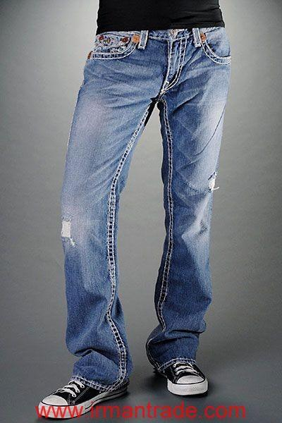
What’s the need?
All members of a specific tribe wore something particular on their skin or body to identify themselves with their group
All the swim team shaved their heads before the state meet
Wearing True Religion jeans

Slide 18
What’s the need?
All the students who wear orange and blue on Fridays
Pointed shoes with three inch heels
A pink puffy Cinderella dress with sparkles and beading
Hunters wore pelts of their prey to show other how many and what kinds of animals they had killed.

Slide 19
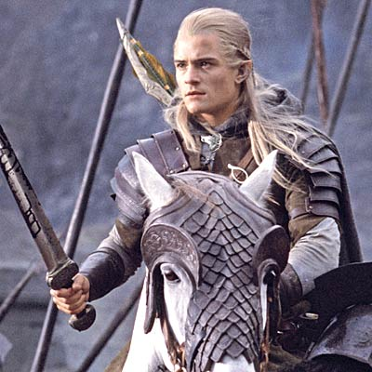
What’s the need?
Body shields and suits of armor protected the body from enemies
A dinner jacket with tails
Tight Wrangler jeans with a big silver belt buckle
A loin cloth was worn below the waist even though the weather was warm enough to go without

Slide 20
VALUES
Ideas and beliefs that are important to an individual
Motivation for a person’s actions
Basis of decisions, lifestyle, and code of ethics

Slide 21
ATTITUDE
Individuals feeling or reactions to people, things or ideas
Formed from values

Slide 22
Personality
The total characteristics that distinguish an individual

Slide 23
Conformity vs. Individuality
Conformity – obeying or agreeing with some given standard or authority
Individuality – self expression

Slide 24
Just REMEMBER! It’s not necessarily the brands we wear, but beauty lies with you!

