Slide 1
Bell Work
At what age is an infant considered a “toddler”~ what is one defining feature of a “toddler”?

Slide 2
Children’s Book~ Bring Tuesday
Tuesday
Madison S.
Yardlee C.
Thursday
Torri A.
Shania J.

Slide 3
Take Unit 1 Test
Good Luck!!

Slide 4
Fix Tests
Fix Unit 1 Test
  15 minutes
  Go through and correct each answer you have incorrect.
  Be sure to write the question and a sentence answering the question!
  I will also play the Reality Baby Video if you need to do a Readiness Quiz

Slide 5

Child Development:
Unit 2
Toddler and Preschool
Toddler Physical Development

Slide 6
1. TODDLER
a) Refers to the name of the stage when a 1-2 year old discovers the new ability of walking.
  The first steps are wobbly, with toes pointed outwards, feet apart, and arms held out for balance.
    With practice, the child improves steadiness, balance, and body control but will still walk or run with feet further apart.
(beam)

Slide 7
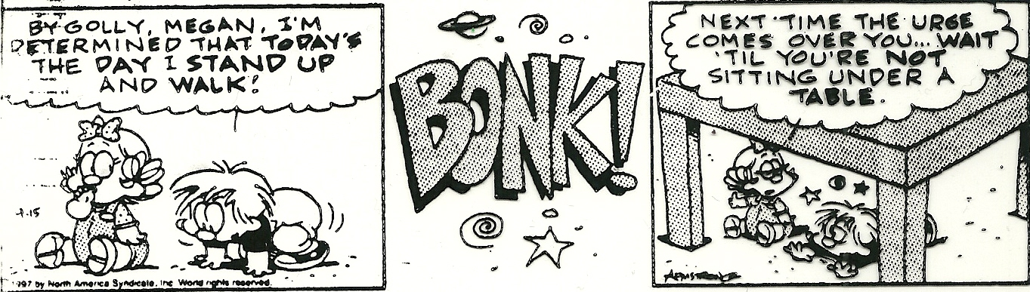

Slide 8
b) Spend time each day in active play to exercise muscles, practice walking, and use up stored energy.
Toys/activities that promote walking:
  push walking toys
  pull walking toys
  riding toys
  walking games
    Battle the balloon (keep a balloon floating in the air)
    Dancing
    Obstacle course
    Roll the dice game
      (each # on the dice stands for an activity. Roll the dice to see what to do
      – run, jump, hop, crawl… - Roll a second time to see how many times to do it.)

Slide 9
c) Shoes for a toddler :
should facilitate walking by having:
  a flexible sole,
  non-skid bottoms,
  be comfortable
Have your child with you and do the standing pinkie test.
Look at the cost of the shoe and the material of the shoe.

Slide 10
2. Physical growth of a toddler slows down in this period of development.
Children from ages 1-3 gain about 1/2 pound per month. Growth in height slows by about 1/2.
Their head chest and abdomen all measure about same
There is rapid growth in a toddler’s arms and legs.
Body changes in a toddler’s proportion helps to improve their balance and motor skills.
The strengthening of the spine through active play, makes their back straighter so the toddler’s posture (stance and walking) is more upright.
  Their abdomen still protrudes, their head is somewhat forward, and their elbows and knees are slightly bent.

Slide 11
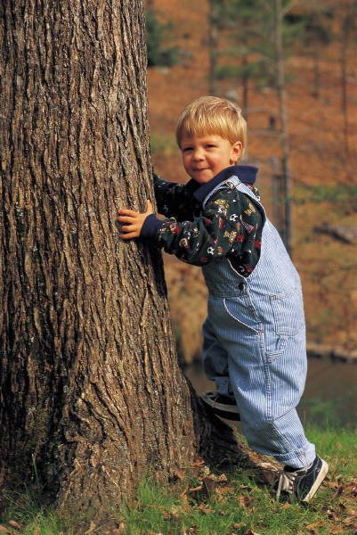
AVERAGE LENGTH AND WEIGHT FROM 1 – 3 YEARS
AGE | HEIGHT | WEIGHT
12 (1 yr) | 30 inches | 21 pounds
18 (1 ½ yrs) | 32 inches | 24.5 pounds
24 (2 yrs) | 34 inches | pounds
30 (2 ½ yrs) | 36 inches | pounds
36 (3 yrs) | 38 inches | 32 pounds

Slide 12
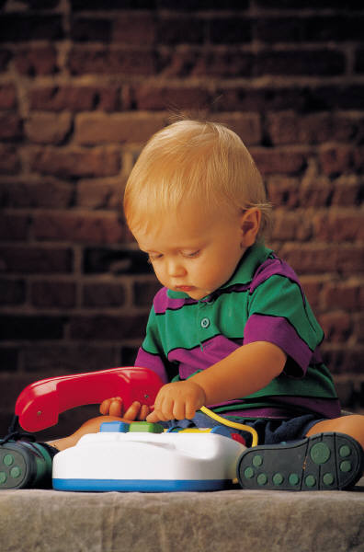
3. Large (Gross) and Small (Fine) Motor skills are not developed as predictably as they were in the first year.
  Due to the wide range of physical abilities, each child develops at their own rate.
  These variations can be caused by physical size, health and diet, interest, temperament, opportunities, etc...
a) Large Motor Skills:
b) Small Motor Skills:

Slide 13

Child activity
Notes:
Crepe paper dance

Slide 14
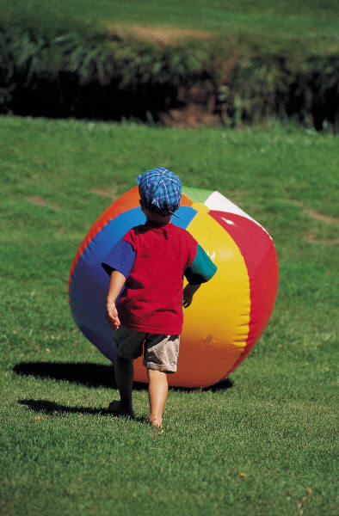
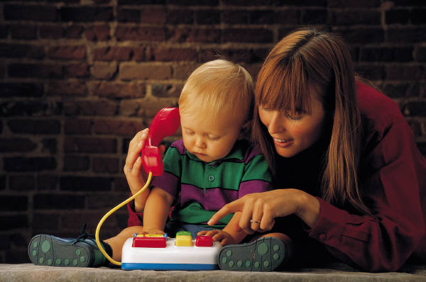
Average Motor Skills
A) LARGE
  1 Year Old
    Crawling, beginning to walk
    Learning to run
  2 Year Old
    Walks well
    Goes up and down steps alone
    Runs
    Seats self on Chair
B) FINE
  1 Year Old
    Pincher grasp
    Mastering holding objects
  2 Year Old
    Uses spoon and fork
    Turns pages singly
    Attempts to dress self

Slide 15
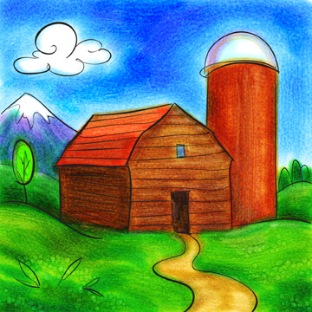
HAND-EYE COORDINATION, moving the hand precisely to what is seen, is poor at first, but with practice it improves.
Help a toddler improve their fine motor skills and dexterity, skillful use of the hands and fingers, by providing:
  blocks, beads, crayons, toy pianos…….
Pen lid
Close your eyes and draw a farm animal

Slide 16
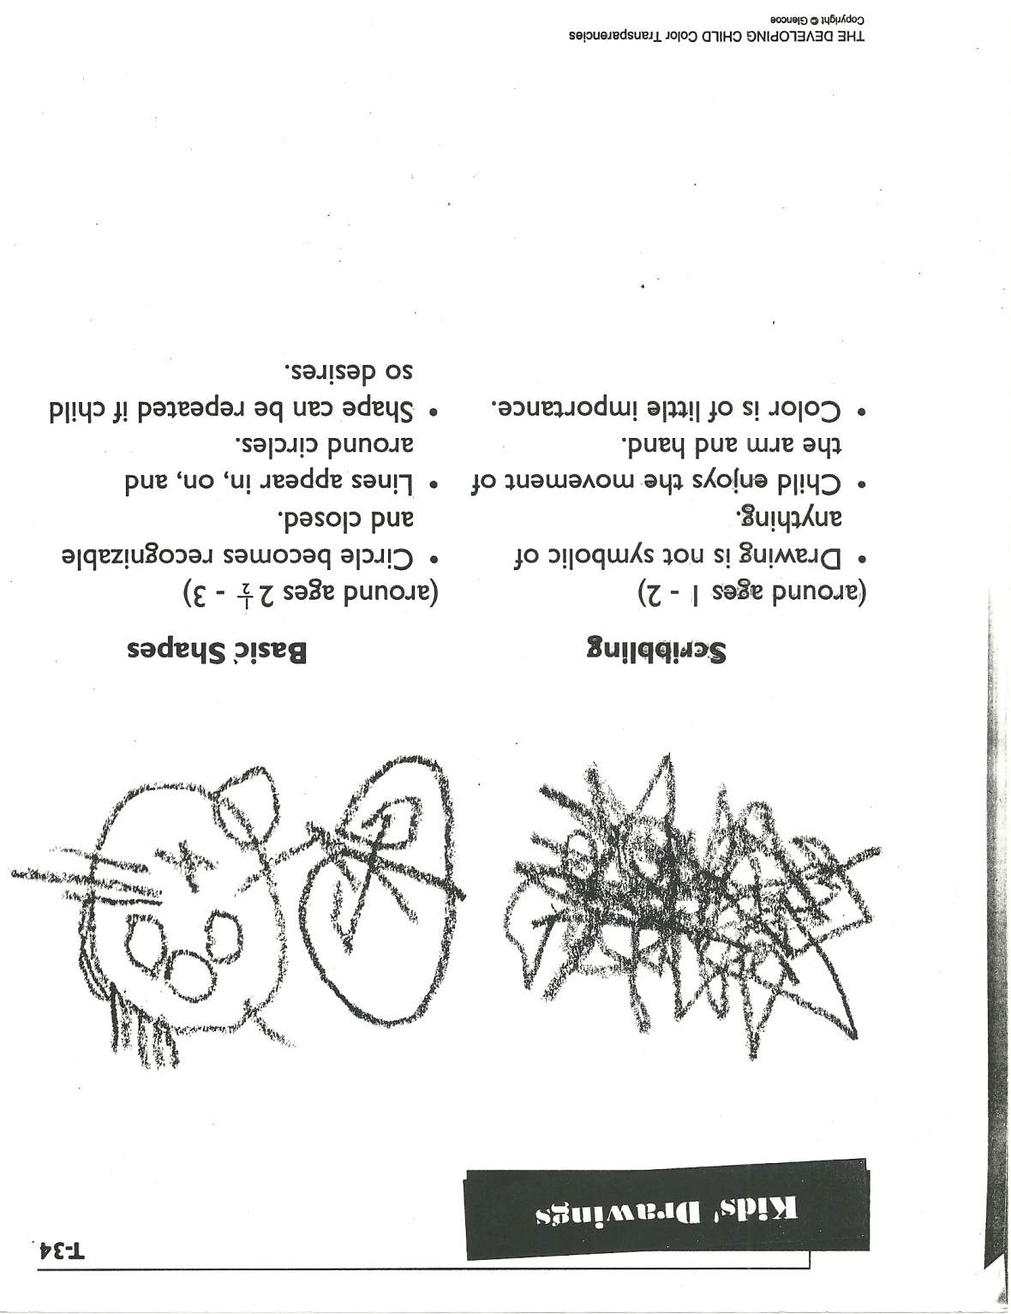

Race track with cars

Slide 17
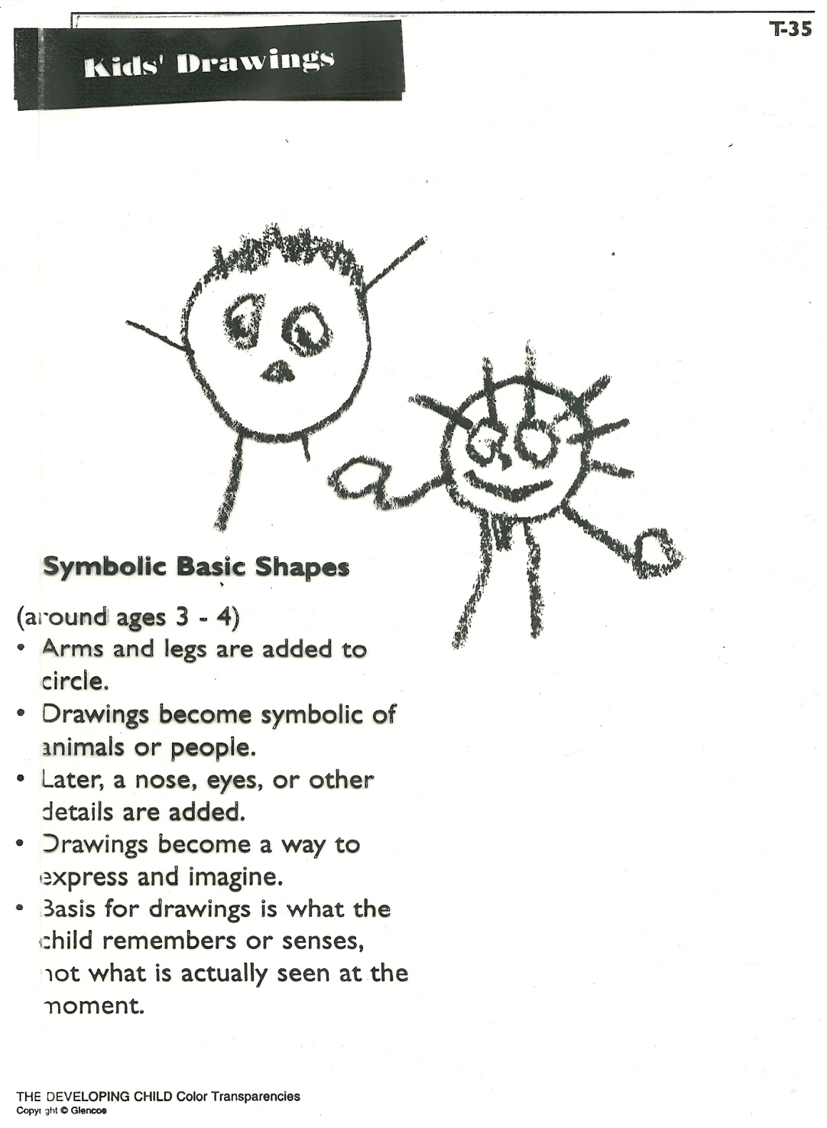
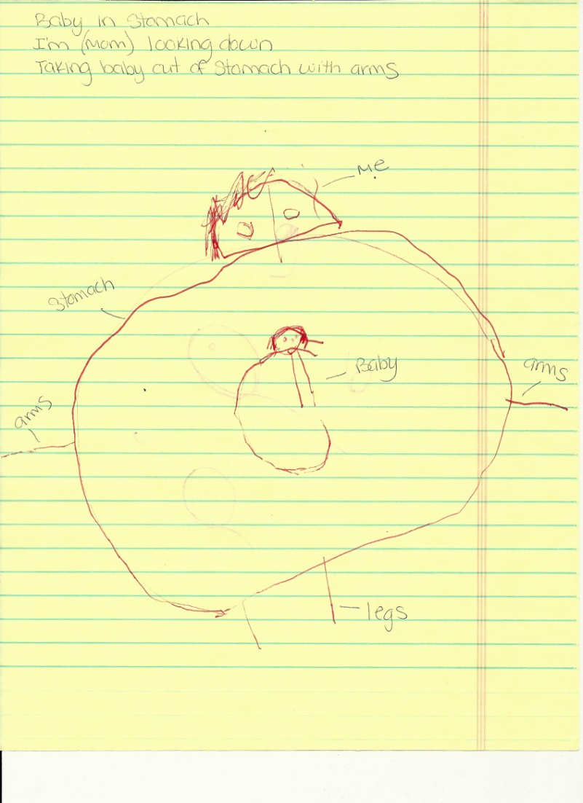
A pregnant Mom

Slide 18
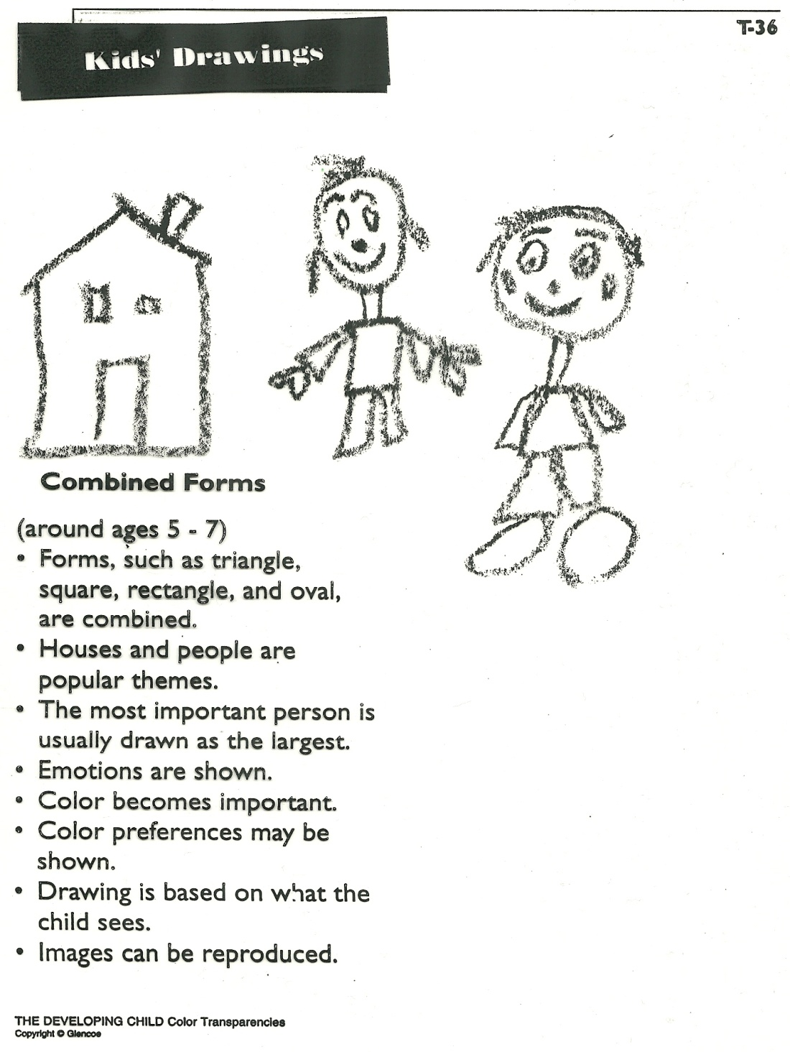
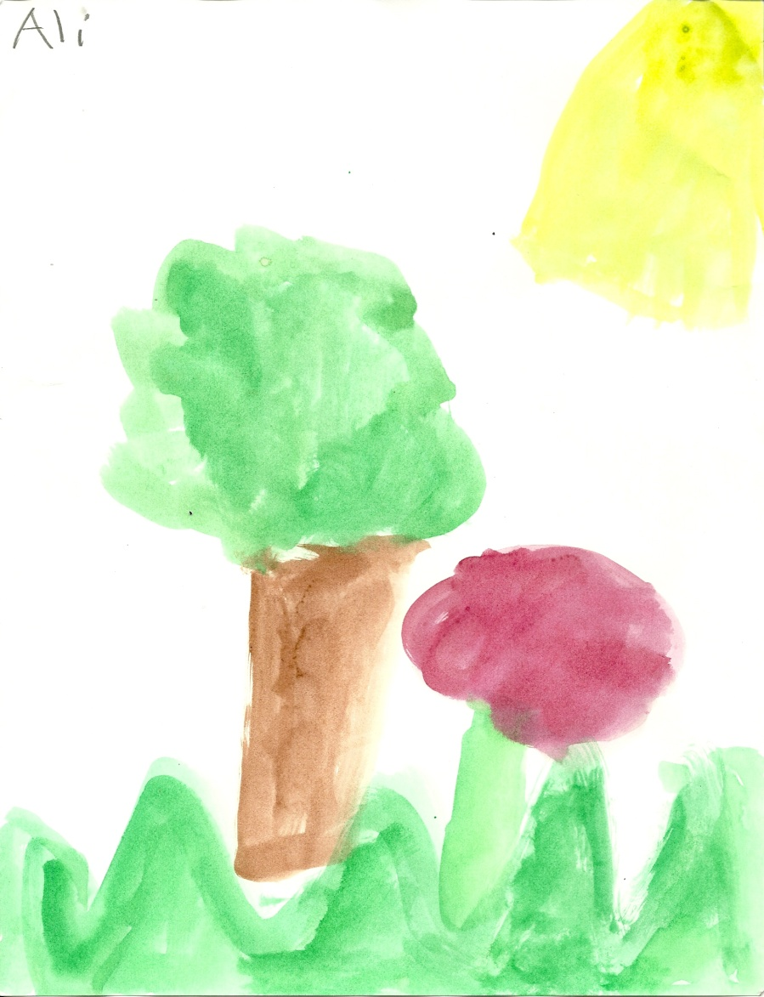

Slide 19

d) A toddler takes on the stairs
climbing up on hands and knees
then sliding down
Next they practice walking up the stairs by holding hands or the railing and placing both feet on the step.
The toddler finds “Stair Challenge”
going downstairs alternating feet
to be a very difficult task to master.

Slide 20

4. A toddler who is given the opportunity and encouragement to develop Self-Help Skills will lead to a feeling of independence, confidence, and high self-concept.

Slide 21
1. self-feeding depends on and helps improve their small motor skills.
Because a toddler’s growth is slowing down, they will eat less than they did in their first year.
  Due to their small stomachs, it is best to feed them small meals and snacks every 3-4 hours.

Slide 22
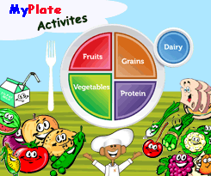
Children need a variety of nutritious foods daily so plan meals using the MyPlate.
c) Use convenience and packaged foods cautiously and serve fresh foods as often as possible.
  Packaged foods are high in salt, fat, sugar, preservatives, artificial colorings and flavors.
Link

Slide 23
d) Follow the infant self-feeding guidelines and these other tips:
Snack
Use a variety of colors to make the meal visually appealing.
Include foods with different textures (crunchy, chewy, juicy, hard, soft…)
Foods with a variety of shapes add appeal.
Serve a variety of temperatures – both hot and cold foods.
Serve small proportions: give 1 TBL of food per age (the size of the child’s hand)
Allow the child to help in simple food preparations and setting the table
Cut food into small pieces.
Do not force feed or show anger during mealtime
Keep mealtime pleasant and positive
Eat together as a family – have the toddler sit at the table with the family
Sit with your child and talk with them as they eat
Provide child size eating utensils and dishes, unbreakable, facilitate success
Offer only one new food at a time
Low sugar and low salt foods
Never use food as a punishment or a bribe.
Remove the food from the child when there is more playing than eating

Slide 24
ANIMAL CRACKERS
c) More Math
Estimate how many animal cookies you have in you container.
Now count how many animals cookies you have.
Sort your animal cookies by putting them into cages.
Circle the cage that has the most animal crackers
Draw a square around the cage that has the fewest
Five animal crackers from the grocery store,
I ate one, now I only have four.
Four animal crackers, tasty as can be,
I ate another, now I only have three.
Three animal crackers and what did I do?
I ate another, now I only have two.
Two animal crackers can be lots of fun,
I ate another, now I only have one.
One animal cracker and now I am done,
I ate that one so now I have none.
Janice Nikoghosian
a) Tell a story about your animal crackers.
b) Cookie Math
3 animal cookies and 2 animal cookies
1 animal cookie and 1 animal cookie
2 animal cookies 3 animal cookies

Slide 25
Reflection #1, Unit 2
What was your favorite activity or hobby to do as a child? Explain the activity and why it was your favorite.

Slide 26
Bell Work
How can meal time be made more appealing for a toddler? (i.e. what are some guidelines to follow)

Slide 27
Books and Babies
Reality Baby Check-in
Children’s Book
Shyann
Anita
Emily P.
Emily H.
Angela P.
Demi R.
Kaitlyn C.

Slide 28
Books and Babies~ Tuesday
Reality Baby
Child’s Book
Genesis
Merlyn
Alex
Meagan
Justine
Meagan

Slide 29
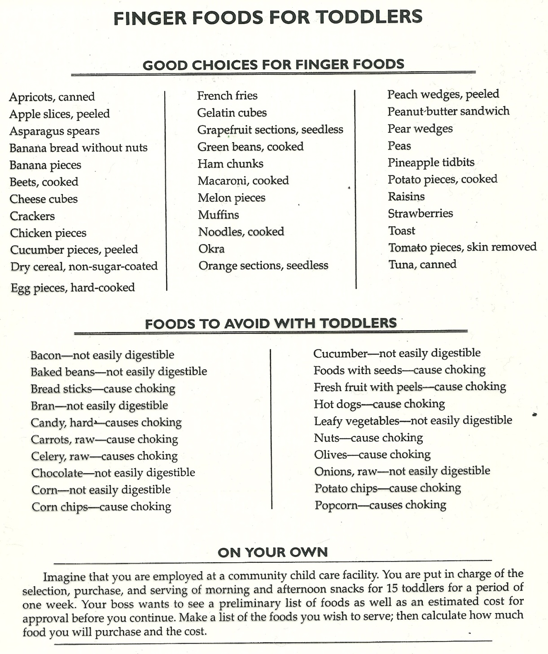

Slide 30
2. Help children develop a good attitude about good hygiene (personal cleanliness) and proper skills.
  Teach them to wash their hands each time the use the bathroom.
  During bath time let the toddler: Wash, rinse, and dry themselves.
    Never leave a young child alone in the bath – not even for 1 minute.

Slide 31
      3. The quality of a child’s teeth is greatly influenced by their diet (what they eat).
The mom’s diet during pregnancy and the diet and care of the child during the first 2 years will lay the foundation for good or poor teeth.
  Give a child sugar foods/candy/drinks sparingly and avoid putting a child to bed with a bottle unless it contains water.
  Help the child learn how to brush and floss their teeth.
  Help them get in the habit of brushing after they eat.
  Use a small toothbrush and a tiny amount of toothpaste.
  Begin regular dental checkups by 18 months old.

Slide 32
      4. Dressing skills involve large and small motor skills and patience so provide them with many opportunities to practice.
2 examples
      Encourage a toddler to learn how to dress them self by:
        Providing clothes that facilitate self-dressing
          (tags, pictures, easy to put on and take off)
        Being patient with them,
        Allowing them to choose their own clothes.
        Allowing them to dress themselves (even if it is on backwards)

Slide 33
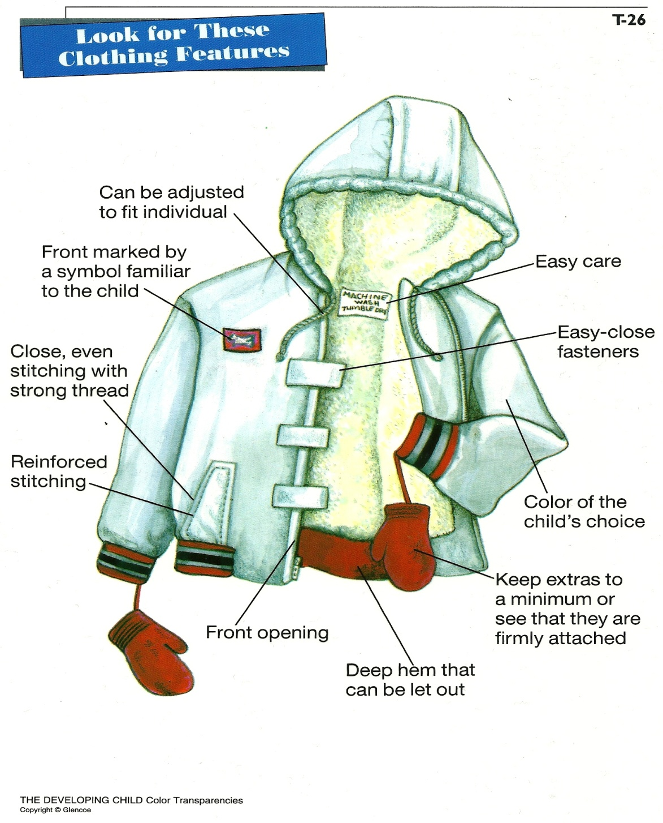
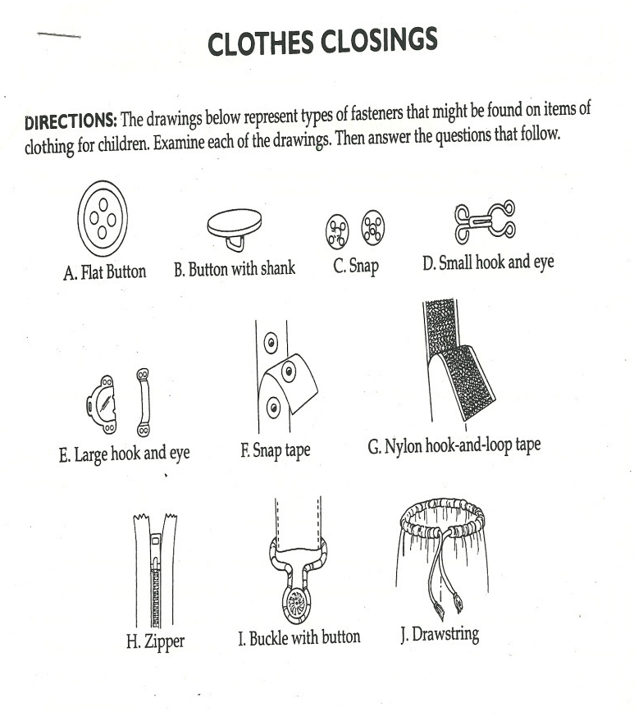

Slide 34
5. When choosing clothes for a toddler, explain and give examples of these 5 areas:
  A. Comfort:
    freedom to move, not scratchy or stiff……
  B. Allowance for Growth:
    waistbands (elastic and one-piece), overalls, lager sizes, stretch fabric, 2 piece
  C. Durability:
    toddlers play hard and get very dirty so: strong fabric, well-made, washable……
  D. Economical:
    clothes are expensive and you will buy a lot of them
  E. Self-help Features:
    tags, pictures, closures (zippers, Velcro, drawstrings…), color of child’s choice…….

Slide 35
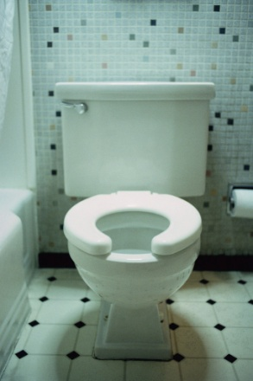
5. Toddlers begin TOILET TRAINING when they are physically and emotionally ready, NOT by a certain age.
Be calm, encouraging, give praise, and having a matter-of-fact attitude will make this easier.
  When accidents occur, be calm, encouraging, giving praise, and having a matter-of-fact attitude
If the child gets frustrated and resists trying, stop and try again in a couple of weeks.
Night time training should be attacked once
they have day time training under control.

Slide 36



6. Because a toddler is more mobile and naturally curious, a caregiver must always think about the child’s SAFETY by setting up an environment where they can play and explore.

Slide 37
7. Toddlers want to be INDEPENDENT so encouraging and providing self-help skills is very important.

Slide 38
DAPLA Activity
Coffee Filter Butterflies
What does DAPLA mean?
Developmentally Appropriate Learning Activity
Things children do to help learn
Not overwhelming to them, fun, exciting.
Teaches many skills~ colors, motor skills, math, rhyming etc. depending on the activity.

Slide 39
TODDLER LABS
MUST DO LAB = Developmentally and Age Appropriate Learning Activity
  Fill out the section in the study guide.
2 other lab choices
  Fill out a lab analysis on each lab.

