Slide 1
Value of Children Are You Ready to be a Parent?
Ms. Davis
Child Development

Slide 2
Why should we study children?
To understand them- how they think, feel, and act.
Why are children important to society?
Future leaders, family, scientists, doctors, caretakers, inventors, etc.
They give us a purpose.
They are examples of lost qualities like love, ethics, humor, fun, play, etc.

Slide 3
Childhood Scenarios
Do you feel that what happens to a person in early childhood impacts him/her for life?
As a group read the scenario and brainstorm how you think the person highlighted in the scenario would be as an adult.
You will present the scenario and your ideas as a group to the class.

Slide 4
Child’s Bill of Rights word scramble
As a group unscramble each sentence

Slide 5
Child’s Bill of Rights
The right to loving and secure human relationships
The right to proper nutrition, healthful and safe living conditions, and appropriate physical and psychological care.
The right to be taught essential living skills.

Slide 6
Child’s Bill of Rights Continued
The right to non-abusive discipline.
The right to learn basic values and moral behavior.
The right to be independent and unique individual.

Slide 7
Child’s Bill of Rights Continued
The right to be protected from people, parents included, who may physically or mentally harm them.
The right to develop individual talents.

Slide 8
Basically…
Parents are legally responsible to provide for a child’s needs not their wants.
In a parent – child relationship, the parent gives and the child receives.

Slide 9
So, are you ready to be a parent?
Complete the following questionnaire
How do these answers make you feel?

Slide 10
Parenting
Married-Child deserves a married male and female who are stable, responsible, committed, respectful and loving to each other.
Financial- Do you have the desire to work and do whatever it takes to support a family? Can you handle a job and child at the same time? Where will you live? Can you budget?
Emotional- Are you patient? Can you control you temper? Do you have realistic expectations? Do you like children? Do you know your values and goals? Parenting is full of selfless acts!!

Slide 11
Parenting
Social- What activities do you like in your free time? Can you do these activities with a child? How much of you social life are you willing to give up? Will you miss free time and resent your child? Do you like playing with children?
Intellectual- Who taught you how to read a book, about sex, your religion, your values, to trust, about honesty, to be obedient, to have a hobby? Are you ready to teach these things to a child?
Physically- Are you preparing your body today physically to have or create a child? Optimum age for child bearing is 20-35 yrs of age. How do you take care of your physical and health needs? Do you live in a good/safe place to raise children?

Slide 12
Parenting
View the following pictures?
Are these parents doing anything special to make the child smile?
What will you do?

Slide 13
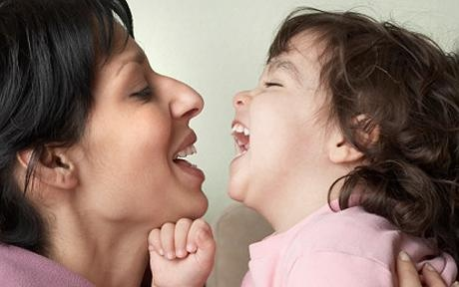
Parenting

Slide 14
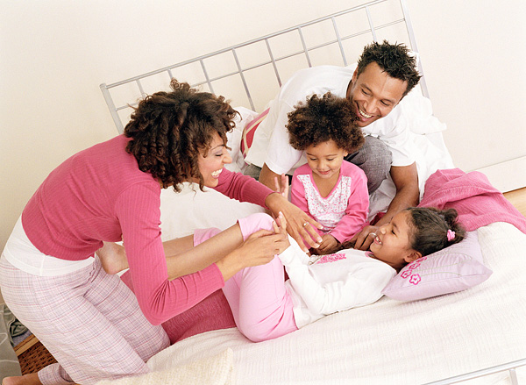
Parenting

Slide 15
Parenting

